Slide 1
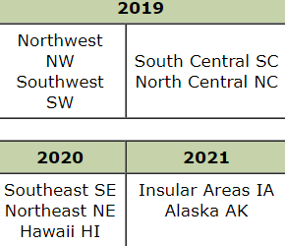
LANDFIRE Alaska Re-Map Update
https://www.landfire.gov/lf_remap.php
Current basemap uses circa 2001 Landsat imagery
Updates incorporated disturbance data, not new imagery
Basemap has poor accuracy for Alaska
LF has different products, including EVT=Existing Vegetation Type and Fuel Models developed from EVT. EVT map units based on Ecological Systems
Current available version is LF 2014; disturbances beyond 2014 not included.
Remap is LF 2.0.0; imagery from circa 2016, disturbances to 2016
Disturbed areas prior to 2017 will be updated to reflect expected 2019 fuels
Disturbed areas before 2009 will use 2016 imagery
Two LF teams; one mapping EVT, one for Fuels

Slide 2
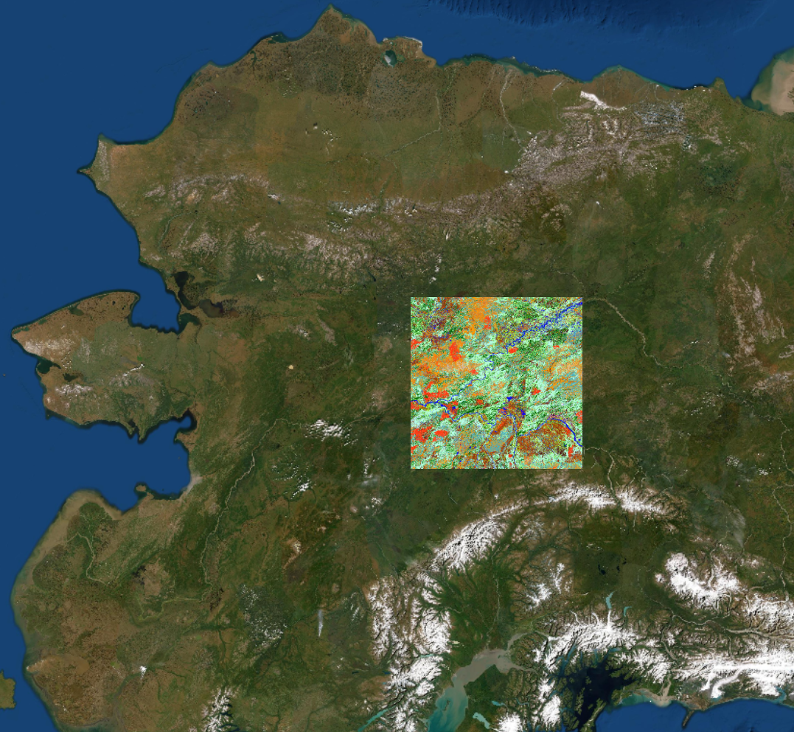
LANDFIRE Alaska Re-Map Update
LANDFIRE has been working with 2 Alaska groups, one for EVT, one for Fuels
EVT: vegetation scientists, mapping specialists, fire personnel
Fuels: smaller group, mostly fire staff. LANDFIRE uses the 2018 Fuel Model Guide to Alaska vegetation to crosswalk EVT to fuels
Prototype maps of EVT and fuels for interior provided for review in March; comments sent back in early April
Fuels in areas that were burned between 2009 and 2016 will be modeled to reflect 2019 conditions rather than using new imagery.
Based on original EVT, severity, time since burned
Alaska review team had concerns due to poor
accuracy of original map- will discuss more with
LANDFIRE
https://www.landfire.gov/documents/Capable_Fuels_TD.pdf

Slide 3
LANDFIRE Alaska Re-Map Update
Review comments EVT- Issues with floodplains, burned areas, tussocks overestimated
LANDFIRE shifted production schedule to do Hawaii and Insular Areas remap before Alaska
Provides more time to work on the Alaska map- new delivery is May 2021
LANDFIRE now has capability to use both Landsat and Sentinel imagery
LANDFIRE will meet with review groups again - probably early June- especially to discuss use of imagery for fuels in burned areas
Contact: lisa_saperstein@fws.gov

Slide 4
Interagency Fuel Treatment Decision Support System (IFTDSS) Update
Lisa Saperstein, Chris Moore, and Casey Boespflug representing Alaska on the IFTDSS test group
Webinar on Exposure Analysis was May 28; all webinars are recorded.
Exposure analysis assesses likelihood and intensity of fire where Highly Valued Resources and Assets (HVRA) are located
Quantitative Wildfire Risk Assessment being phased in
Fuels Treatment Effectiveness Monitoring is in module (FWS is to submit information to FWS fire staff in Boise for now)
Can re-use ignitions in Landscape Burn Probability

Slide 5
Interagency Fuel Treatment Decision Support System (IFTDSS) Update
As usual, Alaska is different…
Used national HVRA data from the National Wildfire Risk Assessment; AK not included for many of the data sets
Default fuels treatment edit rules do not include Alaska
Requested an Alaska-specific help page to point out differences, and they got right on it

Slide 6
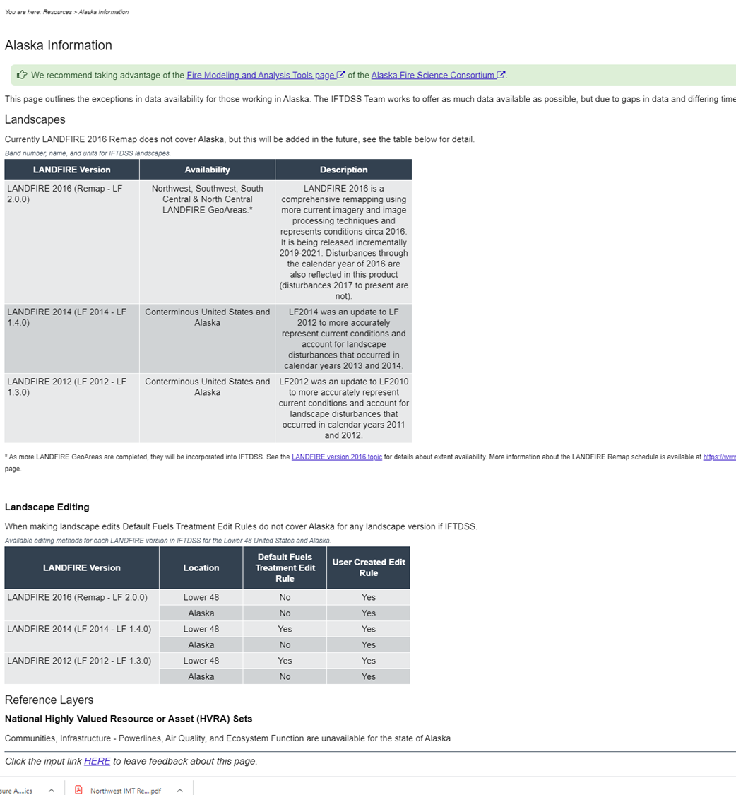

Slide 7
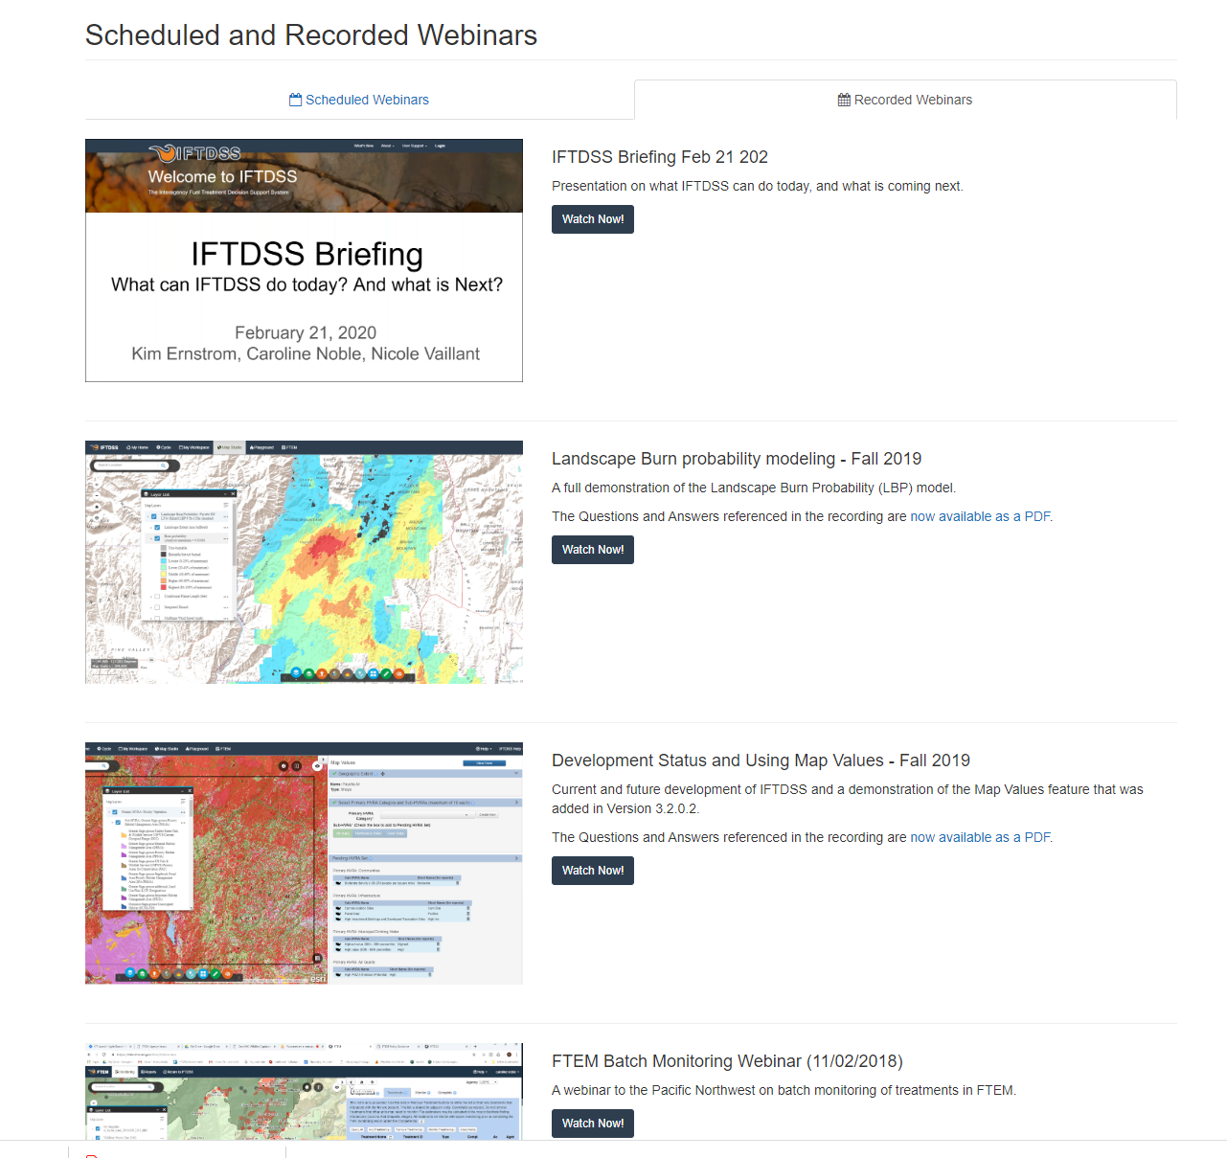
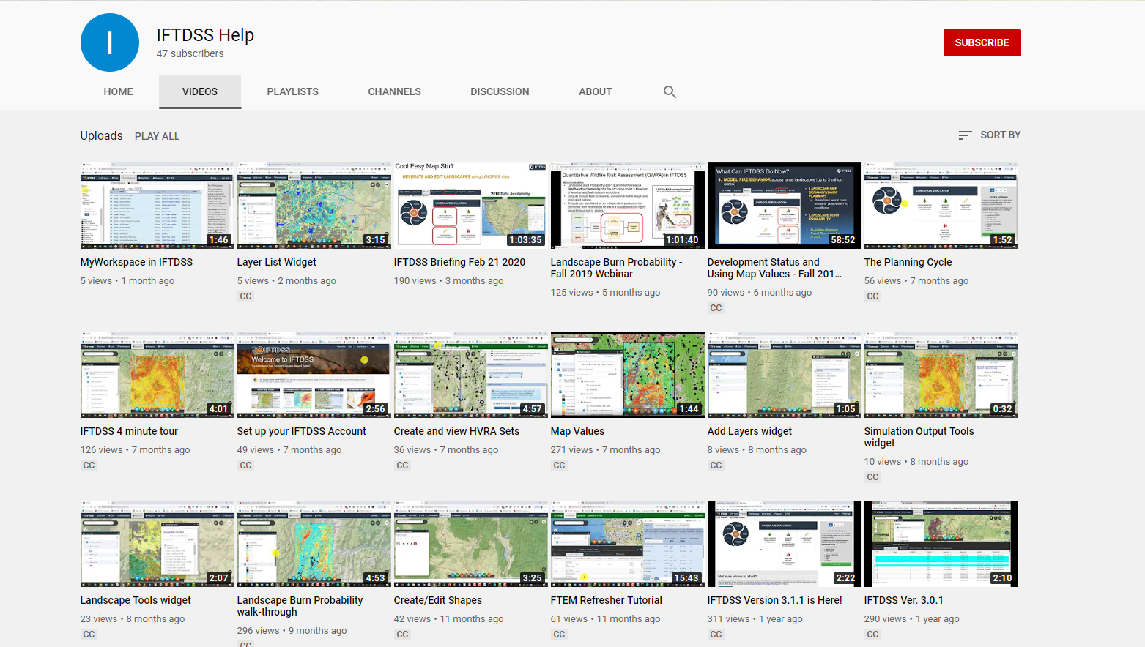
Interagency Fuel Treatment Decision Support System (IFTDSS) Update
Run through webinars, YouTube training videos before we request any individual training
Would be good to get IFTDSS staff here for future Fall Fire Review/Consortium Workshop
https://iftdss.firenet.gov/landing_page/webinars.html

Slide 8
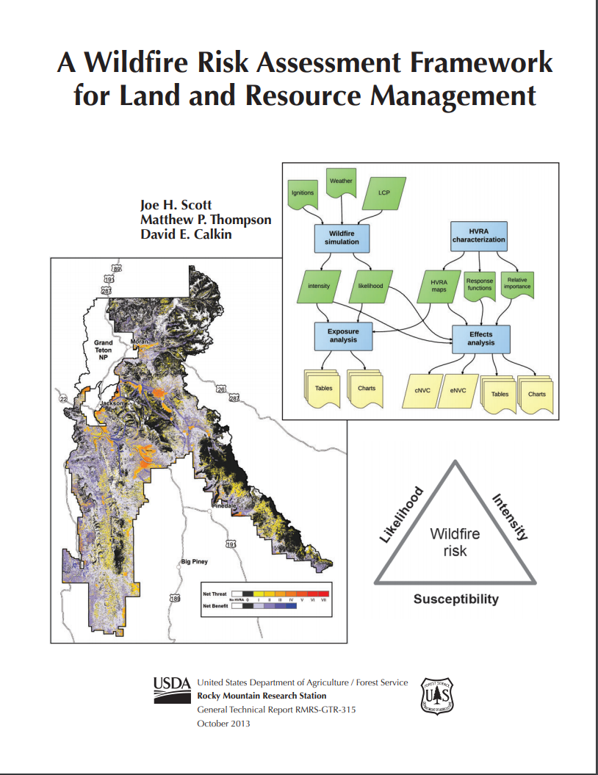
Interagency Fuel Treatment Decision Support System (IFTDSS) Update

