Slide 1
Open Burn Permit /Air Quality Coordination
Alaska Department of Environmental Conservation
Mark E. Smith
907-269-7676
mark.smith@alaska.gov

Slide 2
Overview
Regulations
Permit Process
Pre-Burn Coordination
Burn Coordination
Post-Burn Report

Slide 3
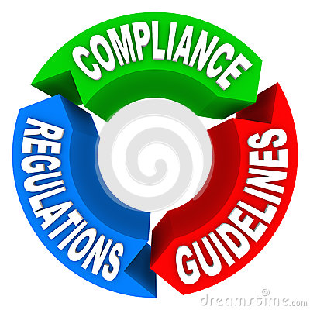
Regulations
18 Alaska Admin Codes, Chapter 50, Air Quality Control (18 AAC 50)
18 AAC 50.065 covers Open Burns
Prohibited in an area if the department (DEC) declares an air quality advisory
Prohibited between November 1 and March 31 in wood smoke control areas (FNSB)
Some exceptions to the rule with prior coordination
Controlled burns over 40 acres annually require written department (DEC) approval
May be required to send out public notices in advance of the burn
Structures for Firefighter training require written department (DEC) approval
If public notice was required, follow up on complaints, document and provide to DEC if requested.

Slide 4
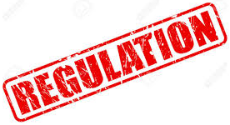
Regulations
Alaska Enhanced Smoke Management Plan (ESMP)
Under state regulations, all agencies, corporations, and individuals that burn areas larger than 40 acres of land a year, whether slash or in situ, require a controlled burn approval (Prescribed Fire) application and written approval from DEC.
The ESMP outlines the process for DEC, land management agencies, and private landowners/corporations
End goal is to minimize smoke and air quality issues

Slide 5
Permit Process
Online Open Burn Application can be downloaded from DEC
One stop shop for permit needs
http://dec.alaska.gov/air/air-permit/open-burn-application
Online Open Burn Application Instructions
Multiple types of permits available – Initial/Renewal
Application fees for permit
Open Burn Contacts
PERSON | AREA | PHONE | EMAIL
Ed Kulack Juneau | SE Alaska Open Burn Approvals and Complaints | 907-465-5103 | Ed.kulack@alaska.gov
Krista Botkin Anchorage | South Central and SW Alaska Open Burn Approvals and Complaints | 5104 | Krista.botkin@alaska.gov
Mossy Mead Fairbanks | Interior and Northern Alaska Open Burn Approvals and Complaints | 907-451-2191 | Mossy.mead@alaska.gov

Slide 6
Permit Process
Open Burn Approval Letter
The Responsible Authority must call and notify the DEC by noon the business day prior to any planned burn (call the number listed in the Open Burn Approval Letter) or email: dec.AQ.airreports@alaska.gov.
1. Controlled Burn Approval number
2. Authorized Agency Name
3. Burn Location
4. Burn Date(s)
5. Contact Name during burn
6. Contact Telephone Number
7. Description of how and when the Test Burn will be completed
8. Estimated duration of Active Firing (ignition) Phase (prescribed burning only)
9. Estimated duration of the Smoldering Phase (prescribed burning only)
10. Description of Pre-Burn Public Notices
11. Consideration of weather forecast and air quality advisories in area of burn

Slide 7
Pre-Burn Coordination
DEC is notified of Open Burn
Review current burn plan/application
May request additional information from burn boss
Review forecasted model data for burn dates
Run Transport Model
Hysplit
Determine smoke movement/impact on a daily basis

Slide 8
Burn Coordination
Meteorological conference call day of the burn
NWS/DEC/Burn Boss
Spot Forecast review
Verify area to be burned
Talk about wind/transport outlook for the burn period
If required, may request additional calls to discuss fire characteristics
Pictures of smoke plume
Afternoon wind direction, helps verify model for next day

Slide 9
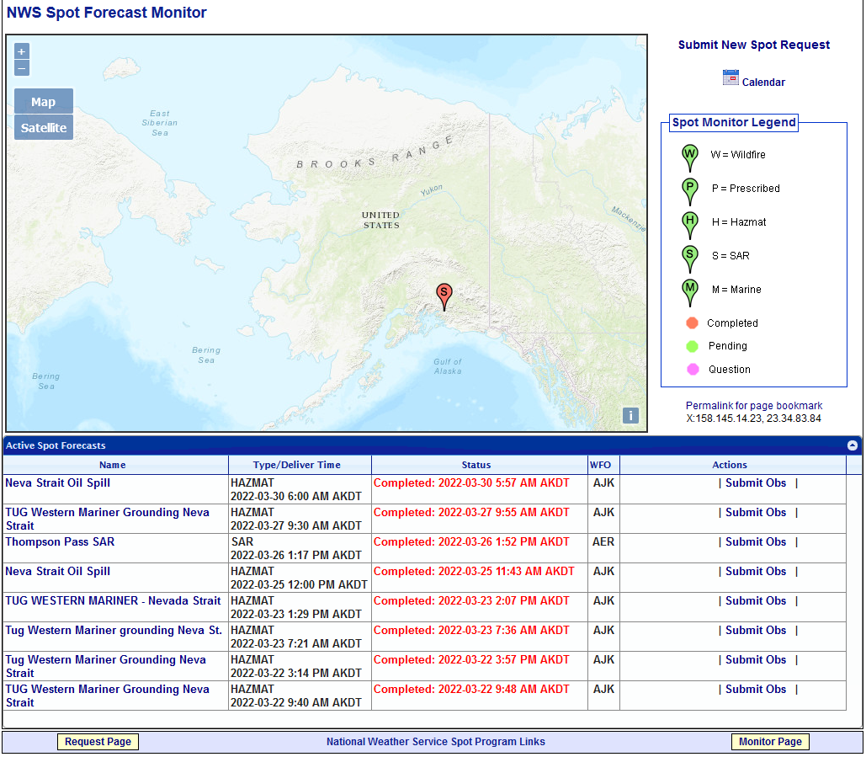
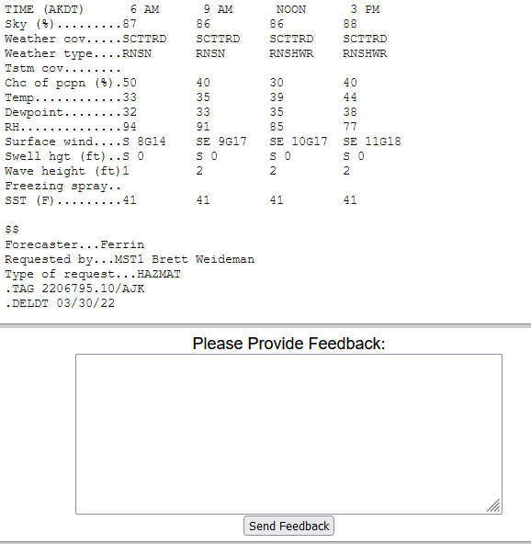
Post-Burn
If smoke behaved differently than forecasted
Fill in Spot Forecast Feedback on National Weather Service website
https://www.weather.gov/spot/monitor/?lat=64.8241347079049&lon=-158.02167656249952&z=4

Slide 10
Questions
Mark E. Smith
907-269-7676
mark.smith@alaska.gov

