Slide 1
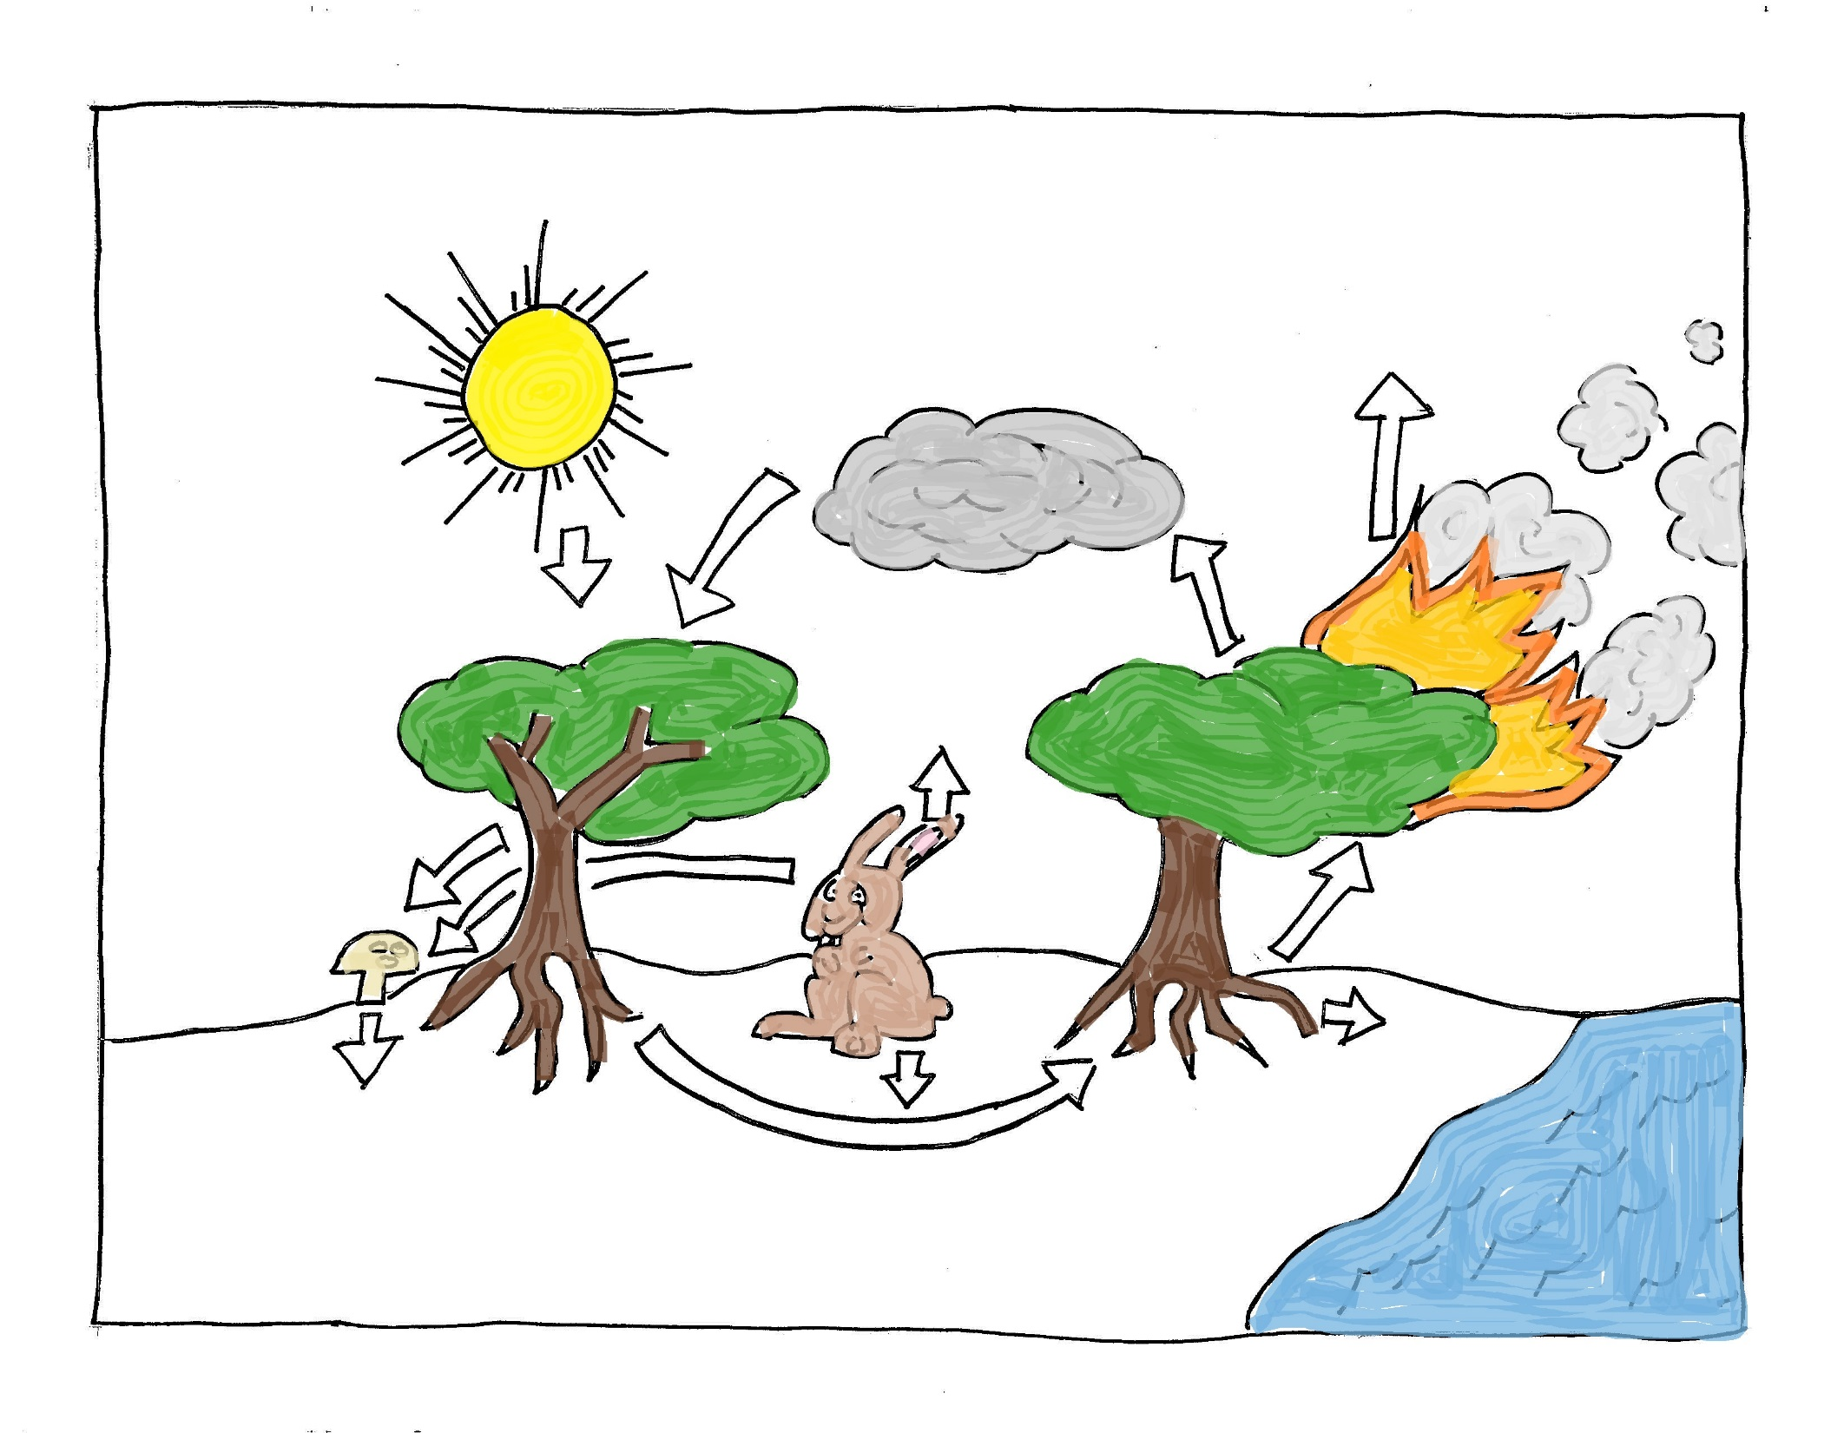
The Fire Triangle, Combustion, and the Global Carbon Cycle
Notes:
Procedure – part 1.
Explain: We’ve been studying the Fire Triangle and the process of combustion.
Let’s explore combustion a little more deeply and then fit it in with the basic life processes on Earth, as described in the Global Carbon Cycle.

Slide 2
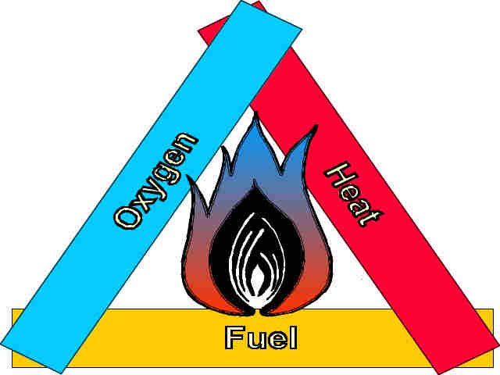
Oxygen + Fuel + heat
Notes:
We’ll start with the Fire Triangle: oxygen, fuel, and heat. If you break it apart and line up the “ingredients,” you have an arithmetic expression for what makes fires “go” – what makes combustion happen.

Slide 3
Oxygen + Fuel + heat Carbon dioxide + Water + Heat & Light
Notes:
Now let’s list the products of combustion. They are carbon dioxide, water, heat, and light.

Slide 4
Oxygen + Fuel + heat Carbon dioxide + Water + Heat & Light
O₂ + C&H atoms + heat CO₂ + H₂O + Heat & Light
O₂ + C₆H₁₂O₆ + heat CO₂ + H₂O + Heat & Light
Notes:
We can use chemical symbols for both the ingredients and the products of combustion.
It’s a little tricky to give a specific formula for fuels, because they could be any mixture of millions of compounds. But all fuels contain carbon and hydrogen, and they usually contain oxygen and other kinds of atoms as well. Let’s plug in the formula for glucose, C₆H₁₂O₆, since the main component of woody fuels is cellulose - a very long chain of glucose molecules.
Now we have a brand-new model – the chemical formula (“equation”) for combustion.

Slide 5
Oxygen + Fuel + heat Carbon dioxide + Water + Heat & Light
O₂ + C&H atoms + heat CO₂ + H₂O + Heat & Light
O₂ + C₆H₁₂O₆ + heat CO₂ + H₂O + Heat & Light
6O₂ + C₆H₁₂O₆ + heat 6CO₂ + 6H₂O + Heat & Light
Notes:
Finally, let’s make sure the equation shows that the number of atoms going into the combustion process is the same as the number that are produced. This is called “balancing” the equation.
Our new model is more complicated than the Fire Triangle, but it is also more powerful. It helps us keep track of the atoms that are moved around in this chemical change, and it lets us predict how much of each “ingredient” (“reactant”) is needed to produce a specific amount of products.
Part 1 of the lesson ends here. Part 2 is a lab investigation.

Slide 6
The Fire Triangle, Combustion, and the Global Carbon Cycle
Notes:
Procedure Part 3.
Now let’s see how the process of combustion fits into the life processes on Planet Earth.

Slide 7
Combustion:
C₆H₁₂O₆ + 6O₂ + a little heat/light 6CO₂ + 6H₂O + a lot of heat/light
& many other
C-H
combinations
Notes:
Here’s our model of combustion.

Slide 8
Combustion:
C₆H₁₂O₆ + 6O₂ + a little heat/light 6CO₂ + 6H₂O + a lot of heat/light
& many other
C-H
combinations
Respiration:
C₆H₁₂O₆ + 6O₂ + a little heat/light 6CO₂ + 6H₂O + a lot of heat/light
Notes:
Here’s another chemical equation. It describes the process that living things use to obtain energy – a process called respiration:
What do you notice about these two equations?
Explain: Fire isn’t the only process that takes energy from carbohydrates and releases CO₂ and water into the air. Respiration is just a fancy word for breathing; breathing is how we get oxygen to our cells so them can produce energy, a process called cellular respiration. Animals aren’t the only living things that use respiration to get energy. Nearly EVERY living thing does – animals, plants, algae… even the tiniest microorganisms use respiration. But if plants and animals just kept on doing respiration, all the carbohydrates and oxygen would be converted to CO₂ . We wouldn’t last very long.
Ask: How do carbohydrates and oxygen get replenished—how do we reverse the process?

Slide 9
Combustion:
C₆H₁₂O₆ + 6O₂ + a little heat/light 6CO₂ + 6H₂O + a lot of heat/light
& many other
C-H
combinations
Respiration:
C₆H₁₂O₆ + 6O₂ + a little heat/light 6CO₂ + 6H₂O + a lot of heat/light
Photosynthesis:
6CO₂ + 6H₂O + sunlight C₆H₁₂O₆ + 6O₂
Notes:
Explain: Lucky for us, plants are able to reverse the process of combustion and respiration by grabbing the energy from sunlight and storing it in the high-energy bonds of carbohydrates. This is called photosynthesis. And the chemical equation for photosynthesis is the mirror image of the equation for combustion of glucose and respiration.
Animals ensure there is abundant CO₂ in the atmosphere, which means plants can grow well, which means there’s plenty of food for animals (including us!) to eat. It also means fuels are abundant, which means there’s plenty of fuel for fires to burn.

Slide 10
Combustion
Respiration
Photosynthesis
Notes:
Ask: Where are combustion, respiration, and photosynthesis occurring in the image?
Answer: Photosynthesis occurs where sunlight & oxygen are going into the tree. Combustion is occurring where the tree is releasing carbon dioxide, water, and smoke into the air. All the other processes – growth, uptake of water and minerals by plants, decay, and defecation - are powered by cellular respiration.
Explain: All of these processes, put together, are called the Carbon Cycle. It is a cycle because you can trace carbon as it moves through one process after another, from one kind of molecule to another. Throughout the process, carbon is reused at every step.

Slide 11
The Global Carbon Cycle
Combustion
Photosynthesis
Plants also do cellular respiration
Roots do cellular respiration too
Fungi are doing cellular respiration
Respir-
ation
Decomposers are also doing cellular respiration
Notes:
Explain: See the labels on the picture. We often talk about “burning” calories or carbs. “Burning” is a short way of saying we use cellular respiration to get the energy we need to rearrange food molecules (carbs) into the molecules we need to live (proteins, DNA, etc. – which make muscle, eyeballs, babies, poop, etc.)
Ask: How do forests store carbon? When do forests release carbon? Overall, do forests function as sources of carbon or storage – reservoirs – of carbon (also called carbon sinks)?

Slide 12
Notes:
Explain: Read the article “Sink or Source? Fire and the Forest Carbon Cycle”. Based upon the information in the article, do forests function as storage for carbon or sources of carbon? This is the answer to question number three on your handout.
Terminology:
When carbon accumulates and is being stored for an indefinite period, it is considered to be a carbon sink. The process by which carbon sinks remove carbon dioxide (CO₂) from the atmosphere is known as carbon sequestration. When carbon is being released to the atmosphere, it is called a carbon source.

