Slide 1
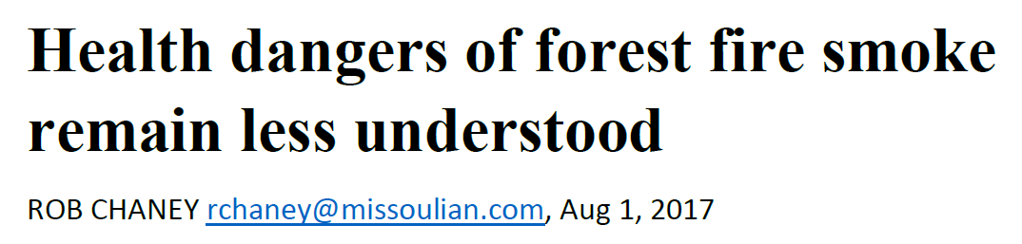
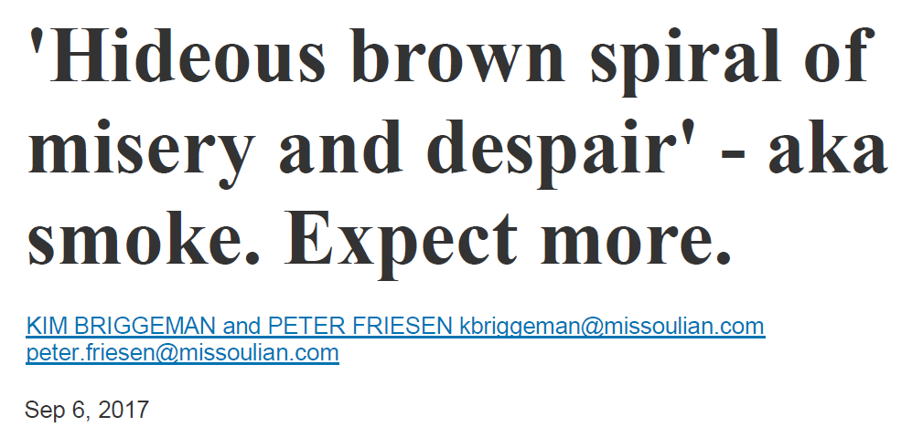
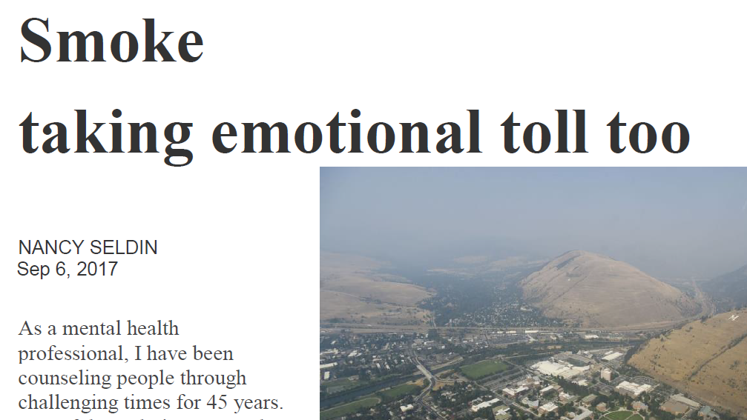
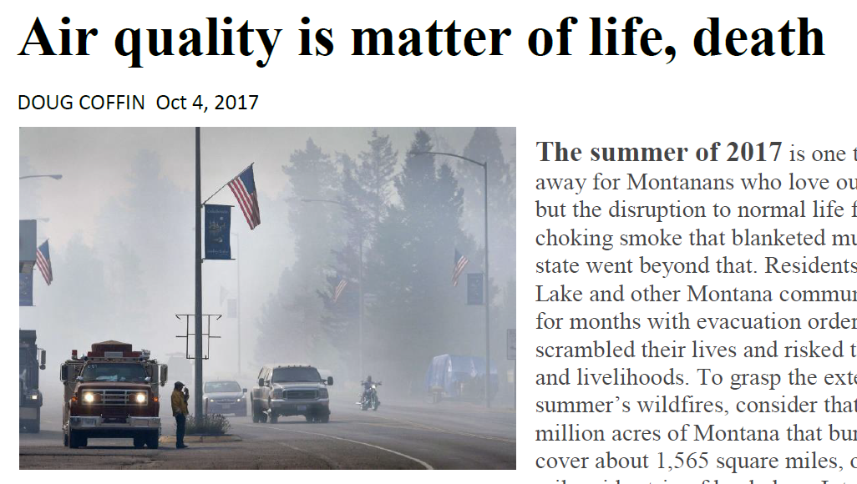
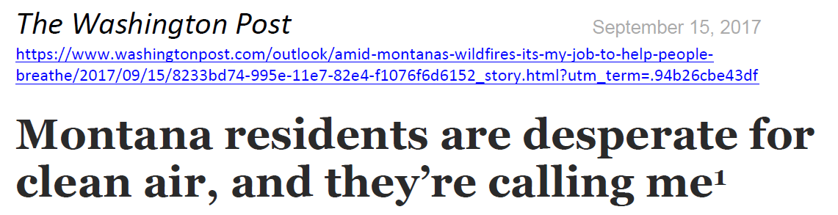
Notes:
Explain: Look at these headlines. All of them are related to the 2017 “fire season” in western Montana, when dozens of large fires were burning and pumping smoke into the mountain valleys.
Smoke from wildland fires can be a tremendous problem for western communities. Let’s learn how something this serious can occur, and then we’ll think about what can be done about it.

Slide 2
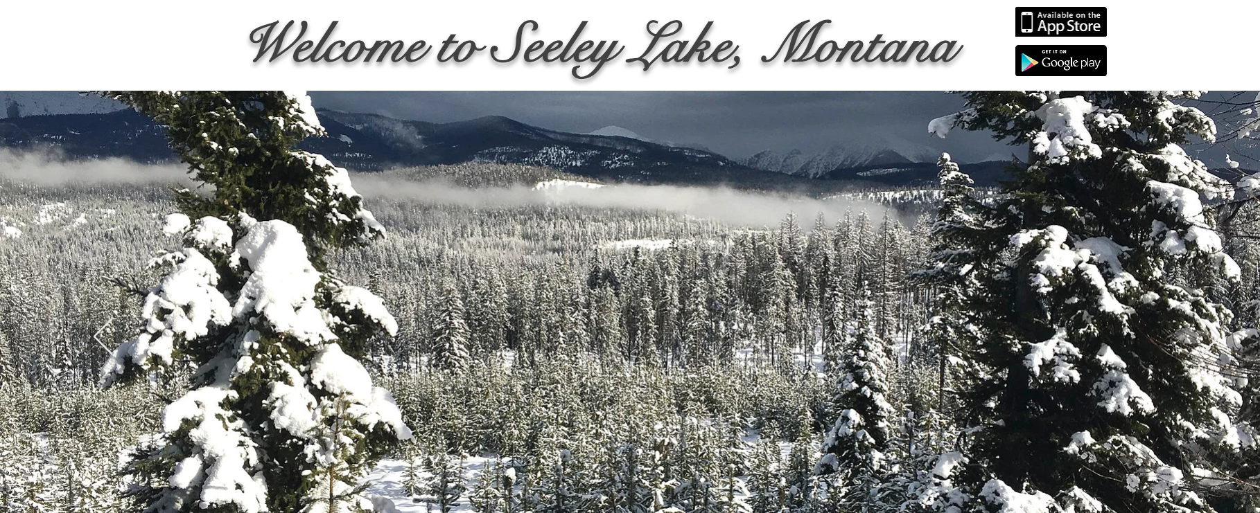
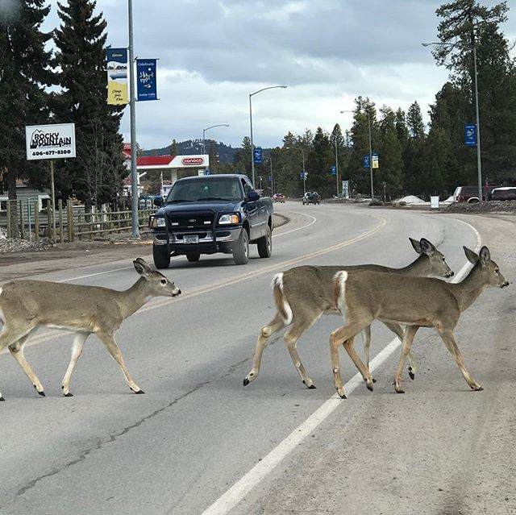
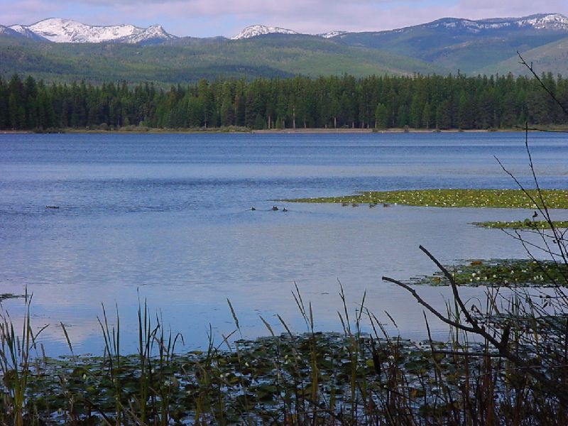
https://www.seeleylakechamber.com/
https://scontent.cdninstagram.com/vp/c205b360871d4d7be2c84b9bb37f8a2c/5D51C6EF/t51.2885-15/sh0.08/e35/s640x640/54513454_373029456754146_6318026885555144953_n.jpg?_nc_ht=scontent.cdninstagram.com
https://www.fs.usda.gov/recarea/lolo/recreation/wateractivities/recarea/?recid=10318&actid=78
Notes:
We’ll study the weather and smoke from the fire that triggered those particular headlines – the Rice Ridge Fire. The fire was started by lightning on July 24, 2017, just a few miles from the little town of Seeley Lake, Montana (population 1,659). Seeley Lake is in a very appealing location: It is in a deep mountain valley alongside a beautiful, clear lake. The downtown has a charming rural feel. The area has plenty of wildlife, hunting opportunities, and snow sports. It also has a thriving, progressive lumber mill. The photo on the right shows Seeley Lake’s main street on an ordinary day in late winter.

Slide 3
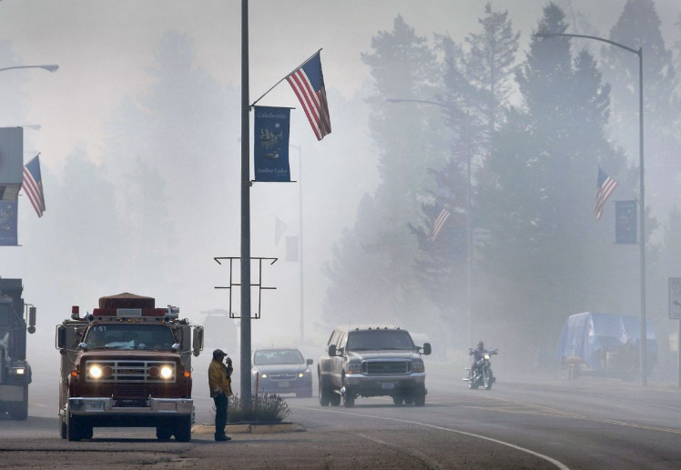
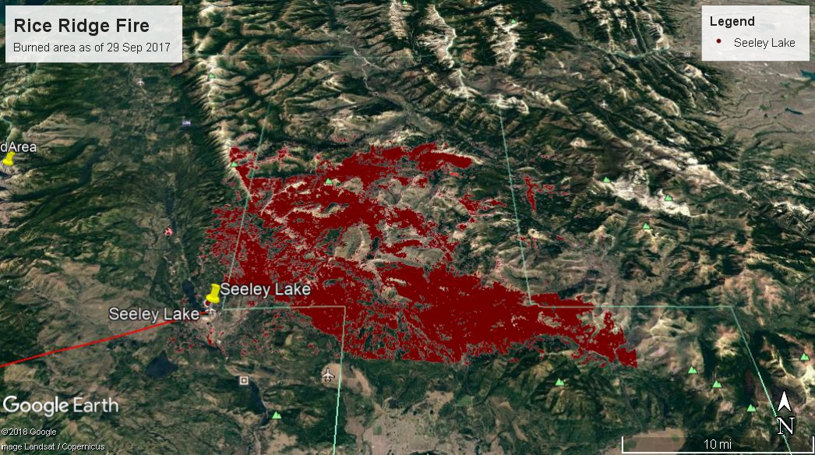
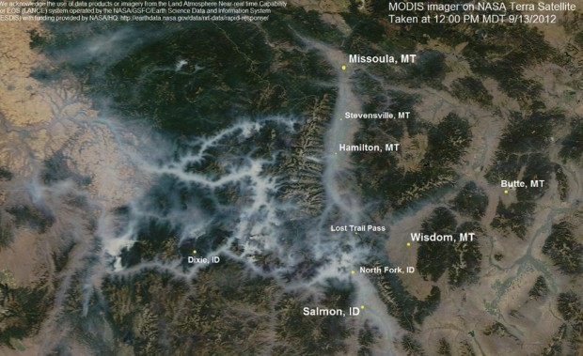
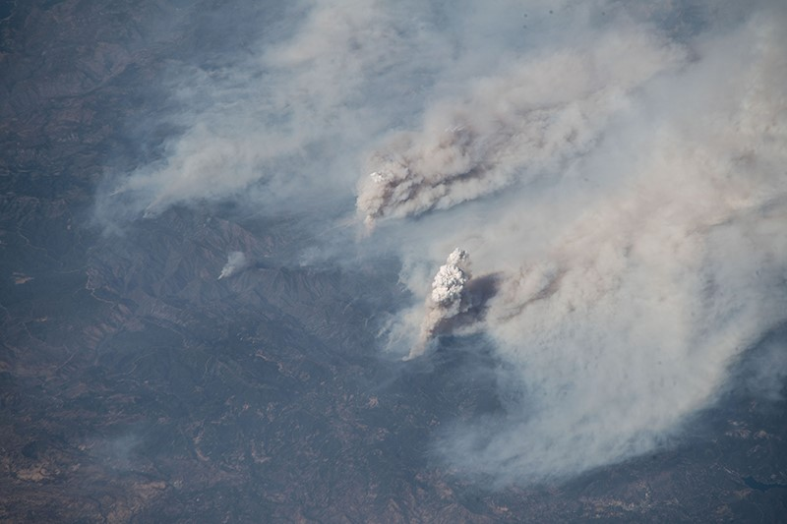
KURT WILSON, Missoulian
NASA_CA_Wildfires_ISS_2018.
NASA_Smoke-FilledValleys_MODIS_13Sept2012
Notes:
Here’s the same street during the fire, which eventually burned about 160,000 acres (240 sq mi, 630 sq km). Can you picture how big an area that is? (Use the scale of miles in the lower right corner.) Calculate: If the fire burned in a perfect square, how big would it be on each side? It would be about 15 miles along each side.
As the photo shows, smoke from the fire reduced visibility. At times when the smoke layer was really deep, it probably looked from above like the photo in the lower left (which shows smoke from wildfires in California during 2018). If the smoke was stuck mainly in the valleys, it would have looked like a gray stream flowing down the drainages – like the photo in the lower right (which shows the Bitterroot Valley in western Montana in September 2012). Either way, the air in the valleys was full of smoke. Just how bad was the air quality in Seeley Lake?

Slide 4
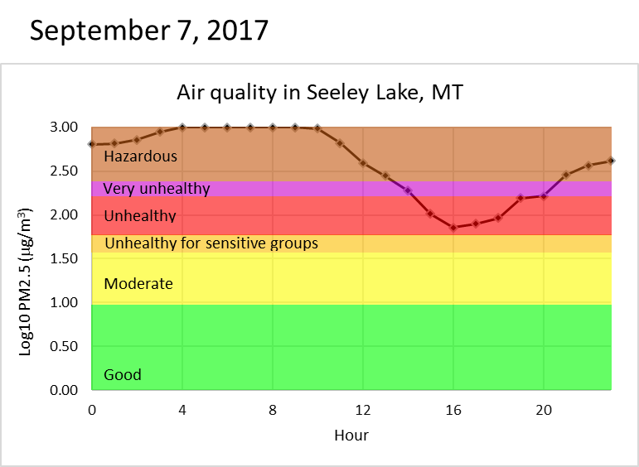
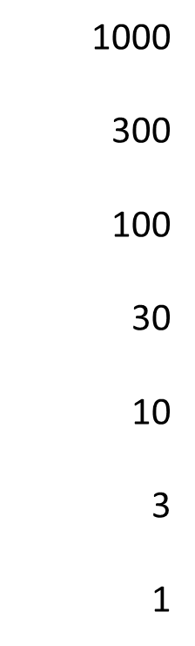
PM2.5 (μg/m³)
Midnight
Noon
11 pm
Notes:
This graph shows the air quality on one of the worst days during the fire. What is on each axis? The horizontal axis shows time: It uses a 24-hour clock, so it goes from 0:00 (midnight) on the left through 12:00 (noon) in the middle, to 23:00 (11:00 pm) on the right. The vertical axis is color-coded to show categories of air quality. These are based on the effects of pollution on people’s health: The scale goes from “good” (green) at the bottom to terrible - “hazardous” – (brown) at the top.
Why does the graph level off at the top? That’s because the amount of smoke in the air was greater than what the recording instruments could measure. (Note that the measurements are shown on a logarithmic scale, so we can see very small values and very large ones on a single graph.) [Tab 1. Interactive plot 1 or Tab 8. SeeleyPM2.5 in RiceRidgeData.xlsx.]

Slide 5
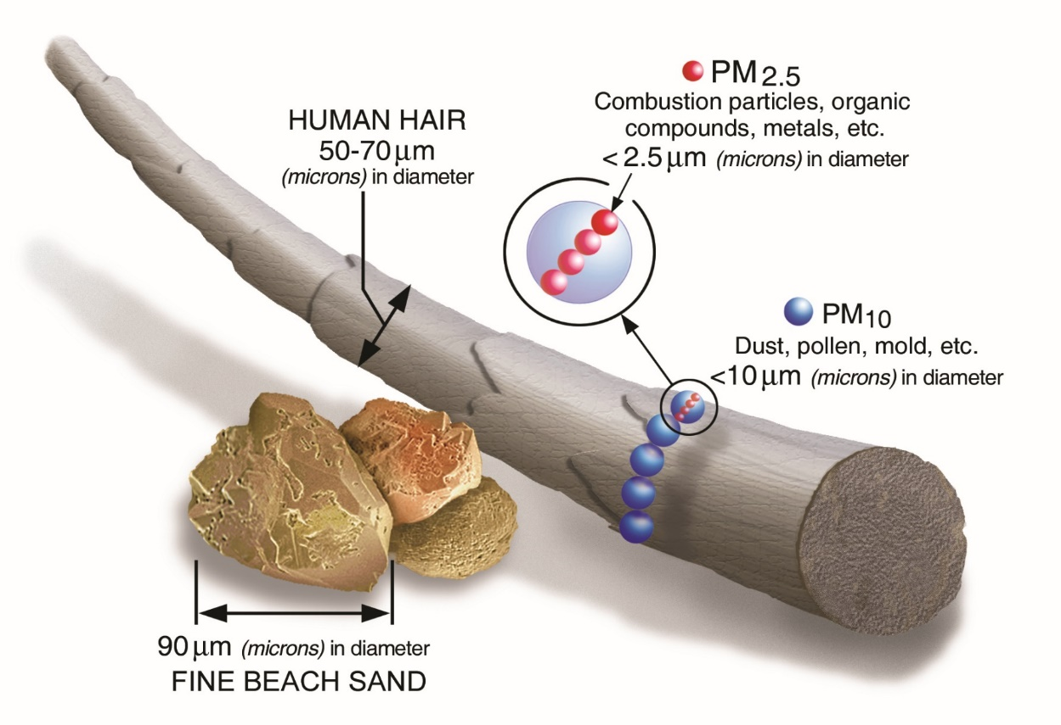
Weight of Particulate Matter
less than or equal to 2.5 microns across,
expressed in micrograms (μg)
per cubic meter (m³)
PM2.5 (μg/m³)
Picture a cubic meter:
How big is 2.5 microns (micrometers)?
1 m
1 m
1 m
www.airnow.gov
Notes:
What exactly is PM2.5? It is the weight of very tiny particles in 1 cubic meter of air. How tiny? PM2.5 particles are smaller than 1/20th the width of a human hair!

Slide 6
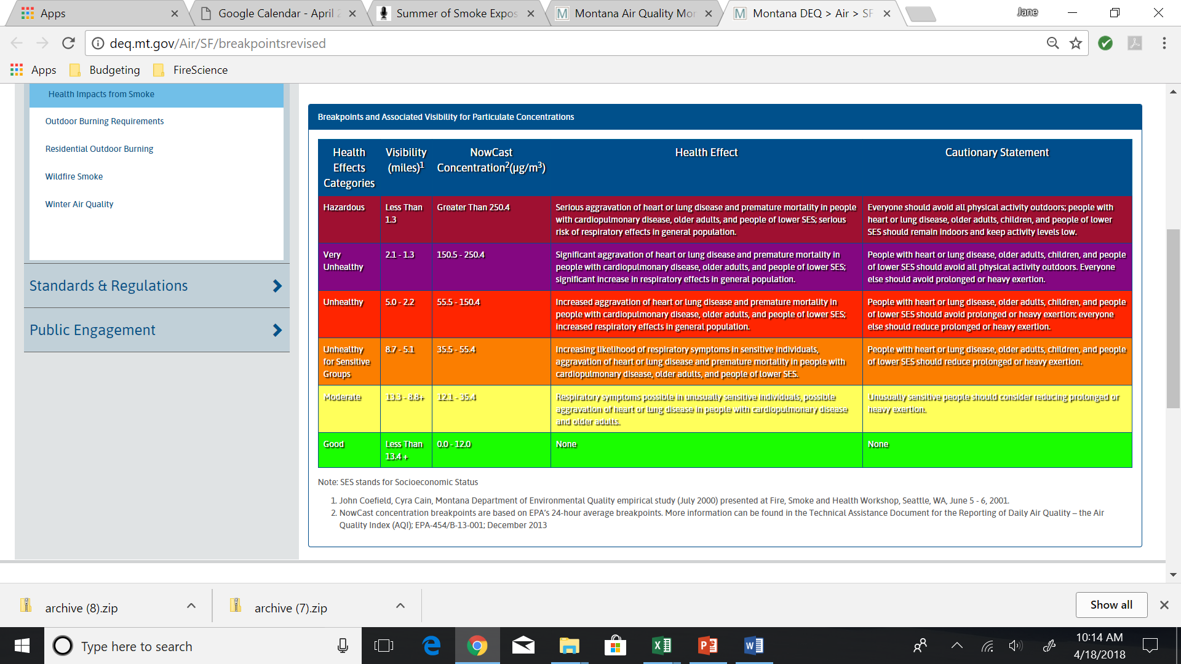
Visibility and Recommendations for Outdoor Activities Based on Air Quality
(http://deq.mt.gov/Air/SF/breakpointsrevised)
Health Effects Categories | Visibility (miles)¹ | NowCast Concentration²(μg/m³) | Health Effect | Cautionary Statement
Hazardous | Less Than 1.3 | Greater Than 250.4 | Serious aggravation of heart or lung disease and premature mortality in people with cardiopulmonary disease, older adults, and people of lower SES; serious risk of respiratory effects in general population. | Everyone should avoid all physical activity outdoors; people with heart or lung disease, older adults, children, and people of lower SES should remain indoors and keep activity levels low.
Very Unhealthy | 2.1 - 1.3 | 150.5 - 250.4 | Significant aggravation of heart or lung disease and premature mortality in people with cardiopulmonary disease, older adults, and people of lower SES; significant increase in respiratory effects in general population. | People with heart or lung disease, older adults, children, and people of lower SES should avoid all physical activity outdoors. Everyone else should avoid prolonged or heavy exertion.
Unhealthy | 5.0 - 2.2 | 55.5 - 150.4 | Increased aggravation of heart or lung disease and premature mortality in people with cardiopulmonary disease, older adults, and people of lower SES; increased respiratory effects in general population. | People with heart or lung disease, older adults, children, and people of lower SES should avoid prolonged or heavy exertion; everyone else should reduce prolonged or heavy exertion.
Unhealthy for Sensitive Groups | 8.7 - 5.1 | 35.5 - 55.4 | Increasing likelihood of respiratory symptoms in sensitive individuals, aggravation of heart or lung disease and premature mortality in people with cardiopulmonary disease, older adults, and people of lower SES. | People with heart or lung disease, older adults, children, and people of lower SES should reduce prolonged or heavy exertion.
Moderate | 13.3 - 8.8+ | 12.1 - 35.4 | Respiratory symptoms possible in unusually sensitive individuals, possible aggravation of heart or lung disease in people with cardiopulmonary disease and older adults. | Unusually sensitive people should consider reducing prolonged or heavy exertion.
Good | More Than 13.4 + | 0.0 - 12.0 | None | None
Notes:
In Seeley Lake during the summer of 2017, “hazardous” levels of PM2.5 occurred for part of every day from August 15 through September 9, a total of 26 days in a row.
What are some of the consequences of “bad air” for human health? How would Seeley Lake’s smoke affect people’s lives? In particular, how would it affect students’ lives? Use the chart to consider effects on students, infants, sick people, elderly people, outdoor laborers, firefighters, and any other categories you can think of.

Slide 7
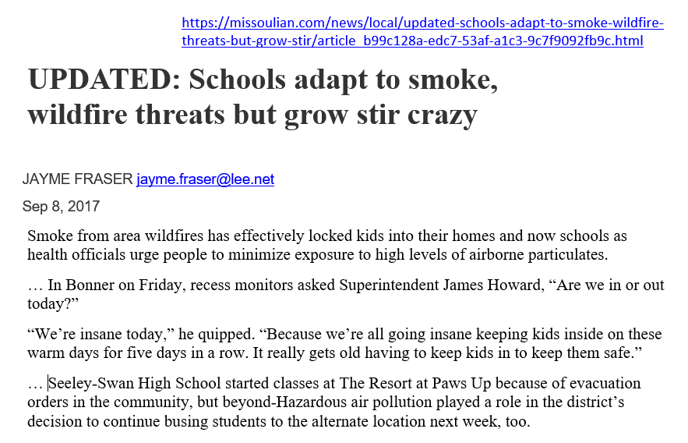
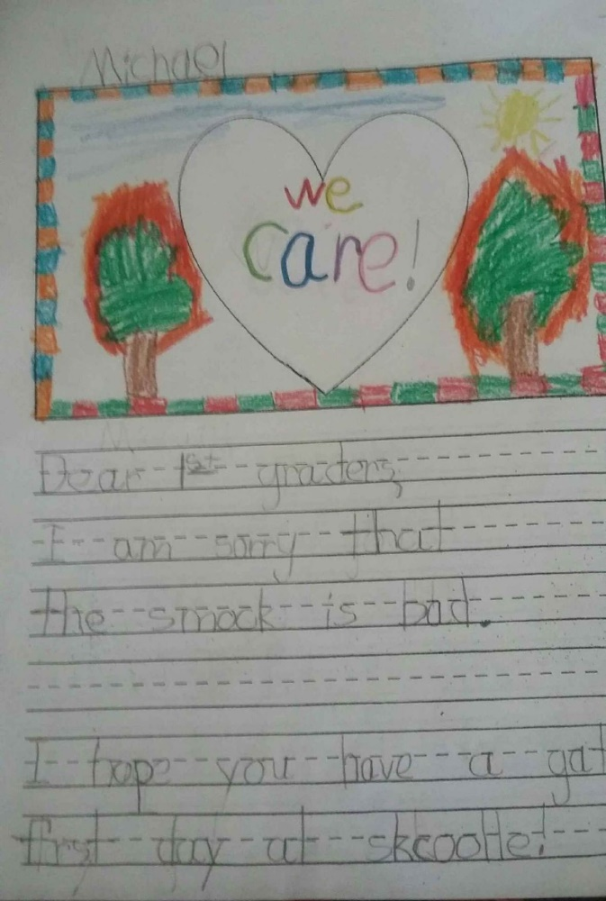
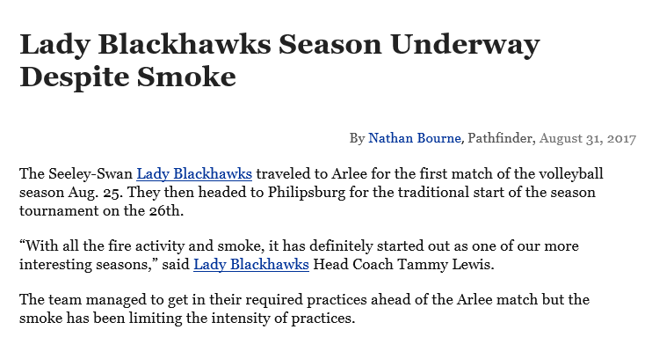
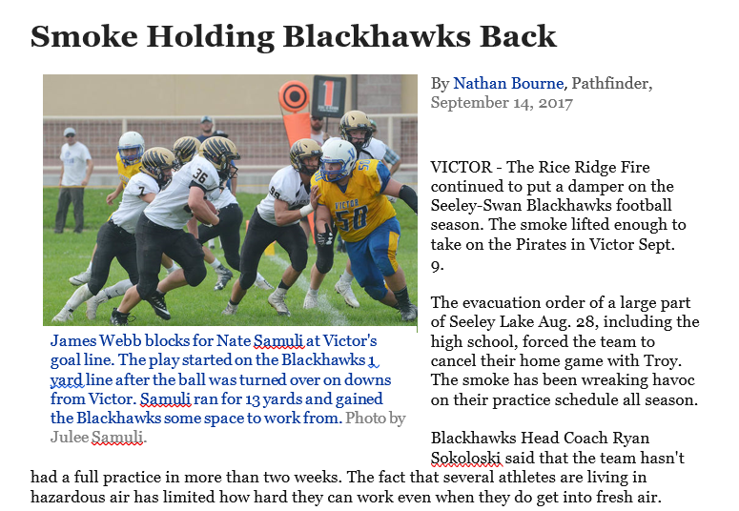
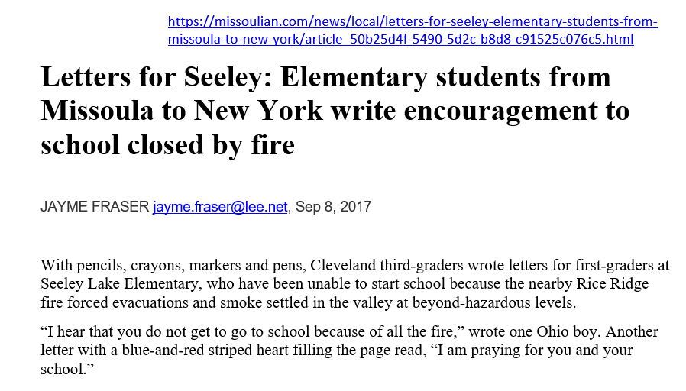
https://missoulian.com/news/local/letters-for-seeley-elementary-students-from-missoula-to-new-york/article_50b25d4f-5490-5d2c-b8d8-c91525c076c5.html
Notes:
Here are some ways the smoke affected school kids.
To understand how smoke can get to be such a problem, we have to look at weather patterns. We’ll study weather records from the Seeley Lake area from July 19, 2017 (a few days before the fire started) through September 14 (after which the fire did not spread much). Then we’ll connect patterns in weather data to patterns in smoke data. Finally, we’ll read the articles behind the headlines that we read in the 1st slide and develop some recommendations on what to do about smoke from wildland fires in the future. [The full articles are available in the folder ArticlesOnSchoolsAndSports.]

Slide 8
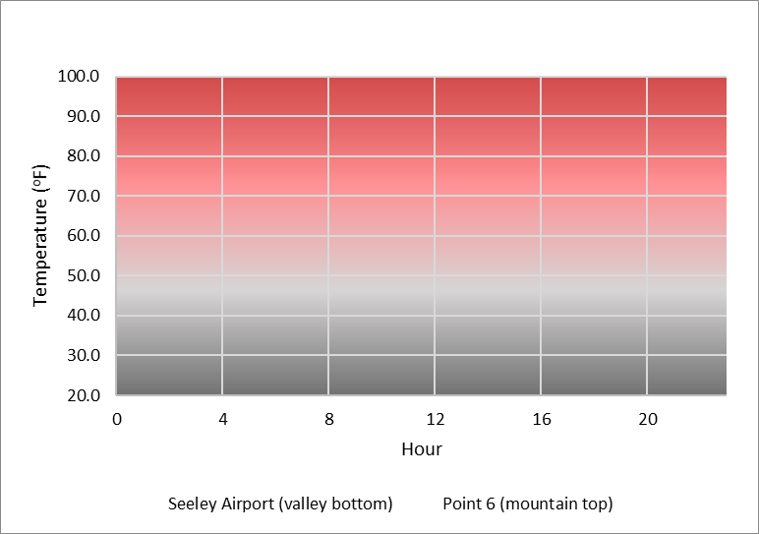
Notes:
Let’s start with what we know about daily temperatures. What do you expect the temperature pattern to be every day in the middle of summer – let’s say, from midnight to midnight? The graph shows cold temperatures in gray tones and warm-to-hot temperatures in red tones.
The vertical axis – Temperature – isn’t labeled. What should the range of temperatures be along that axis? (20 to 100 ºF is a good range.) Get students to describe the temperature pattern to expect in a typical 24-hour cycle. Have them sketch the pattern they expect. Make sure they label the axes. We expect temperature to generally be cool at night, warm up through most of the day, and cool down at night.

Slide 9
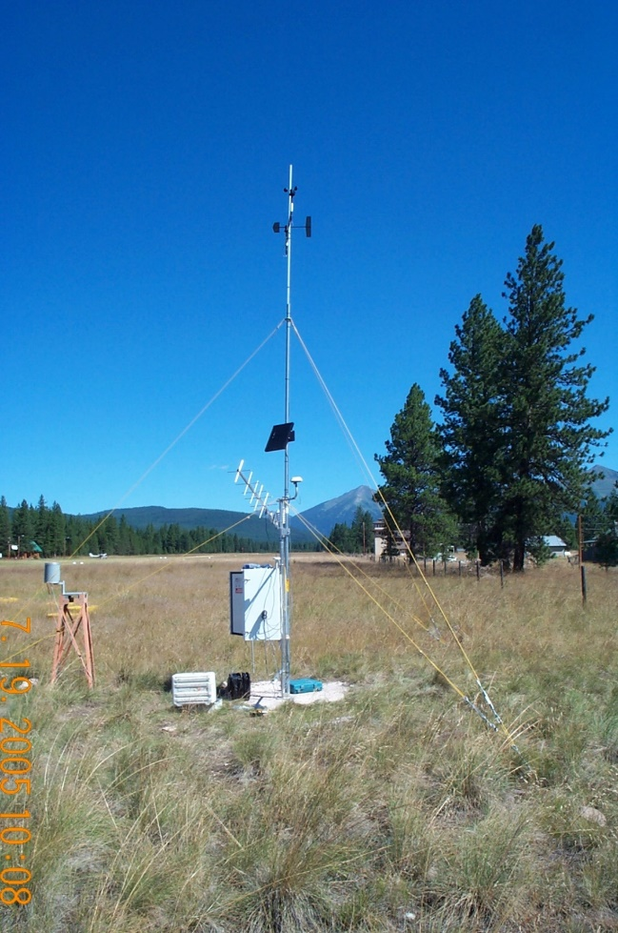
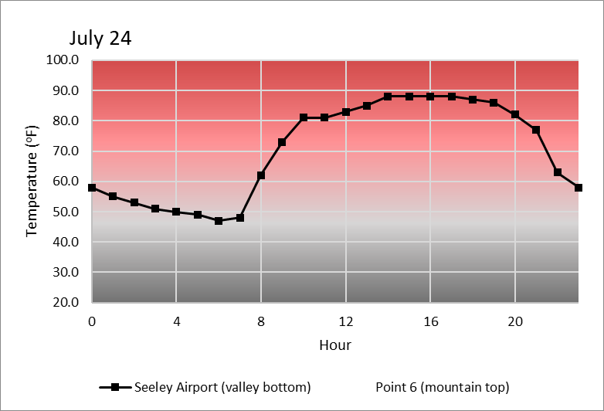

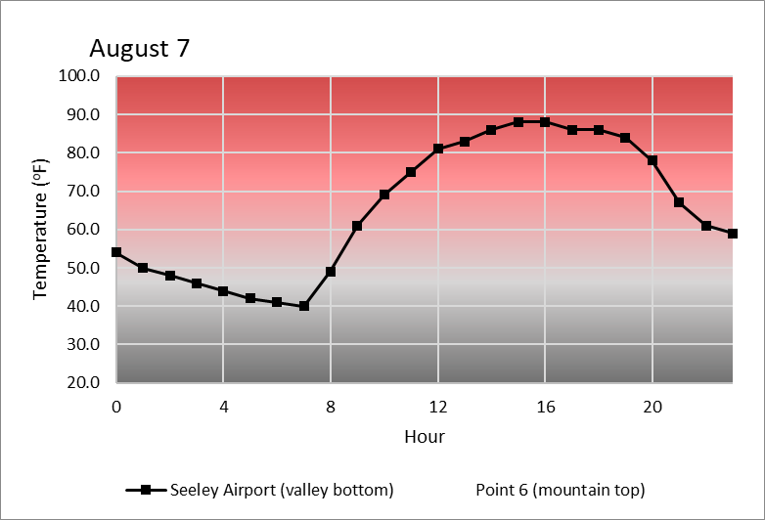
Seeley Lake Airport
Notes:
Let’s see if the data actually support our predictions. Here’s a 3-day sample of temperatures measured near the local Seeley Lake airport. The fire started on Monday, July 24. These graphs show the temperature each Monday during the first three weeks of the fire. Do you see the daily pattern that you expect? Yes, it was cool at night and warm in the daytime. But we’re only looking at 3 days. Do you think that pattern was consistent throughout the summer? [Tab 1. Interactive plot 1 in RiceRidgeData.xlsx]

Slide 10
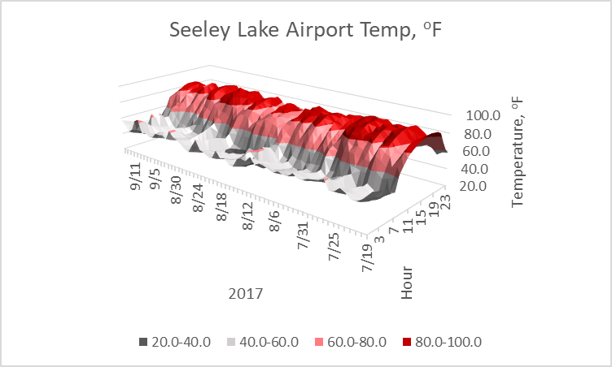
Notes:
We can use this 3-dimensional graph to answer that question. What are the axes? Read the dates from the front corner (7/19) to the back left corner (9/14). Read the hour of the day from the front corner (midnight) to the back right corner (23:00).
The vertical axis shows the temperature at a particular date and time. The colors on this 3-dimensional “surface” help us read the vertical axis. They use the same general colors that were used in the last slide: gray tones for cool, red tones for warm to hot. Can you find an especially cold time? Sometime around August 20, there’s a dark gray patch in the early morning; that must have been below 40. What time of day is usually hottest? Around 16:00, give or take a couple of hours. [Tab 3. SeeleyAirptTemp in RiceRidgeData.xlsx]

Slide 11
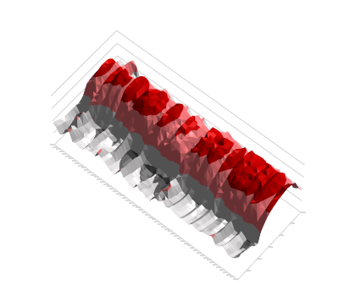
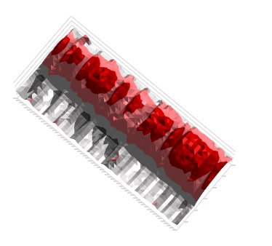
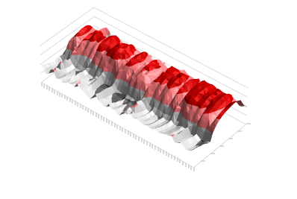
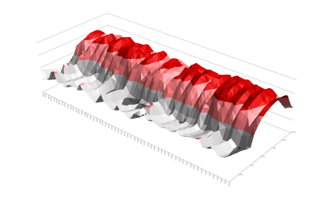
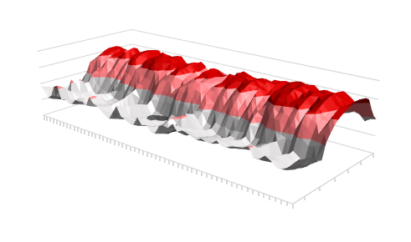
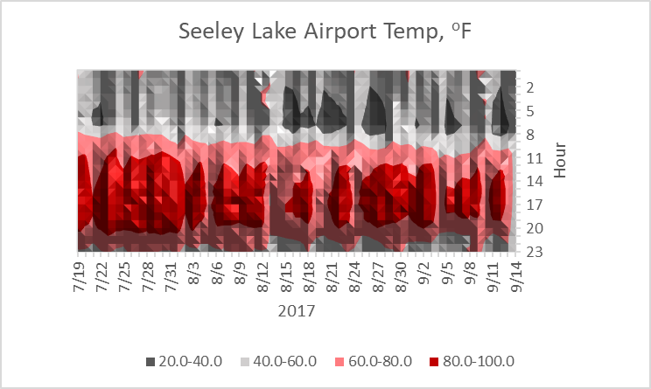
Notes:
Let’s rotate the graph so we can look at it from above. Then we can pinpoint the cold periods more easily. We can read it like a topographic map, where dark gray shows the coldest temperatures and bright red shows the hottest. Identify the cold periods. There are several cold (dark gray) patches in the early mornings between August 14 and September 19.
Can you find a couple of days when the temperature never reached 80 ºF? August 5, August 13-14, and the last two days recorded, September 13-14. The color for these days is pink but there’s no red. [Tab 3. SeeleyAirptTemp in RiceRidgeData.xlsx]

Slide 12
7/24
7/31
8/7
Notes:
Can you see how the temperature graphs that we looked at earlier – the ones that show temperature patterns on 3 Mondays - are just 1-day “slices” from this whole surface? [Tab 3. SeeleyAirptTemp in RiceRidgeData.xlsx]

Slide 13
40º
45º
50º
55º
60º
Warm air –
less dense - rising
65º
70º
Notes:
Why is the heating-cooling pattern so strong? Use what you know from our study of heat transfer (Activity H04) to explain. The pattern is caused by convection. Radiation from the sun warms the earth during the day, and the warm earth transfers energy to the air lying on top of it. As the surface air is heated, it expands, becoming less dense, and therefore it rises until it reaches an elevation where its density (temperature) is the same as that of the surrounding air. If the air is dry, the temperature falls about 1°C for every 100-meter rise in altitude.

Slide 14
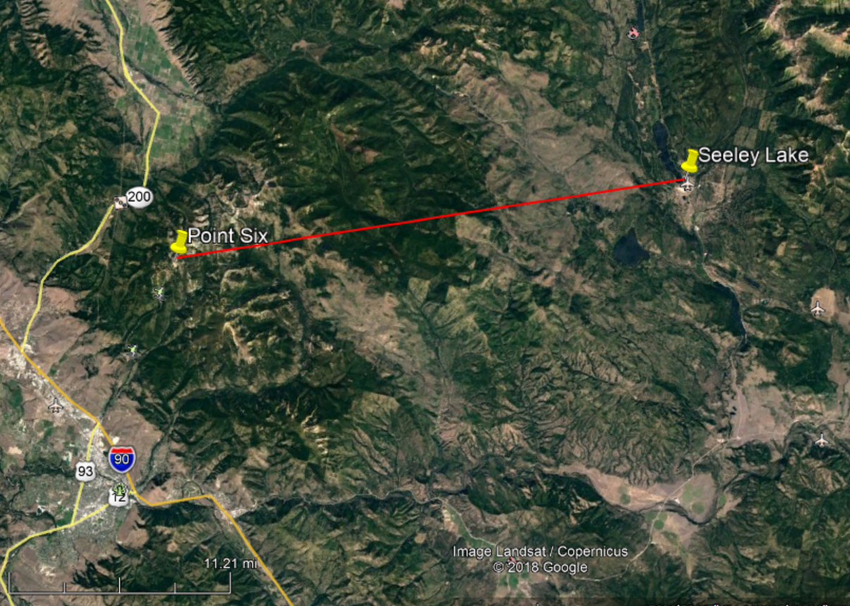
Missoula, MT
Notes:
Would you expect the same temperature pattern on a mountaintop? The pattern of cool nights and warm days should be similar. However, because air cools as it rises (discussed in the previous slide), mountain tops tend to be cooler than valleys on hot summer days. Sketch it on a graph.

Slide 15
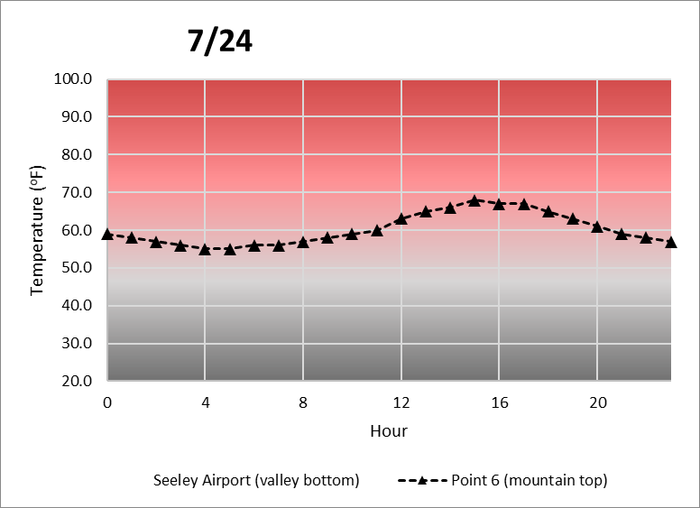


Point 6 (mountain top)
Notes:
Here are the temperature patterns from Point 6 for the same 3 Mondays we looked at earlier. Ask: Do the data support your predictions? Explain why or why not. Yes, they probably do… Do you think the pattern was consistent throughout the “fire season” – when the Rice Ridge Fire and many others were burning in the region? Let’s see. [Tab 1. Interactive plot 1 in RiceRidgeData.xlsx]

Slide 16
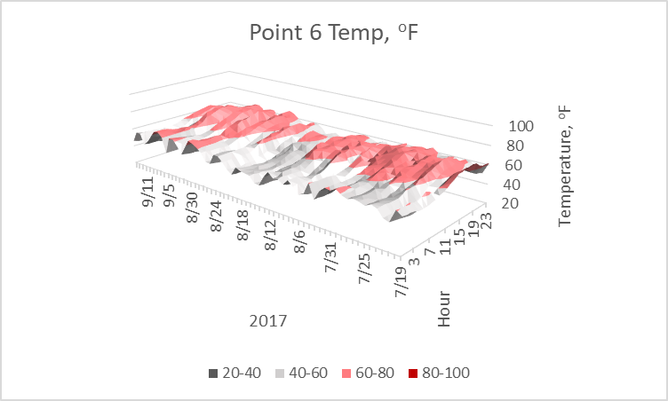
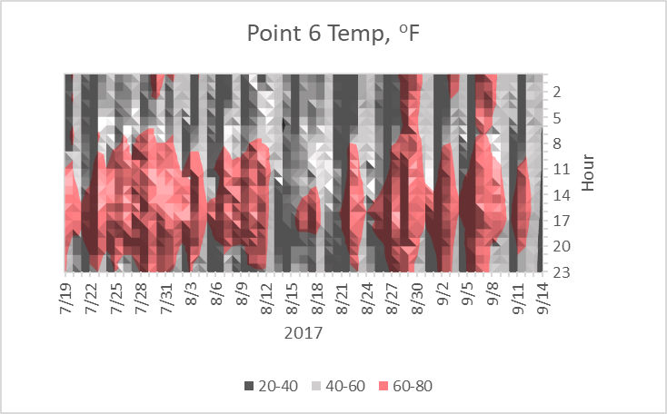
Point 6 (mountain top)
Notes:
Here are the temperature data from the mountain top – Point 6 - throughout the fire season. Is this what you expected? Do you see any surprises? The cooler-nights, warmer-days pattern is as expected. The fact that the mountain top doesn’t get as hot as the valley bottom in the afternoons is as expected. It may be surprising – or not noticed - that the daily range of temperatures on the mountain top is less than in the valley bottom. [It’s ok if it’s not noticed, since it will come up soon. Data are in Tab 4. Point6Temp in RiceRidgeData.xlsx]

Slide 17
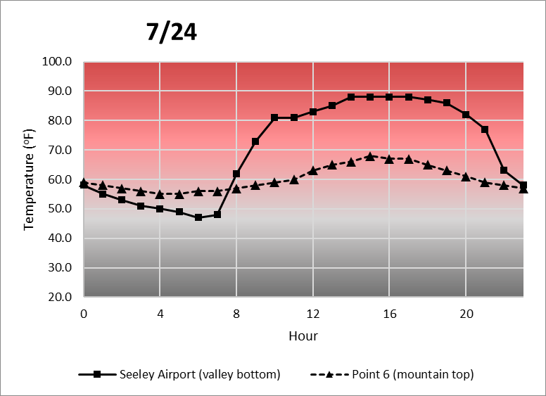
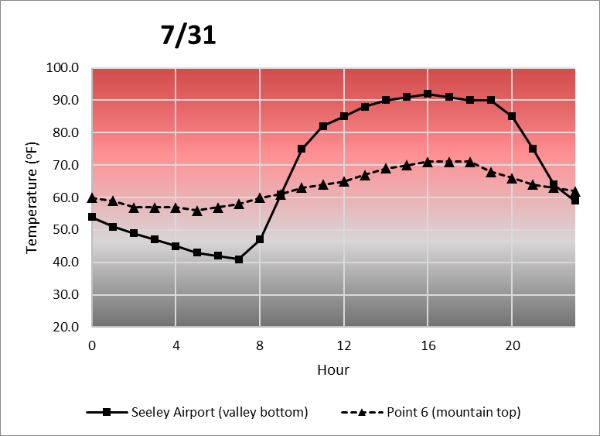
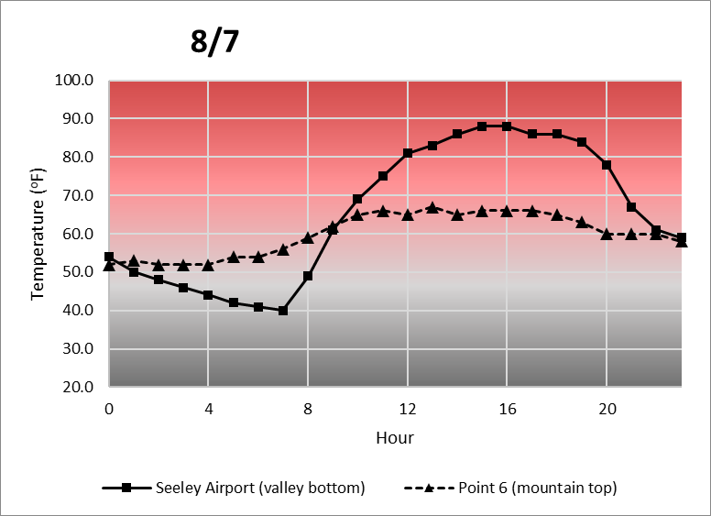
Notes:
How are the temperature patterns at the mountain top (Point 6) and the valley bottom (Seeley Lake) related? These graphs show temperatures at the valley-bottom Seeley Lake Airport (solid black line with squares) and high-elevation Point 6 (dashed black line with triangles) for the same 3 Mondays we’ve been looking at.
What do you notice about these data? Hint (if needed): Look at the morning hours. For a fairly long time almost every night through morning, Point 6 is actually warmer than the Airport – even though it is almost 3800 feet higher in elevation. This event – when high elevations are warmer than low ones – is called an “inversion.” How consistent do you think this inversion pattern is throughout the season? [Tab 1. Interactive plot 1 in RiceRidgeData.xlsx]

Slide 18

Point 6
Seeley Lake Airport
Notes:
Here are the temperature data from both elevations. The legend at the bottom refers to both graphs. (Review: Gray tones show cooler temperatures, and reddish tones show warmer temperatures.) Is the inversion pattern consistent? Yes. The lowest temperatures occurred in the valley bottom (Seeley Lake) during the night and early morning. The dark gray patches show that Seeley Lake was often colder than the mountain top (Point 6) at night. The opposite was true in the afternoons and evenings: The highest temperatures (lots of bright red) occurred at Seeley Lake, while the Point 6 temperatures were cooler (pinkish but very little red). [Top: Tab 4. Point6Temp in RiceRidgeData.xlsx. Bottom: Tab 3. SeeleyAirptTemp.]

Slide 19
Point 6
minus
Seeley Lake Airport
Notes:
We can do the same comparison mathematically by subtracting every data point on the Seeley Lake graph from every data point on the Point 6 graph.

Slide 20
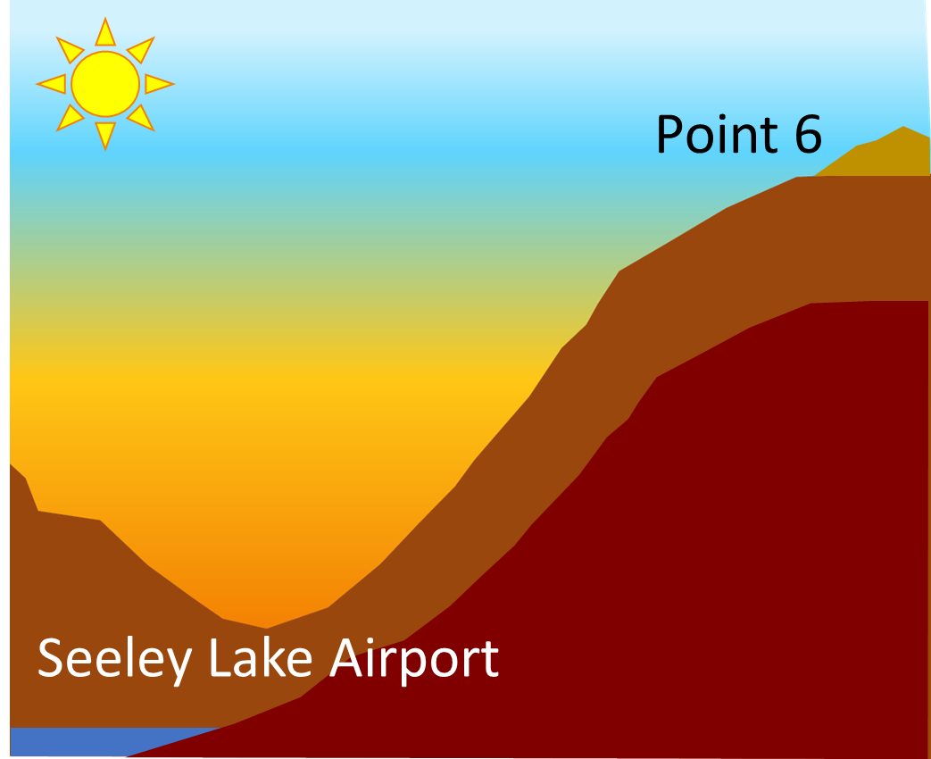
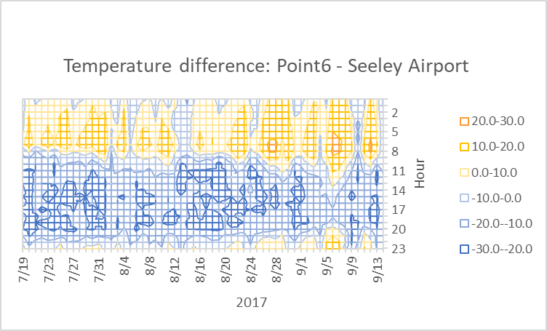
minus
Difference, ºF
Inversion
No inversion
Notes:
Here’s the result – a new graph that shows the subtraction “answers”. Study the legend – what do the colors mean? Orangeish colors show positive differences, when Point 6 (the mountain top) was warmer than Seeley Lake (the valley bottom), and thus orangeish colors mean there was an inversion. Blue colors show negative differences, when Point 6 was cooler than Seeley Lake. Thus blue means there was no inversion.
Describe the pattern in the data: Inversions (when Point 6 was warmer – orangeish colors) occurred consistently between approximately midnight and 08:00. Non-inversions (when Seeley Lake was warmer – bluish colors) occurred consistently from late morning until about 22:00. Is the pattern of nighttime inversions and daytime non-inversions (also called “mixing” or “ventilation”) consistent throughout the fire season? Yes! [Top: Tab 4. Point6Temp in RiceRidgeData.xlsx. Bottom: Tab 3. SeeleyAirptTemp. Right: Tab5. Point6-SeeleyAirport.]

Slide 21

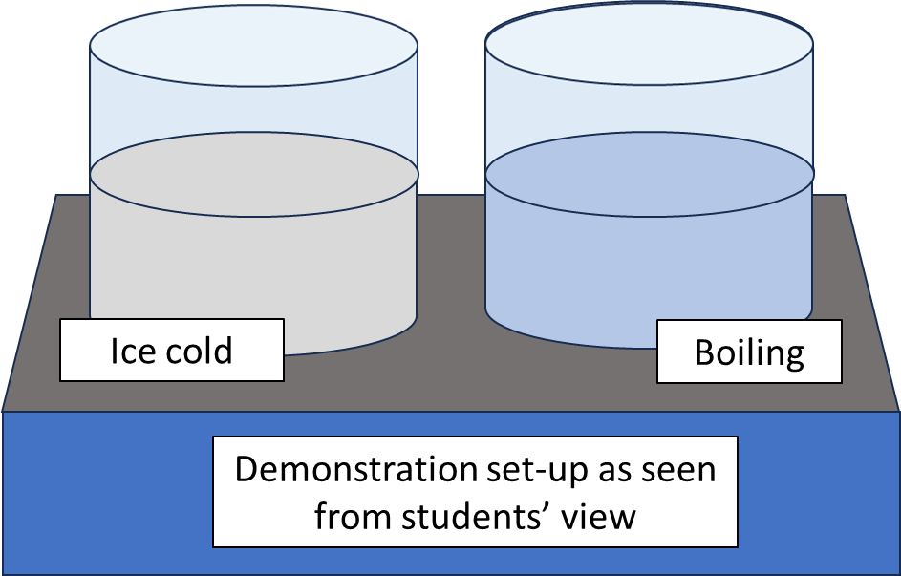
https://www.youtube.com/watch?v=LPvn9qhVFbM
Notes:
Inversions have some interesting effects. Let’s look at a demonstration of actual inversions on a miniature scale.
Either
Click on the link (upper-left photo) for a 2:49-minute YouTube video (https://www.youtube.com/watch?v=LPvn9qhVFbM) about inversions from “Steve Spangler Science” in Denver, CO. The video is about winter air quality in Denver, , CO. The video is about winter air quality in Denver, but the principles apply perfectly to smoke dispersion from wildland fires… OR …
Create a demonstration yourself. Use the instructions described in H11_InversionDemonstration_Boiling-vs-Ice.pdf, which uses temperature measurements and observations of air stability/turbulence above containers of near-freezing water and near-boiling water to illustrate inversions.

Slide 22
40º
45º
50º
55º
60º
65º
70º
Notes:
Why do inversions occur? Use what you know about the earth, the sun, and gravity to explain. As we saw in an earlier slide, air in the valley bottom rises due to convection. It stops rising when it reaches the same temperature (density) as the air around it. But cool air is denser than warm air, and denser (heavier) stuff tends to flow downhill due to gravity. So while convection is lifting air upward during the day, cooler air from above is flowing into the valley to replace it. During the daytime, that cool air is in turn heated and rises. Meteorologists say a lot of “mixing” or “ventilation” occurs during the day, and the rising air can be quite turbulent.
Ask: How would you expect that turbulence to affect fire behavior and the use of aircraft to manage fires? Expect more rapid fire spread, possibly in any direction. Expect increased danger for aircraft or conditions that are too turbulent for flying.

Slide 23
35º
40º
45º
50º
60º
70º
60º
50º
45º
Notes:
At night, convection slows down and may even stop. The wind might be strong and gusty in the evening, but it usually slows down right at sunset. The cool (dense) air from above does not stop moving though. It continues to sink into the valley. Without the sun’s warmth, mountaintop air cools quickly and increases the downhill flow. Throughout the night, this cool air pools in the valley bottom, causing an inversion. The layer of cool air gradually displaces the warm air. It lifts the warm air just as you lift your blankets when you crawl into bed. The layer of warm air above the valley bottom is called the “thermal belt”. Mixing and turbulence continue in the thermal belt, but – because of the inversion - the air at the valley bottom accumulates and stays put until it can be heated up in the morning. Meteorologists say the valley-bottom air is “stable”.
We might say that mountain valleys “breathe” once a day: They inhale slowly during the night and then make a giant, powerful exhale during the day. Let’s see if we can find that pattern in the wind data from the Rice Ridge Fire.

Slide 24
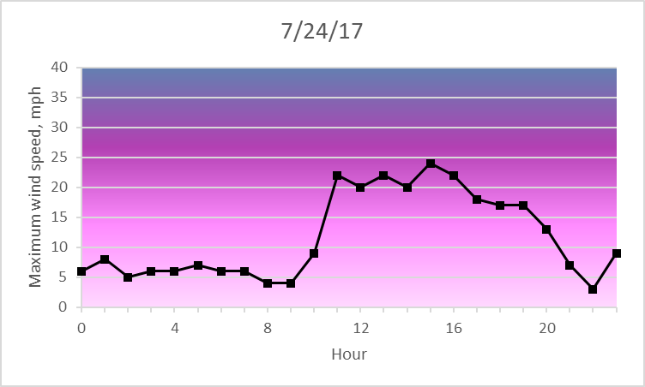
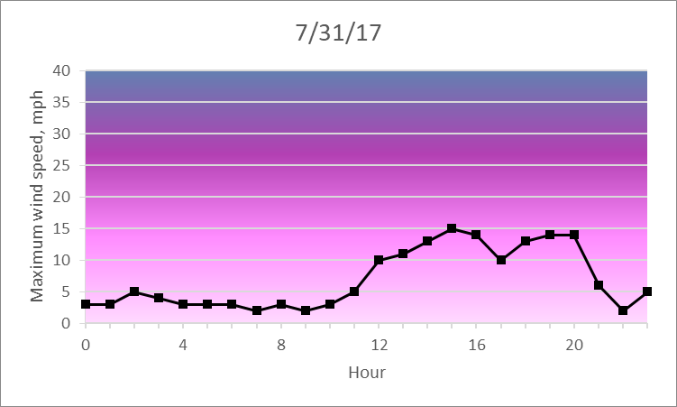
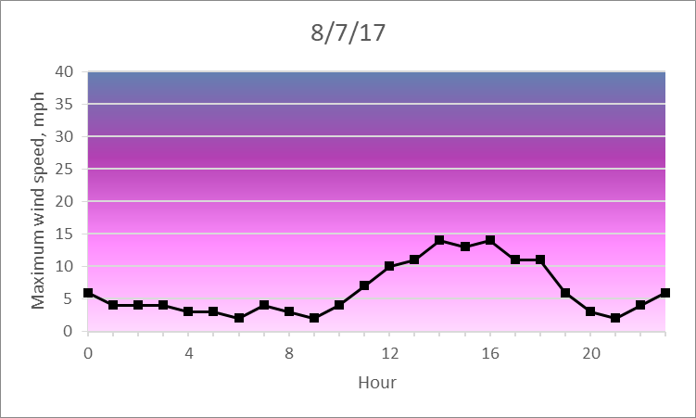
Wind gusts at
Seeley Lake
Airport
Notes:
The first graph shows the strongest wind gust (gust: “a sudden brief rush of wind”) recorded every hour on July 24 at the Seeley Lake Airport. Next… here’s the temperature/ inversion pattern for that day. Is the wind pattern consistent with how inversions work? Yes: At the airport, we should see stable air in the nights and mornings – that is, we should see light breezes but no strong wind gusts. Why? Because Point 6 is warmer than the valley bottom, so an inversion is occurring.
In the afternoons and evenings, we should see turbulence – gusty winds - at the airport. Why? Because Seeley Lake is warmer than the Point 6 mountaintop at that time of day, so no inversion is occurring.
Next look at data for 2 more Mondays. What do you see? Is the pattern consistent? Yes. Now… what pattern in wind gusts do you expect in the Point 6 data? Inversions and nighttime cooling should have less influence; we should see turbulence both day and night. [Tab 2. Interactive plot 2 in RiceRidgeData.xlsx.]

Slide 25
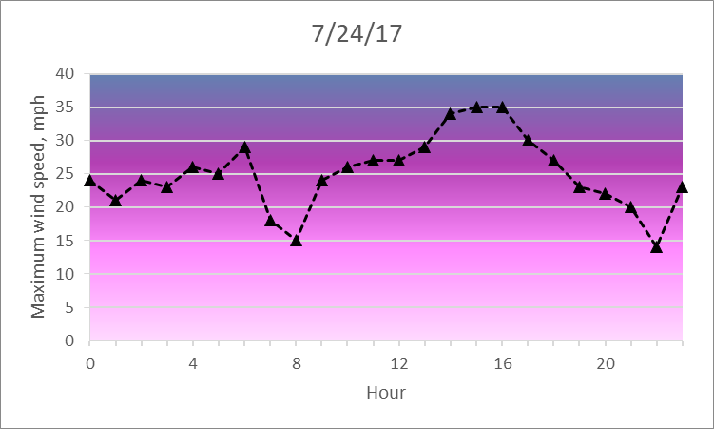
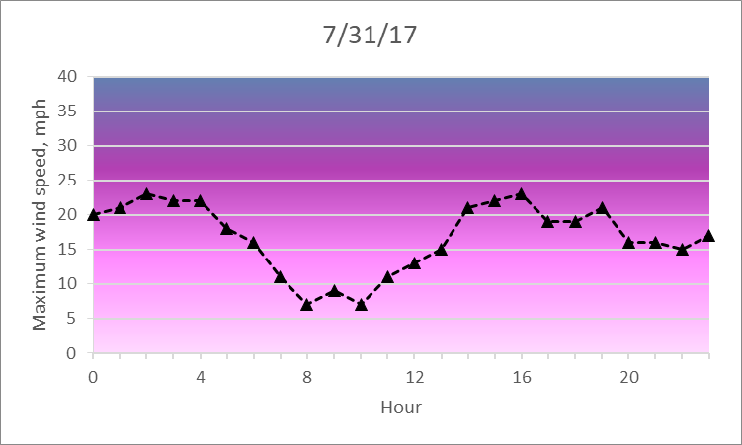
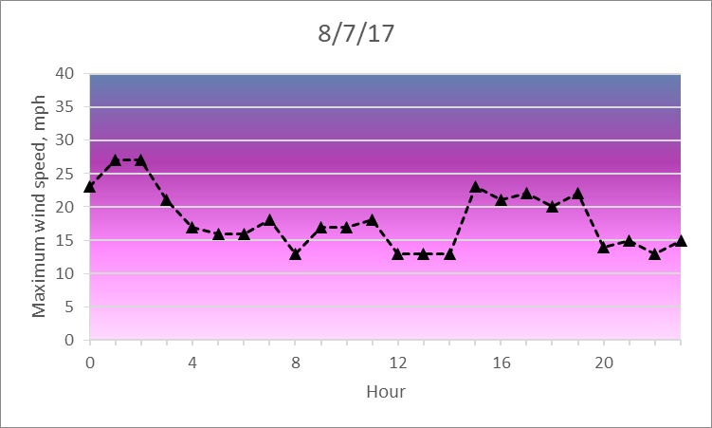
Wind gusts at Seeley Lake Airport
Wind gusts at Point 6
Notes:
Compare the wind gusts in the valley bottom - Seeley Lake Airport (left, with data shown by solid lines and black squares) with wind gusts on the mountain top - Point 6 (right, with data shown by dashed lines and black triangles). What pattern do you see? We see much stronger wind gusts on the mountain top. Why? The air on the mountain top is mixing with air from adjacent valleys, and it is also mixing with air high above the surface that’s being pushed around by regional weather and air masses at high altitudes, so it can be pretty chaotic up there. The pattern of stable nights/mornings and turbulent afternoons/evenings is clear in the Seeley Lake data. No such pattern occurs at Point 6. [Tab 2. Interactive plot 2 in RiceRidgeData.xlsx.]

Slide 26
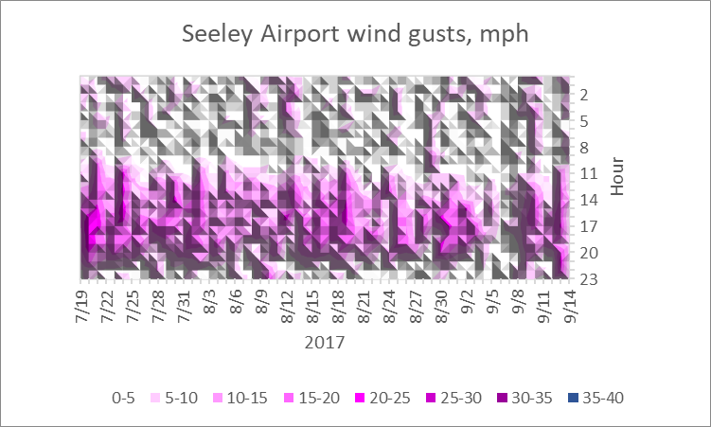
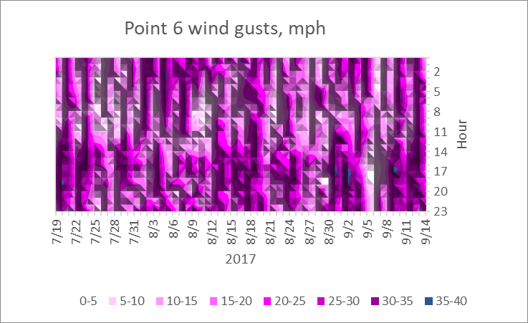
Notes:
How consistent were these wind patterns throughout the fire season? You can assess it in these 3-dimensional graphs, where white and gray show very low (or no) wind, shades of lavender show light to moderate wind, purple shows strong wind (a steady 20-mph wind has large branches in continuous motion*), and dark blue shows very strong wind (whole trees in motion – or breakage occurring*). The nighttime stable/daytime turbulent pattern is pretty consistent at Seeley Lake and pretty weak at Point 6. The only noticeable pattern at Point 6 (the mountaintop) is that the strongest wind gusts – shown in dark blue – occurred in the late afternoons and early evenings.
[*The verbal categories are based on information from https://www.weather.gov/pqr/wind. Note that, while we used wind gusts in the graphics here, average wind speeds for this time period follow the same pattern – it’s just less dramatic.] [Top: Tab 11. SeeleyAirptGust in RiceRidgeData.xlsx. Bottom: Tab 13. Pt6Gust.]

Slide 27

KURT WILSON, Missoulian
Seeley Lake
Prevailing winds
Washington
Rice Ridge Fire
Montana
Wyoming
Oregon
Idaho
NASA image courtesy Jeff Schmaltz LANCE/EOSDIS MODIS Rapid Response Team, GSFC. https://www.nasa.gov/image-feature/goddard/2017/smoke-and-fires-light-up-pacific-northwest
Notes:
We’ve spent a lot of time learning about weather, but we started out trying to learn about smoke. Not only was the Rice Ridge Fire burning right next to Seeley Lake in the summer of 2017, but there were large fires in all of the northwestern states, as you can see in this satellite photo taken on September 4, 2017. Smoke was pouring into the Seeley Lake area from fires to the west. At this point, hundreds of square miles were burning in Montana, Washington, Idaho, and Oregon. Now let’s look at air quality data.

Slide 28
PM2.5 (μg/m³)
Notes:
Remember this graph? It shows the air quality in Seeley Lake on September 7, one of the worst days during the summer of 2017. Now we have the knowledge to connect air quality data with weather patterns. What do you expect to the temperature pattern to be on this day, based on your knowledge of daily air flow patterns? When there are high levels of particulates (night and early morning), there are temperature inversions in the valley. When the particulates decline in the afternoon, the valley bottom is warmer than the mountain and no inversion is occurring. [Tab 8. SeeleyPM2.5 in RiceRidgeData.xlsx.]

Slide 29


September 7, 2017
Air quality in Seeley Lake
Temperature in the valley (Airport) and on a mountain top (Point 6)
Notes:
Here’s the air quality data we just looked at, along with the temperature pattern for the same day. Is this what you expected? Probably yes… It looks like bad air quality is connected to inversions, as predicted. Do you think the pattern was consistent throughout the fire season? [Tab 1. Interactive plot 1 in RiceRidgeData.xlsx]

Slide 30




Temperature difference: Point 6 minus Seeley Airport
Notes:
Here are graphs of the inversion pattern and air quality for the entire season. The graph in the upper left is the one we looked at earlier. Review: How did we get that graph? It was created by subtracting the Seeley Lake temperatures from Point 6 temperatures. What do the colors mean? Shades of yellow-to-orange show inversions (mountaintop warmer than valley bottom, valley air stable) and shades of blue show good mixing (valley bottom warmer than mountain top – no inversion – valley air turbulent).
Describe the relationship between inversions and smoke throughout the fire season: Valley “breathing” occurred throughout the season, and nighttime inversions were common even before fires began to produce large amounts of smoke (around the end of July). Then the air quality got worse nearly every day until early September. On most days, there was some relief from the smoke as the inversion “broke” in the late morning, the valley bottom became warmer than the mountaintop, and the valley winds increased. For a few days in early September – when inversions lasted until late morning or even noon – air quality stayed unhealthy or worse throughout the day.
Could smoke itself influence an inversion? Could smoke make an inversion worse? Yes, because the smoke can become so thick that it is hard for the sun's rays to reach the ground and heat it up. Thus smoke can increase the intensity and length of an inversion.
Why do you think the inversions (and bad air quality) lasted longer into the day as the season progressed? The nights got longer and colder as summer turned to early fall. Thus time of year influences how long inversions stick around each day. [Top: Tab 5. Point6-SeeleyAirport in RiceRidgeData.xlsx. Bottom: Tab 8. SeeleyPM2.5.]

Slide 31
Notes:
So while the lightning-caused Rice Ridge Fire grew from a tiny spot to nearly 160,000 acres (240 sq mi, 630 sq km)…

Slide 32




Photo by Kurt Wilson, courtesy of The Missoulian. https://missoulian.com/news/state-and-regional/summer-of-fire-and-smoke/article_bd3838b6-a2da-11e7-aa62-37df81b34987.html
Photo by Tom Bauer, courtesy of The Missoulian. https://missoulian.com/news/state-and-regional/summer-of-fire-and-smoke/article_bd3838b6-a2da-11e7-aa62-37df81b34987.html
Photo by Tommy Martino, courtesy of The Missoulian. https://missoulian.com/news/state-and-regional/summer-of-fire-and-smoke/article_bd3838b6-a2da-11e7-aa62-37df81b34987.html
Notes:
… the people in the valley, including firefighters, were enduring air that looked like this.

Slide 33

Notes:
And while the air might have been better for firefighters in the thermal belt on higher slopes and ridges, they didn’t get much of a break from dangerous, gusty winds - even at night.

Slide 34

Swirling embers in the smoke column lofted by group tree torching on the Pioneer Fire, Idaho, 2016. Photo by Kari Greer/U.S. Forest Service. https://www.uidaho.edu/news/climate-change/wildfire.
Notes:
Here’s a little more detail about that last comment: Stable air at night (which is common in valley bottoms) gives firefighters a chance to work close to the fire and make substantial progress in containing the fire, even though nighttime firefighting increases risks because of poor visibility, exhaustion, and lack of support from aircraft. But unstable, turbulent air in the thermal belt means that gusty winds may continue through the night. These conditions can be very hazardous for firefighters: The fire may spread rapidly, and it could spot - igniting new fires (which will be harder to detect due to low visibility and lack of air patrol). Intense burning in the thermal belt could also cause debris to roll downhill into the quieter valleys, endangering firefighters below and possibly starting more spot fires, which could then spread uphill and entrap firefighters above.

Slide 35
Notes:
With all of our knowledge about weather, smoke, and firefighting, we now return to the disturbing headlines that we saw at the start of this activity. What can be done about the smoke from wildland fires? We’ll read the 5 articles connected to these headlines, and we’ll also get some information from records made by Incident Commanders on the Rice Ridge Fire and another 2017 fire nearby, the Lolo Peak Fire. Then we’ll come up with recommendations for how to handle smoke when it occurs and how we might be able to prevent smoke from getting this bad, even if our fire seasons get longer and more areas are burned.

