Slide 1
Which diagram describes…
Normal air temperature pattern? inversion?
Cold
Cold
Hot
Hot
Cold
Notes:
Ask: If the cylinders represent parcels of air, which diagram shows normal conditions and which one shows inversion conditions?

Slide 2
Cold
Cold
Hot
Normal
Inversion
Hot
Cold
Notes:
Discuss:
If you viewed or created the demonstration in the video: The demonstration with warm water on the bottom and cold water on top represented normal conditions. With warm water below cold water, the liquids were unstable; instead, they were circulating – moving - and the colors were mixing. With cold water below warm water, liquids were stable – not moving, not circulating - and the colors were not mixing. These stable conditions represent an inversion.
If you used the ice/boiling water demonstration: The air above boiling water showed normal conditions because the air was unstable, even turbulent; pollutants in the air would disperse upward. The air above ice showed an inversion because the air was very stable; pollutants would be trapped in the cold air and would not disperse.

Slide 3
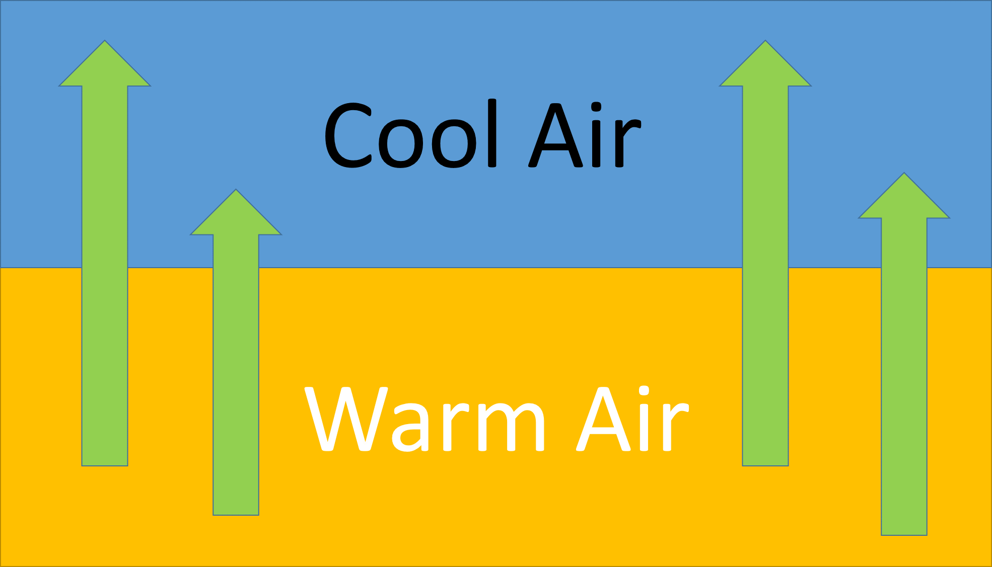
40º
45º
50º
55º
60º
65º
Normal Atmospheric Condition: Air moves up from the ground.
Air is unstable.
70º
Notes:
Explain: Normal atmospheric conditions occur when sunlight warms the earth’s surface in the morning, and this warms the air on the ground. The warming air expands and therefore rises. As it rises, it gradually cools off. If the air is dry, the temperature falls about 1°C for every 100-meter rise in altitude (about 5º F for every 1000 ft). As a result of this natural cooling, mountain tops are usually cooler than valleys on hot summer days. Due to all the air movement, these conditions are described as unstable.

Slide 4
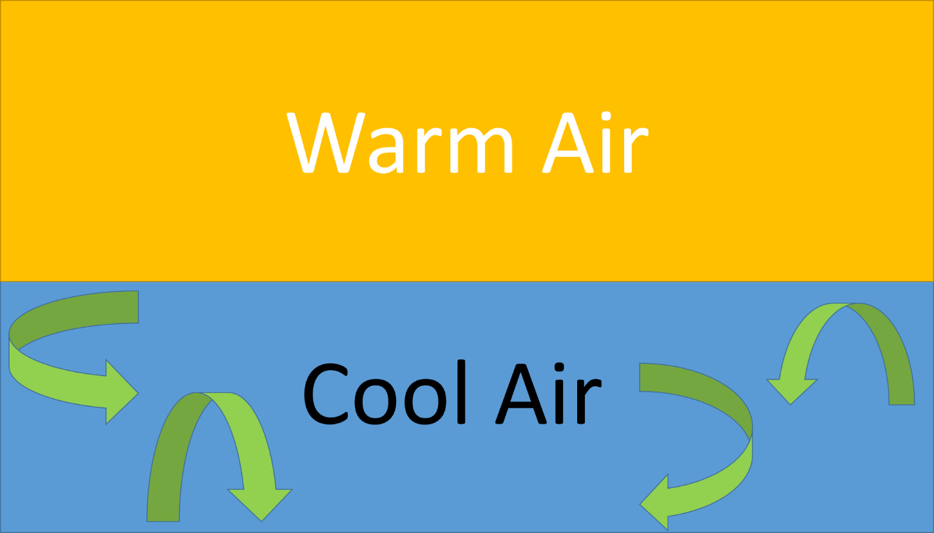
Temperature Inversion:
Air on the ground is stuck there.
It cannot move up and out.
Air on the ground is stable.
Normal Atmospheric Condition: Air moves up from the ground.
Air is unstable.
Notes:
Explain: Inversions occur when air at the earth’s surface is cold. It is not getting warmed by the sun, so it is not expanding and rising. It is stuck on the ground. It cannot be dislodged until it is heated or stirred up by wind. We say the cold, surface air is very stable.

Slide 5
35º
Temperature Inversion:
Air on the ground is stuck there.
It cannot move up and out.
Air on the ground is stable.
40º
45º
50º
60º
Thermal belt
70º
60º
50º
45º
Notes:
Explain: Inversions often occur at night. The cool air on the mountain tops is denser than the warm air in the valleys. When the sun goes down and stops stirring up the surface air, the cool, dense mountaintop air flows downhill into the valley bottoms. The blanket of warm air at middle elevations is called the thermal belt.

Slide 6
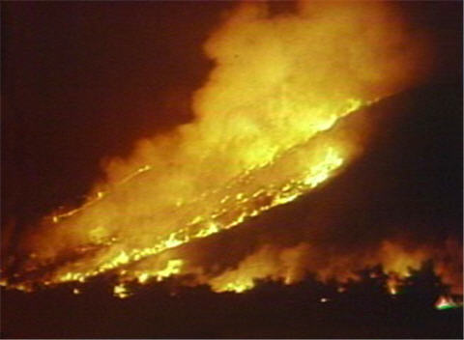
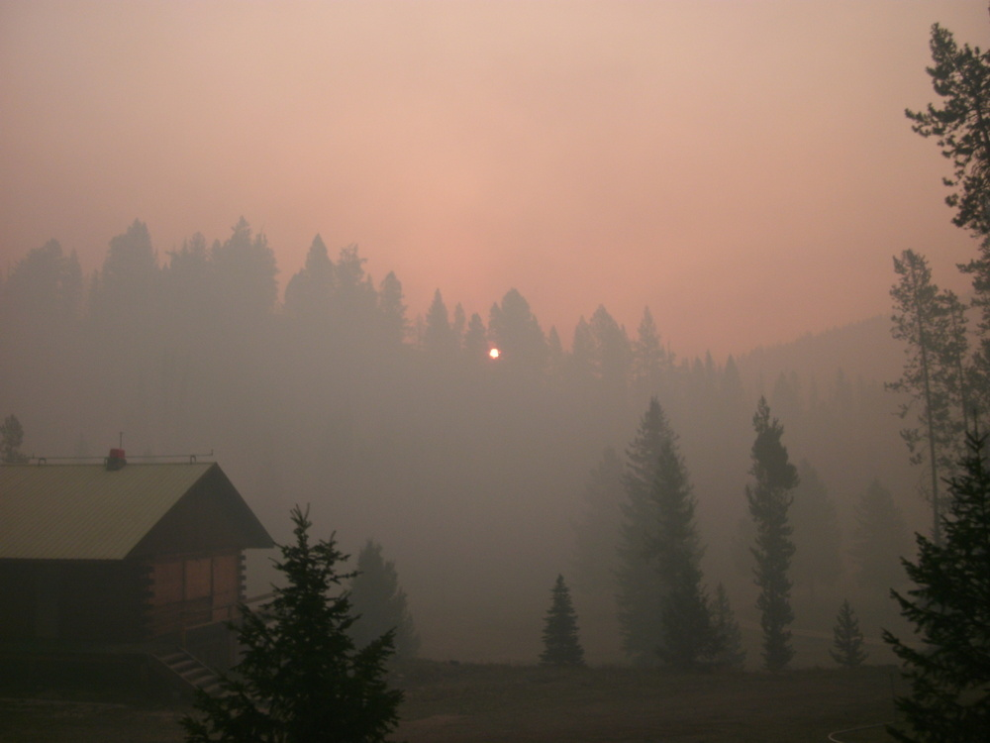
During temperature inversions:
2012 Mustang Complex, ID-MT (inciweb.nwcg.gov)
Photos fromWILD4520 - Wildland Fire Management and Planning, sponsored by Bureau of Land Management.
If smoke keeps the morning sun from heating the ground, inversions can persist for days.
Nighttime fire behavior in the thermal belt can be very intense.
Notes:
Ask: So how do inversions affect fires … and how do they affect us? Discuss the points in the slides; this discussion leads into the Assessment. Source for left photo: http://ocw.usu.edu/Forest__Range__and_Wildlife_Sciences/Wildland_Fire_Management_and_Planning/Unit_7__Atmospheric_Stability_and_Instability_2.html

