Slide 1
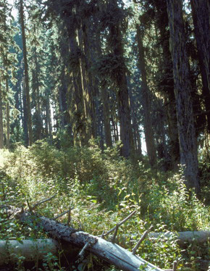
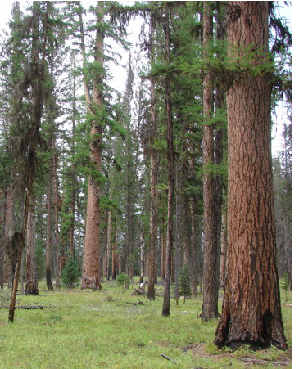
Dave Powell, USDA Forest Service, Bugwood.org.
Photo courtesy of Rick Trembath.
How is a fire likely to spread in each photo?
Notes:
Using what you learned by doing the Lab Preparation (Handout H09-1), explain how the fire would likely spread in each of these forests on a windy day.
Left: A surface fire could easily climb into the tree crowns because there are a lot of surface fuels and ladder fuels. In addition, the trees are close together. This is a dense stand, like some of those modeled in the previous activity (H08, “matchstick” forests). Thus a crown fire could develop if it is dry enough and windy enough.
Right: A surface fire could spread in these fuels but would not be able to climb into the tree crowns because there is no ladder fuel. In addition, the trees are spaced far apart so their crowns are not interconnected. Surface fire could occur, but crown fire could not.

Slide 2
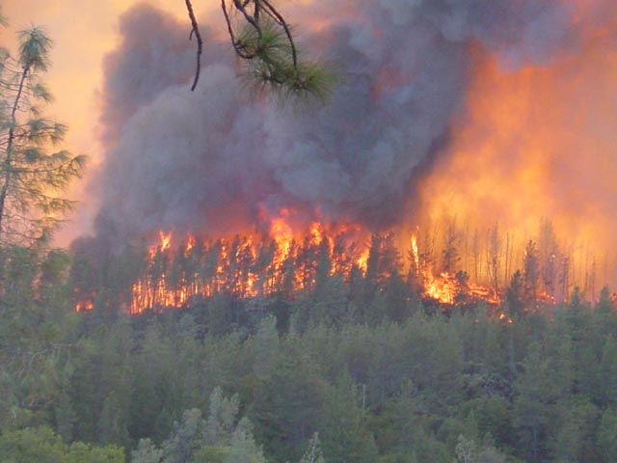
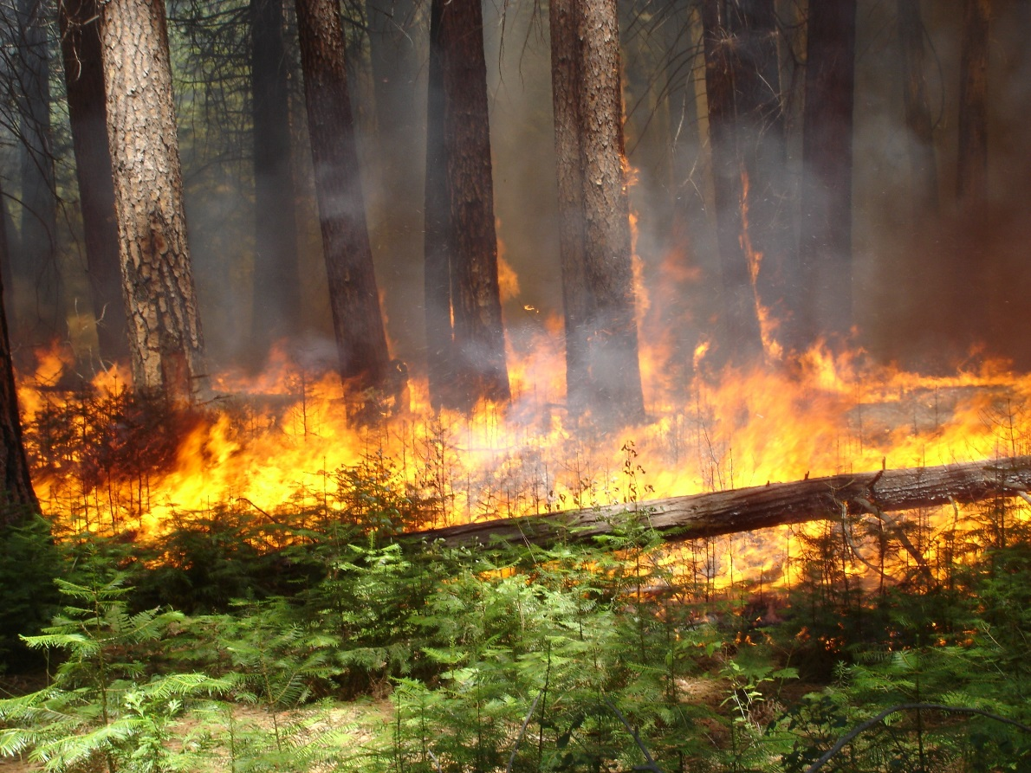
What kind of fire is burning in each photo?
Notes:
What kinds of fuels are burning in each fire? What kinds of fires are these?
Left: A crown fire is burning through surface, ladder, and crown (also called aerial) fuels.
Right: A surface fire is burning through surface fuels (seedlings, logs, litter).

