Slide 1
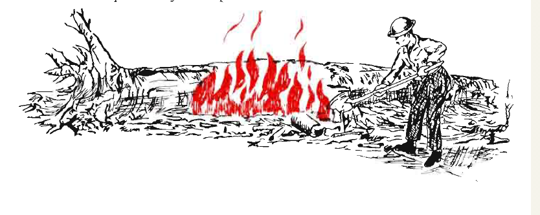
How firewise are these homes?

Slide 2
1
Notes:
Good job! -- Screened in porch is good, wide driveway is good, green grass is good. Needs work: Clean the roof, get the duff out from base of trees, remove some trees from back of house, make sure area under steps is free of burnables. Replace wooden latticework under porch with wire mesh.

Slide 3
2
Notes:
Good job! Roof looks clean, there’s little vegetation next to house, there are no trees overhanging the house.
Needs work: Replace wood shake roof, rake needles from under trees.

Slide 4
3
Notes:
Good job! House has a clean roof, there’s little vegetation next to house, there are no trees overhanging house, there’s a green lawn.
Needs work: Water the lawn a little more.

Slide 5
4
Notes:
Good job! House has a clean roof and a green lawn, there’s no vegetation close to house, house has shingle roof.
Needs work: Replace wooden latticework under deck with wire mesh. Make sure there’s no flammable stuff under there. Replace bark chips below deck with rocks.

