Slide 1
Models and examples of FSEN science co-production
Andi Thode, Inga La Puma, Nick Skowronski

Slide 2
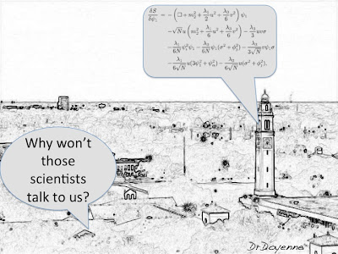
What is wrong with “regular” production of science?
It doesn’t get seen
It doesn’t apply
No one can understand it
It doesn’t get used
Notes:
Does it solve an immediate problem?

Slide 3
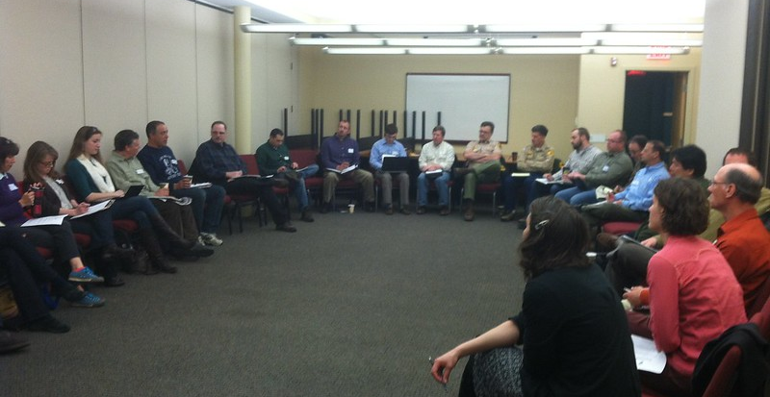
What is co-production of science?
Co-creates new knowledge to inform decision-making
Characteristics:
Initiated by any stakeholder
All partners from project inception
Co-lead and co-designed
Quality of interaction determines usefulness of science
Notes:
This is sort of the ultimate in co-production. It is rarely ever neat and tidy and is always based on relationships.

Slide 4
How does co-production of science happen?
Communication/ Trust
Translating vocabulary
Sharing opportunities and limitations
Practical implications of project
Opportunities to share success
Notes:
Exchanges are best suited to help with these bracketed items.

Slide 5
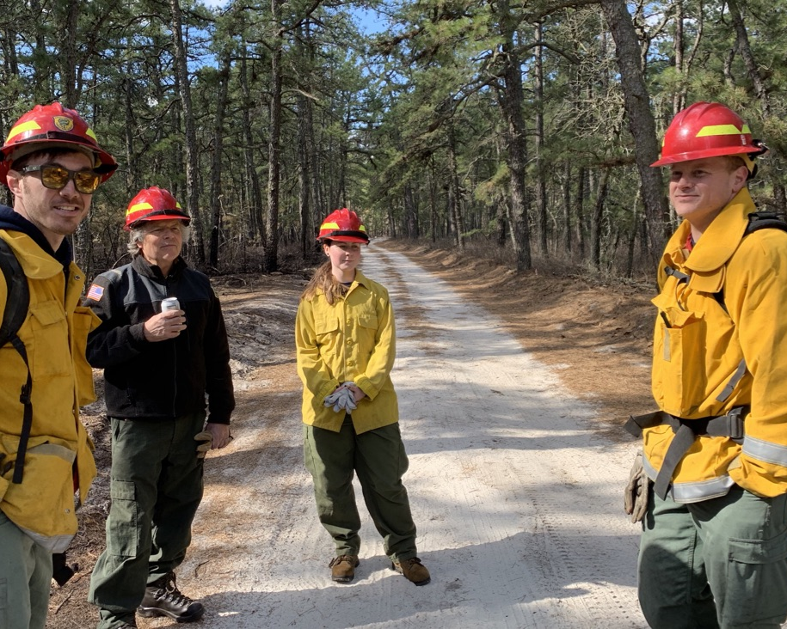
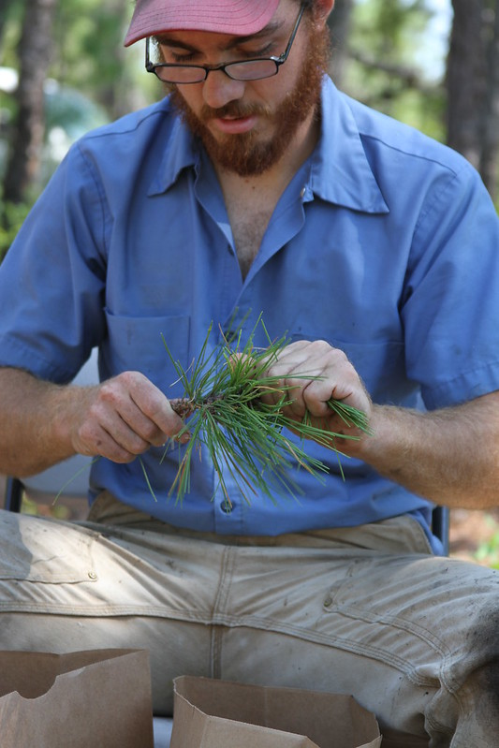
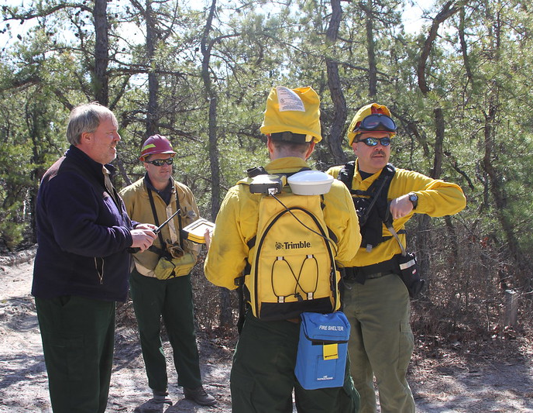
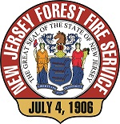
New Jersey Forest Fire Service Example
Connecting People
Identified those committed people with resources -open to new ideas
Can we work together?
How can we start on a small scale?
Start small – web grows
Notes:
Nick Skowronski- background in management/ moved to science while working with USFS as a tech.
Early on, they were coming in before and after a burn to gather data – but they were granted ACCESS and given information on the burn.
Yeah, sure you can go clip some bushes- no problem…but still a little hesitant.

Slide 6
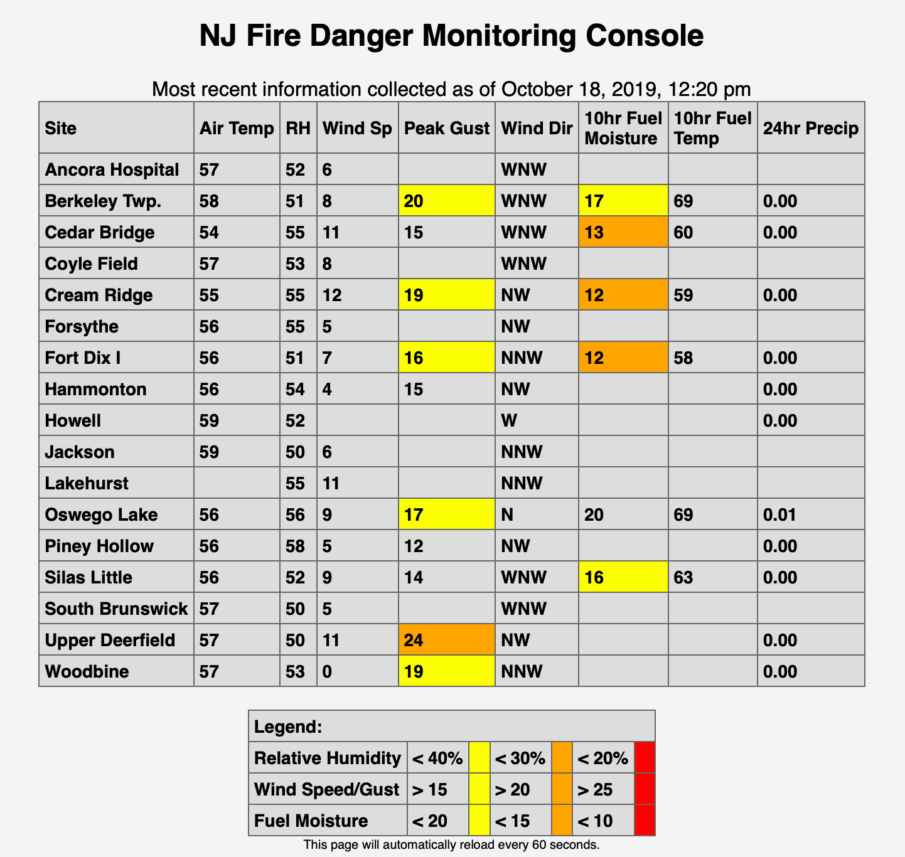
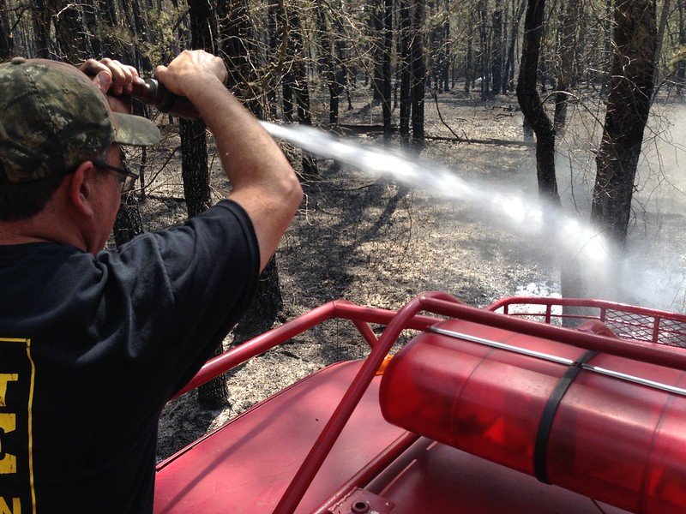
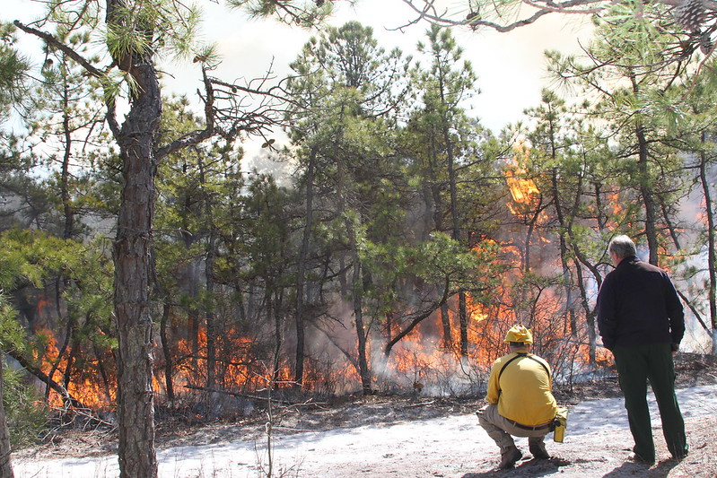
New Jersey Forest Fire Service Example
Establishing trust
Fill an immediate science need – Fire weather
Take S130/190, go burning, and respond to fire
Stop by and just talk about ideas with local fire wardens
Notes:
NJFFS was open to it, and that is also key. They welcomed us to see if it might help them.
Scientists are not managers, managers are not scientists and they usually don’t want to be. They chose to be what they are for a reason. It’s OK to be different, but understanding those differences is the key to successful communication and trust. Just make an effort. They’ll figure out something for you to do. Now they know that you know what their operational limitations are.
Formal and informal opportunities to get to know one another. Create opportunities for relationships to develop.

Slide 7
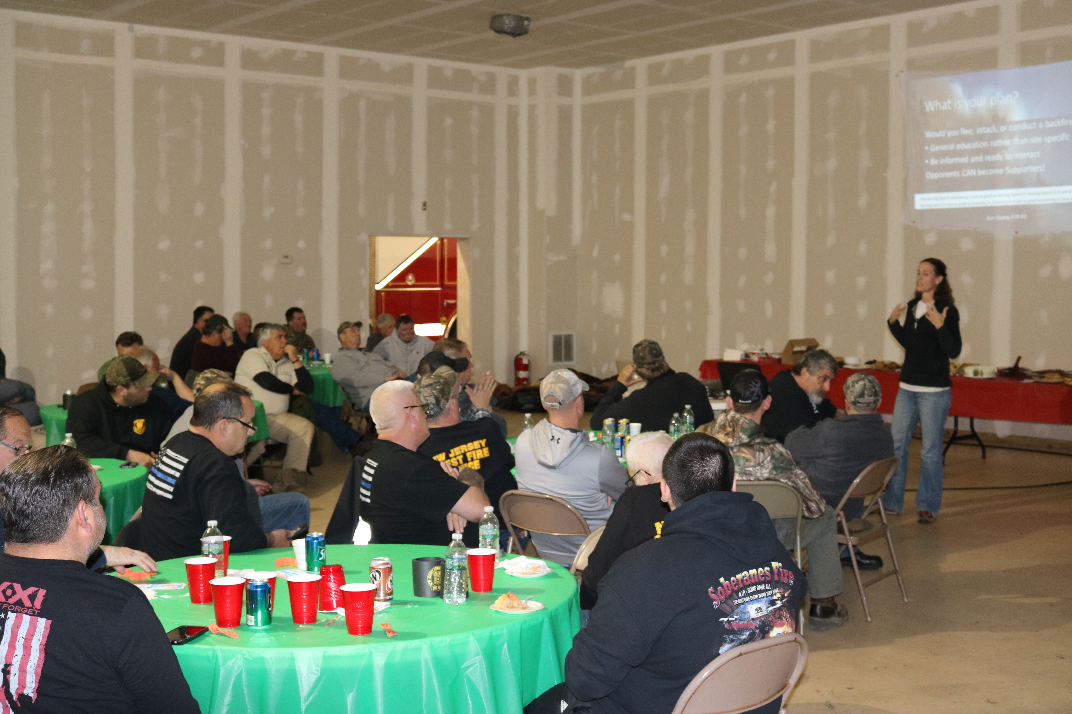
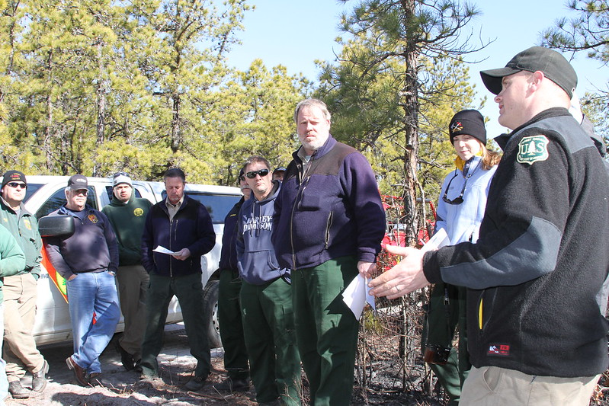
New Jersey Forest Fire Service Example
Disseminating information in an inclusive way
Making it to NJFFS events, presenting at Division meetings
Showing how the research fits in
Notes:
Go to them, ask questions, explain things, don’t just publish in academic journals.
Take time to talk about implications and what all of it could mean. Find people that can be translators.
Rinse and repeat for a few years.
Growth of trust and the growth of capacity.

Slide 8
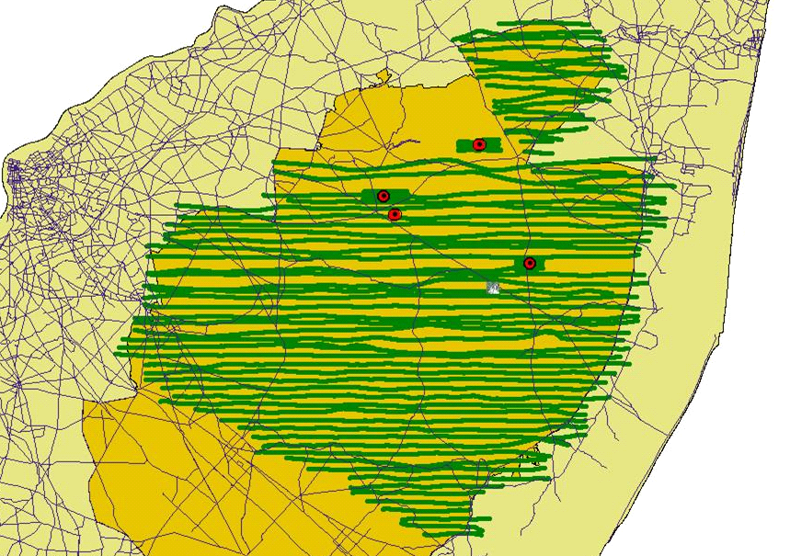
NJ Fire Science Blows UP! Collaborative Science at its best!
2007 Warren Grove bulk density - permitting
Smoke emissions (JFSP) planned RxB
Fuel treatment effectiveness (JFSP) specified ignition pattern
Embers (JFSP) 1000 acre catcher’s mitt created for out of season fire needed
SERDP (DoD) fire behavior and physics work – working together normalized

Slide 9
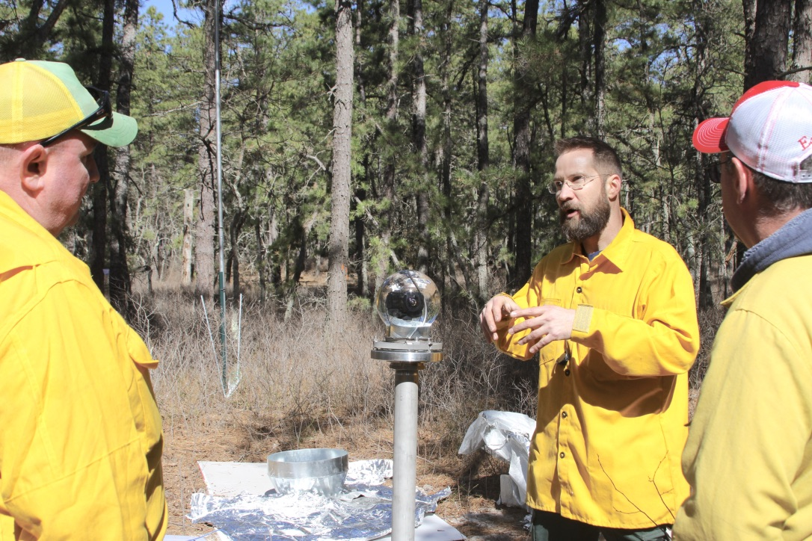
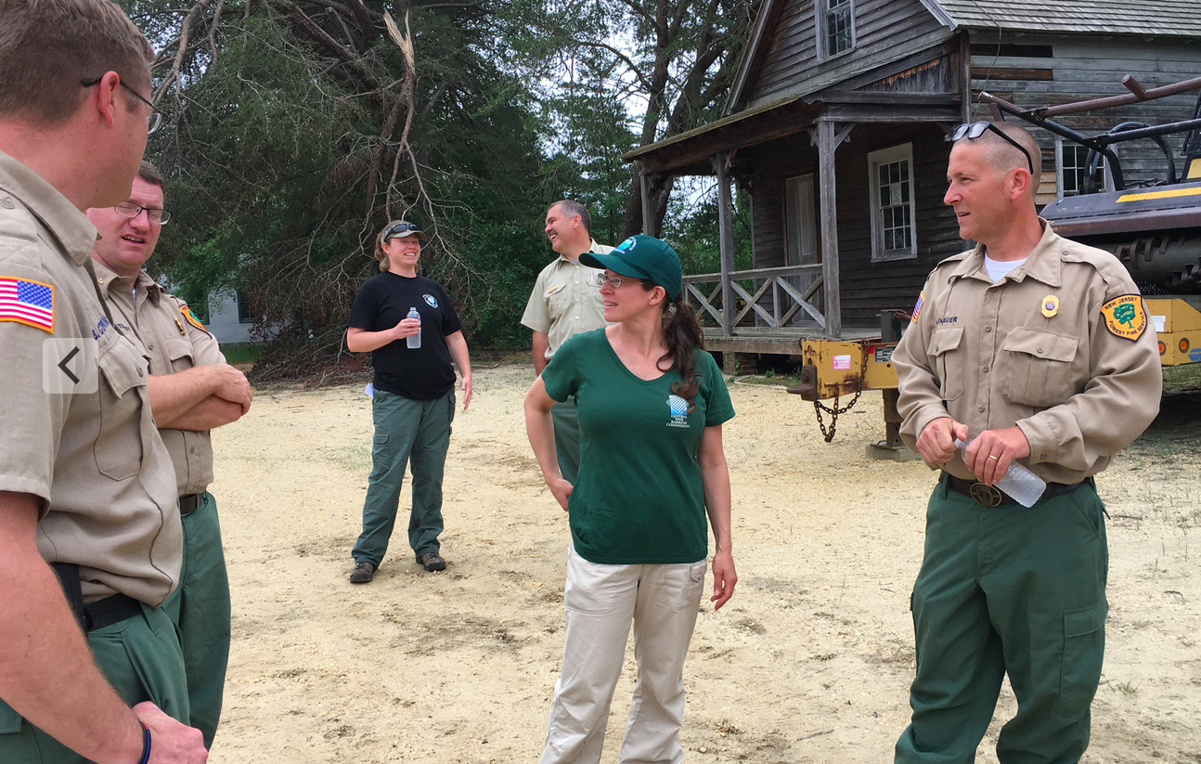
Other Benefits of this Co-production!
Research fires are attractive to other scientists.
Partnerships are attractive to funders.
Managers have specific questions that need to be answered.
Makes co-production easier in the future!
Notes:
NIST guy- amazing 360 degree video
Jumpstart ability for NJ to show Long Island, NY what they are up to in FAC learning exchange.
New questions eg, growing season burn data, tick data, more on emissions needed. Incorporating science and working with scientists into strategic plan and Rx fire legislation.
Start new projects on how this is even done on a collaborative level.

Slide 10
Landscape Impacts of Fire and Climate Change in the Southwest :
A Science-Management Partnership

Slide 11
The goals of this project were to:
Evaluate how fire regimes may shift due to changing climate across Southwest landscapes
Model the potential ecological impact of those changes with treatments, and
Establish ways that managers may address these impacts.

Slide 12
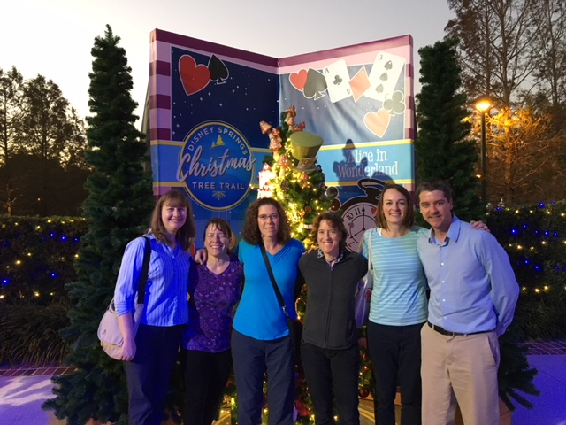
Team
Andi Thode, NAU (PI)
Anne Bradley, TNC
Windy Bunn, NPS
Zander Evans, FSG
Don Falk, UA
William Flatley, UCA
Pete Fule, NAU
Megan Friggens, RMRS
Dave Gori, TNC
Shaula Hedwall, USFWS
Robert Keane, RMRS
Rachel Loehman, USGS
Jack Triepke, USFS
Craig Wilcox, USFS
Larissa Yocom, USU
Notes:
Megan Friggens, RMRS
Dave Gori, TNC
Shaula Hedwall, USFWS
Robert Keane, RMRS
Rachel Loehman, USGS
Jack Triepke, USFS
Craig Wilcox, USFS
Larissa Yocom, USU

Slide 13
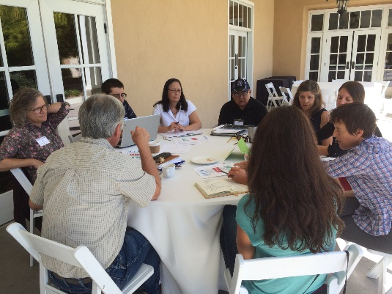
Definitely an experiment in co-production of science
Managers and scientists wrote the grant together
Managers and scientists were involved in every step of the project
Case studies of modeling and tools involved manager and scientist input and testing.
Final stage will test our fire-climate adaptation menu on a real USFS project.

Slide 14
Lessons Learned and Thoughts
Projects have more co-PIs, and thus more logistics
Hire a coordinator!
Different Perspectives allowed for improvements and re-iterations of work
Managers are working on the project as just another piece of their job on top of everything else
Managers change jobs!
Modeling inputs don’t always match what managers think are important
Scientists need publications

Slide 15
What is needed for co-production?
Training and opportunities for communication, facilitation and engagement (Cvitanovic et al 2016)
Incentives (rewards, recognition, support)
Organizations that promote communication between stakeholders (Fire Science Exchange Network and others)
Notes:
Have folks that understands both worlds or create that person – code-switching
individual competencies, such as facilitation, trust building, communication, stakeholder engagement, and knowledge broker’s skills can be acquired through formal or professional development trainings, as suggested by Cvitanovic et al. (2016).

Slide 16
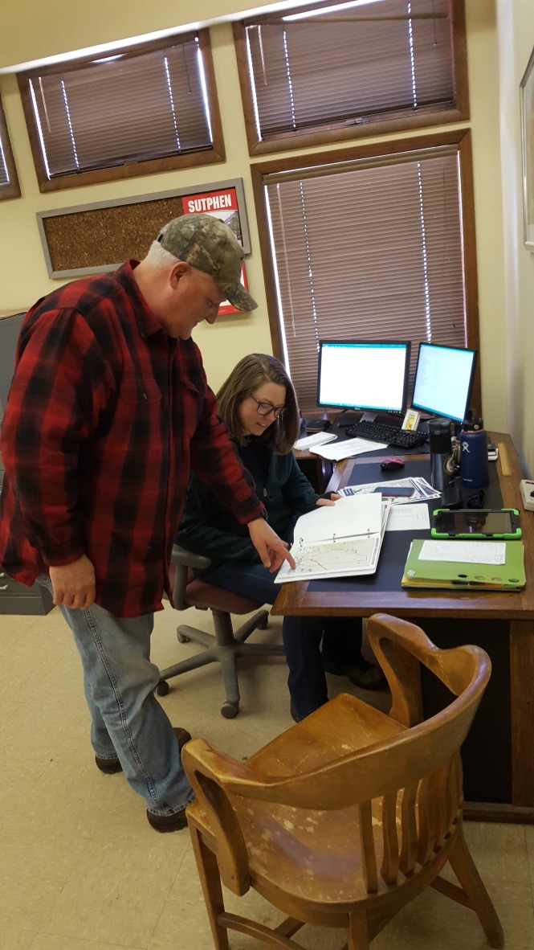
What does co-production of science do?
Increases understanding of complexity
Promotes social learning
Increases likelihood that the science will be used
Improves quality of decisions
Notes:
Different than ”regular science”

Slide 17
Burning Questions?
Photo: Mary Lata, Fire Ecologist

Slide 19
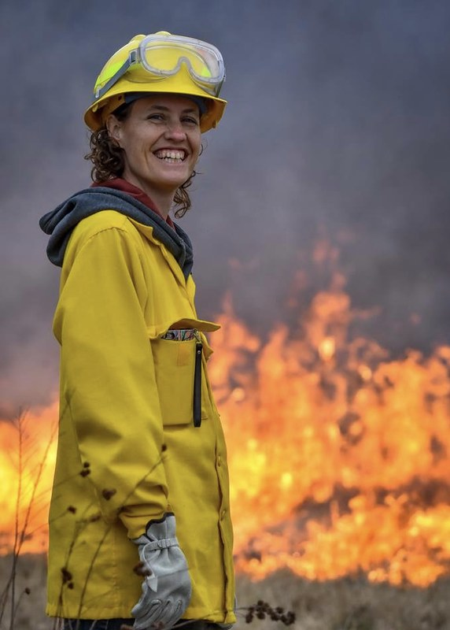
Thank you! Inga.lapuma@Rutgers.edu

