Slide 1
The JFSP Fire Science Exchange Network: Origin, Impact and Future Possibilities
Ed Brunson, Deputy Director
Joint Fire Science Program

Slide 2
Objectives
Provide an overview of the origin and history of the Fire Science Exchange Network
Impact of the FSEN on the wildland fire community
Future challenges and opportunities
Notes:
Three objectives for this presentation and discussion-
Overview
Detail on function and utility of the FSEN
Learn that the needs and issues are at the GACC and predictive service units- What science needs are there, how can the FSEN help meet those needs

Slide 3
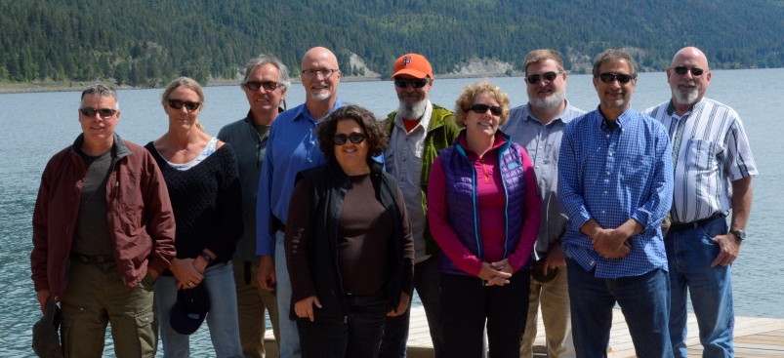
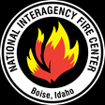
Joint Fire Science Program Background
Program office and Staff
based at NIFC in Boise, Idaho
JFSP Governing Board
Notes:
Established in 1998 (House Conf. Rep. 105–163)
Interagency funding - DOI & USFS ($12M to $14M annually)
Interagency Governing Board: 6 DOI and 6 USFS – thinking more Strategically with Program Office
Program office and staff are located in Boise at NIFC- hosted by the BLM

Slide 4
Joint Fire Science Program established in 1998
Fuels
Fire Behavior
Fire Ecology
Smoke
Human Dimensions
BAER
Notes:
1998- fuels, fire behavior, fire ecology. “Initial core”
2001- National Fire Plan- bump in funding and expanded research focus areas
Note- Coleen Haskell’s office on the Cascade Complex, 2007.

Slide 5
A Need for Science Delivery
A little history: the 2002 Program Review recommended more emphasis on Tech Transfer – ‘the last mile’.
Fuels
Fire Behavior
Fire Ecology
Smoke
Human
Dimensions
BAER
Translation of scientific and
technical information into
appropriate and usable
tools and products
Notes:
Science Delivery-
This started as an in-house program focused on tech transfer in the science disciplines of Fuels, Fire Behavior and Fire Ecology—later Smoke Science, Human dimensions and BAER were added. It is often in the last mile where Research to Operations delivery fails, in many fields of research—not just fire science. Our goal is to make sure agency-sponsored research is appropriate and usable for their issues and activities.

Slide 6
Fire Science Exchange Network
“Since 2009”
JFSP saw a need for increased distribution capacity
Established a nationwide network ‘Fire Science Exchange Network’
Better address regional concerns, closer
communication, build relationships.
FSEN Key Objectives:
Share information and build relationships.
List and describe existing research and synthesis information.
Identify and develop methods to assess the quality and applicability of research.
Demonstrate research on the
ground.
Support adaptive management.
Identify new research, synthesis, and validation needs
Notes:
2007 Program Review, highlighted that even with tech transfer in the Program Office, science was still not getting to the field. So-
JFSP responded to the 2007 Program Review by developing a primary science delivery tool: Fire Science Exchange Network (FSEN). Regional networks are better able to grow and develop with stakeholders, understand regional priorities and differences, have regular communication channels, and build relationships. Because it is such a substantial component of our program, we commit at least 25% of our total funds to Science Delivery including the FSEN. Here are the 6 Key Objectives for the FSEN network.

Slide 7
Connecting the Fire Management and Research Communities
Key characteristics
Boundary spanning partnerships End-user and science driven Active engagement
Translation of scientific and
technical information into
appropriate and usable
tools and products
Tool to connect managers to researchers and research results, (particularly recent research)
Currency- not just science in general, but emphasis on the most recent science
Notes:
So- This tool- the Fire Science Exchange Network- is there, national in scale and ready to engage with new partners.
Tool to connect managers (GACC and Predictive Services) to researchers and research results, (particularly recent research)
Currency- not just science, but the most recent science

Slide 8
Repeat
interactions seem to be key to achieving
co-production.
Mgmt Research Need
Mgmt Research Need
Mgmt Research Need
Mgmt Research Need
Investigation
Investigation
Investigation
Increasing communication
space
Notes:
Be sure to explain what JFSP means by “co-production”

Slide 9
Implementation of Science Delivery
Andi Thode, SW Fire Science Consortium
Alison York, Alaska Fire Science Consortium
David Godwin, Southern Fire Exchange
Stacey Sargent Frederick, California Fire Science Consortium
Notes:
Key characteristics of all the fire science exchanges is that they are boundary spanning (engaging science users and producers), are keyed to understand end-user science needs, and have active engagement.

Slide 10
Science Delivery Accomplishments
Participation
Primary Role of Consumers
FSEN participants by year and affiliation
JFSP 2017 Progress Report
From: UNR JFS Exchange Network 2018 Evaluation Report
From: UNR 2016 National Survey Evaluation of Processes and Impacts
Notes:
Who participates? Job type of individual participants (pie chart 2018 UNR survey) and the agencies/organizations they represent by year from 2013-2017, from JFSP 2017 Progress report.
This is the same professional sector that uses Predictive Service products!

Slide 11
Science Delivery Accomplishments
Face-to-Face Science Delivery in 2016-2017
12,000 Participants
>600 Field trips and consultations
Leadership Briefings - Inform decision-makers/obtain feedback
200 leadership briefings
1,100 decision-makers

Slide 12
Science Delivery Accomplishments
Activities
Social Media
Help Desk-
Who are the experts? Where to find resources? Problem solving

Slide 13
Does the Science Get Used?
Outputs vs.
Outcomes
Managers use fire science! Especially if:
Studies are relevant to fire, fuel, resource manager needs
They have been involved in the study question and design
Appropriate outreach has facilitated application of the science
“The fire community is very much a ‘I know you, I trust you community”
Source: Hunter, M.E. [JFSP Science Advisor] 2016. Outcomes of fire research: is science used? International Journal of Wildland Fire 25:495–504.
Notes:
2013 Program Review resulted in more emphasis on OUTCOMES (is science used in decision-making?). It’s not just about the OUTPUTS (Publications and Activities) it is about OUTCOMES, and that was focus of self-evaluation in 2018. Hard to measure, track capability of studies, user questionaires. That led to Hunter’s study published in IJWF April, 2016 (summarized with other evaluation in this Feb 2017 Fire Science Digest). Outputs vs. outcomes: short outcome would be gaining awareness where a longer term outcome would be changing a behavior or adoption of policy.

Slide 14
Actionable & Useable
The right methods at the appropriate time
•
•
•
•
•
•
•
•
•
•
Field tours Demonstration sites Workshops Conferences Networks of experts Webinars and training Research syntheses Fact sheets and briefs E-newsletters
Social media
Consider users needs, schedule, communication preferences.
The Joint Fire Science Program supports 15 regional Fire Science Exchanges to provide the most relevant, current wildland fire science information to federal, tribal, state, local, and private stakeholders within ecologically similar regions.
Notes:
science delivery is tailored to the users needs, schedule, and communication preferences, to make it actionable and usable.

Slide 15
Future Opportunities
Delivering wildland fire science to policy makers (national, regional, local)
Full spectrum, purposeful facilitation of co-produced and utilized wildland fire science
Workforce development
Notes:
Discuss national coverage, overlap with the GACCs, diversity in regional approach, expertise and connections to science and management.

Slide 16
Future Challenges

Slide 17
Contact Information
JFSP website: www.firescience.gov
FSEN contacts and Program information
Ed Brunson
Deputy Program Director, JFSP
ebrunson@blm.gov
208-387-5975
Notes:
Three objectives for this presentation and discussion-
Overview
Detail on function and utility of the FSEN
Learn that the needs and issues are at the GACC and predictive service units- What science needs are there, how can the FSEN help meet those needs

Slide 18
Notes:
Example of a Fire Science Exchange- (Lake States) hosting a webinar for a NWS Meteorologist to present to the fire and weather community in the lake States. As you can see, this interaction has been taking place for quite some time, depending on the region. This example is from 2012.

Slide 19
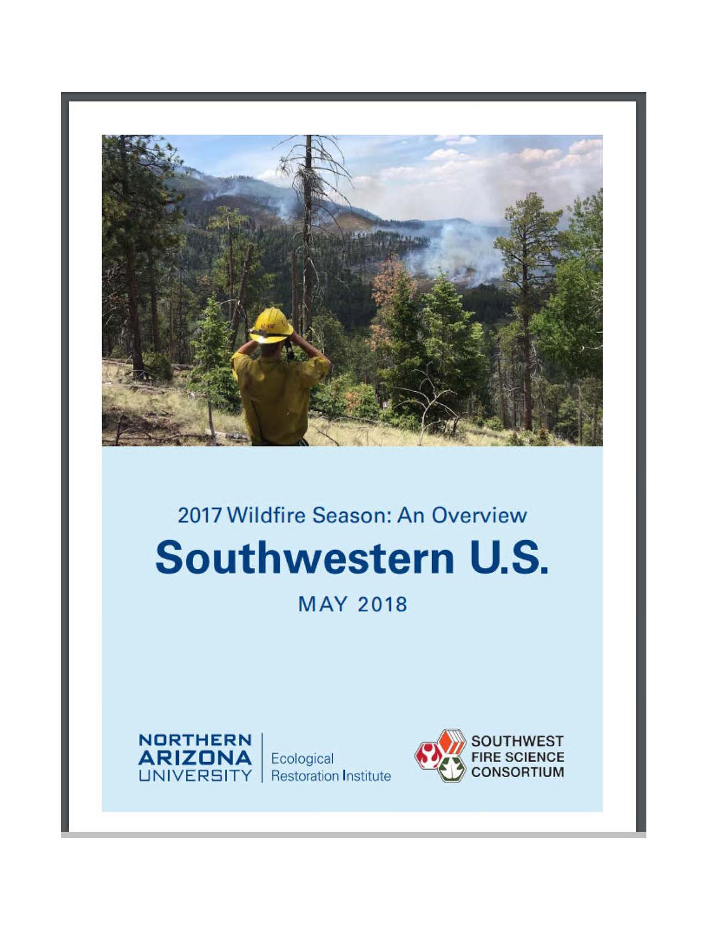
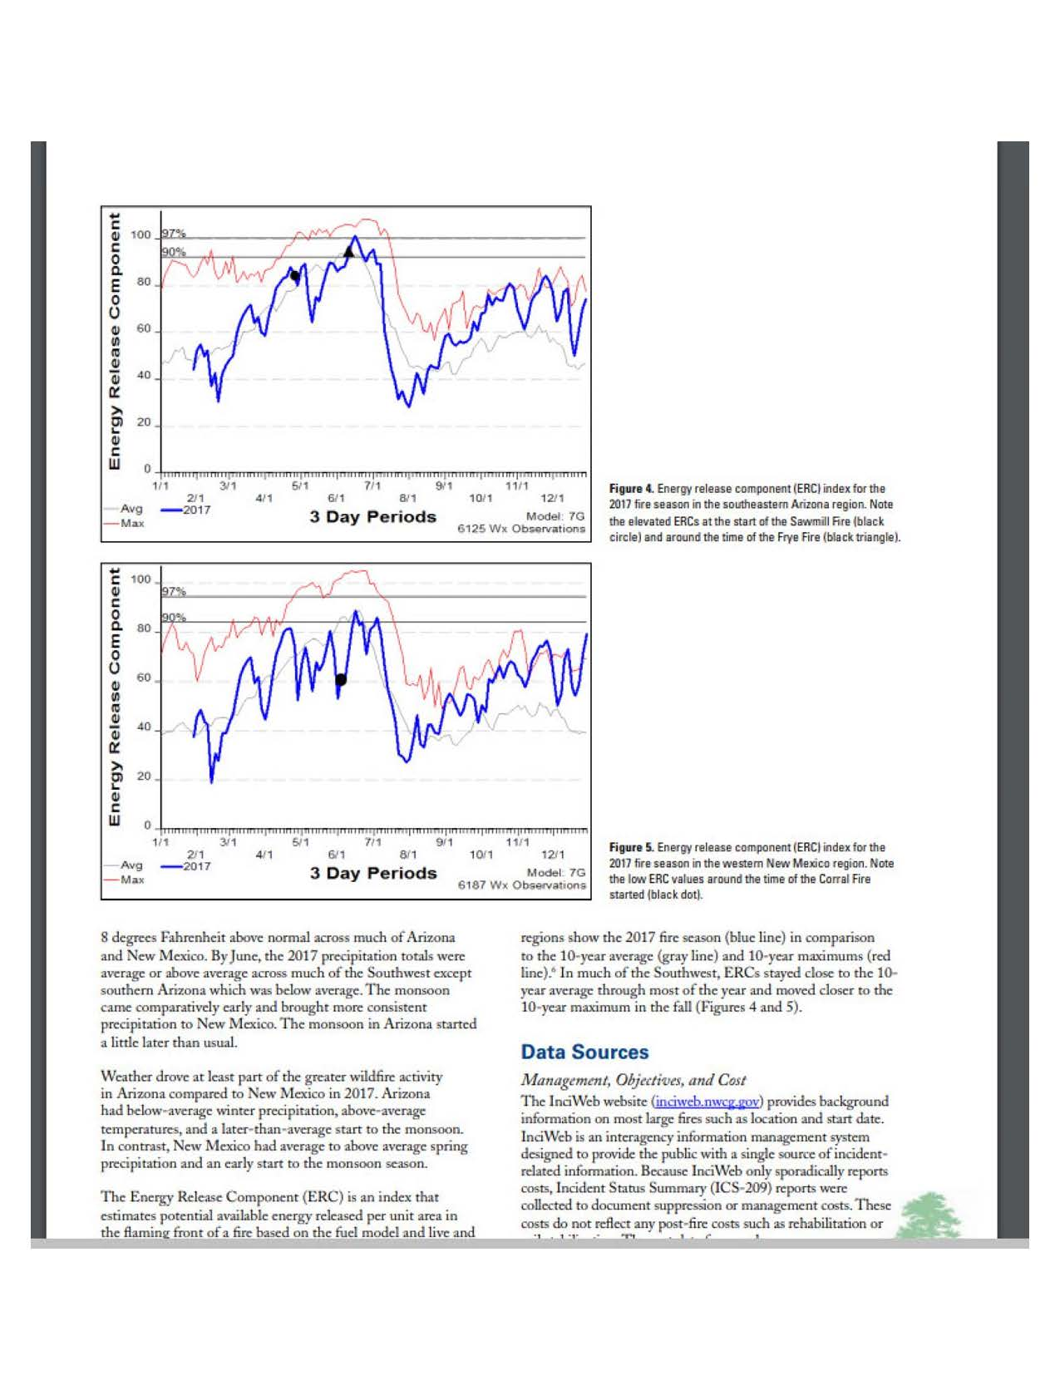
Publishing and Publicizing Fire Season Outlooks- an example from the SW

Slide 20
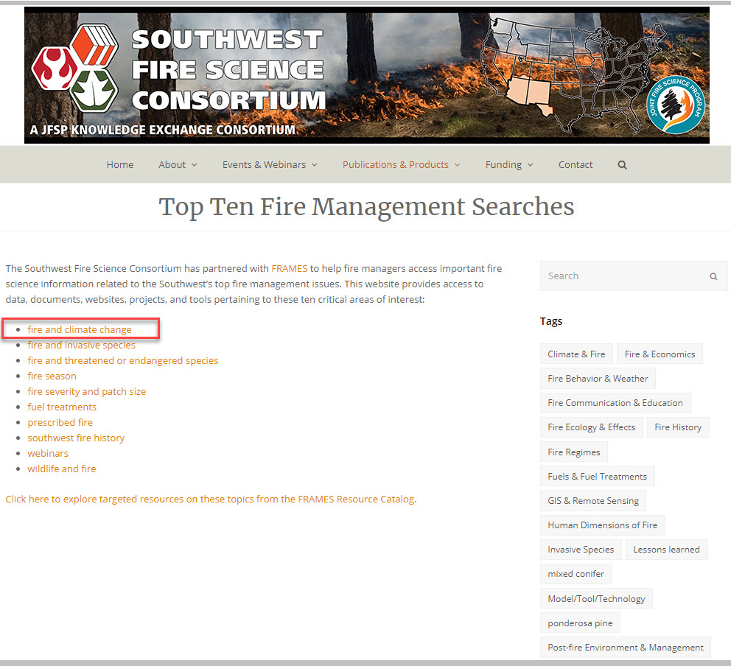

Slide 21
Notes:
Raising awareness of new tools is something that the FSEN can facilitate. This is an example of a webinar highlighting Web Based Fire Weather for the Lake States.

Slide 23
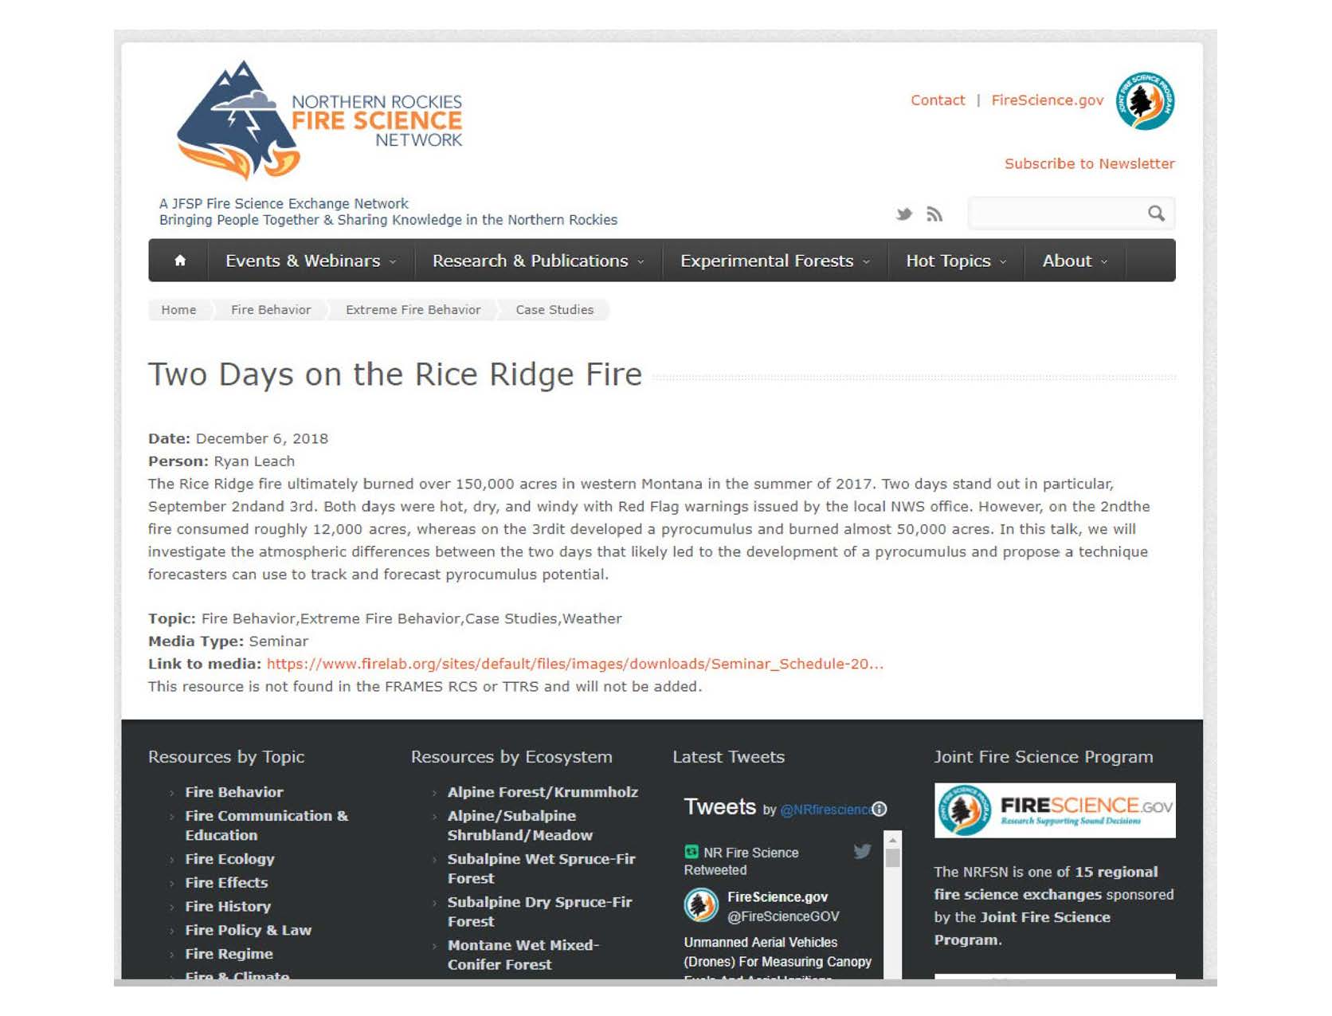
Notes:
Case study from the Northern Rockies- Fire Behavior, Extreme Fire Behavior and Fire Weather.

Slide 24
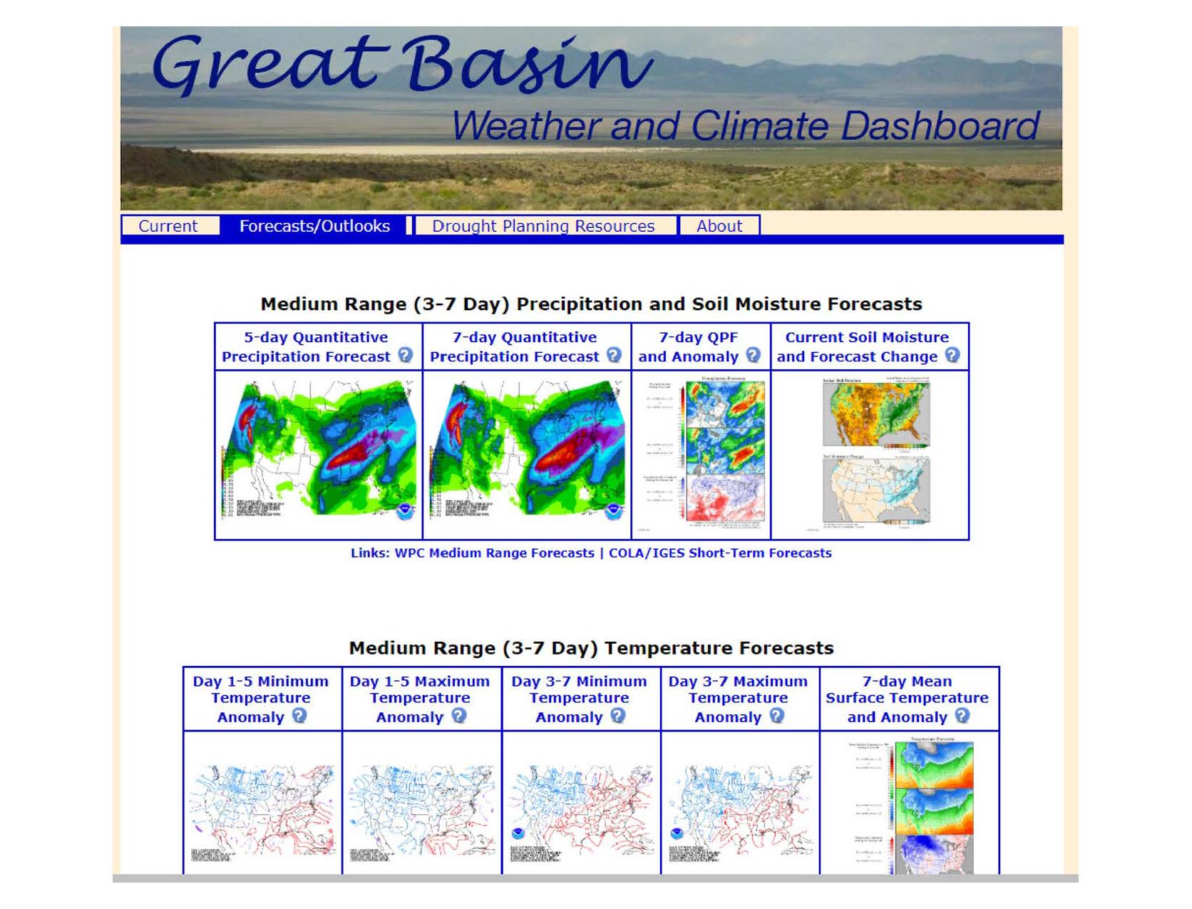

Slide 26
Discussion: how can we better serve your GACCs,
and build stronger partnerships?
Boundary Spanning = “a bridge between science & management”

Slide 27
Validating mesoscale, atmospheric boundary prediction models and tools
2017 Emerging Management Need suggested by the NWCG Fire Weather Subcommittee
Three projects funded in 2017, results will be available in 2020/21
Assessment of HRRR Model Forecasts of Convective Outflows in the Fire Environment- John Horel
Evaluating thunderstorm outflow boundaries in WRF-Fire- Katja Friedrich
Use of NWP Models to Identify Convective Outflows for Fire Weather Forecasting- Jordan Powers

Slide 28
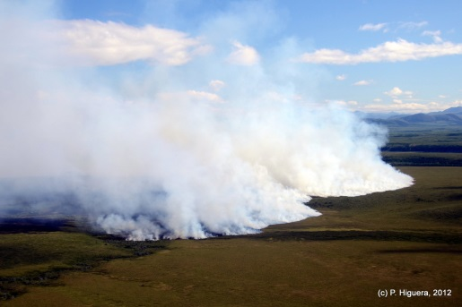
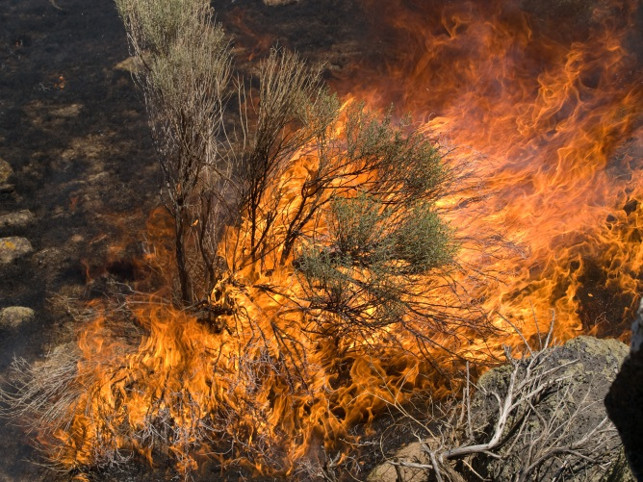
Research & Science Delivery
Research Areas
Long Term – Lines of Work
Short Term – Research Focus Areas
Emerging Management Needs
Science Delivery / Application
Fire Science Exchange Network
Smoke Management and Air Quality
Rangeland Fire Prevention, Management and Restoration
Notes:
Emerging management needs
Improved prediction of mesoscale winds
Factors affecting co-management of risk
Climate and fire interactions
Post-fire re-vegetation effectiveness
Delivery – FSEN Stakeholder roundtables & scientific workshops

Slide 29
How we’re connected:
All-Lands All-Hands
International Arctic Research
Alaska Wildfire Coordinating Group
Climate Research
and Outreach
Advisory Board
PNW FERA,
AirFire, RMRS, WF RD&A
Remote Sensing Research
Alaska Science Center
Notes:
Example from Alaska region:
AFSC location in the Intl Arctic Research Center gives them early access to new boreal climate, forest ecology, hydrology, remote sensing tech, and other relevant science, and grant opportunities to realize them. Their advisory board and recognized role with the AWFCG Research Committee keep them embedded in the wildfire community and accessible to agencies and individuals.
FRAMES keeps us online—new website powered by Drupal, managed to keep almost all our functionality.

Slide 30
Implementation of Science Delivery
– 15 “exchanges” form a collaborative network
Key characteristics
Boundary spanning partnerships End-user and science driven Active engagement
Translation of scientific and
technical information into
appropriate and usable
tools and products
Notes:
Key characteristics of all the fire science exchanges is that they are boundary spanning (engaging science users and producers), are keyed to understand end-user science needs, and have active engagement.

