Slide 1
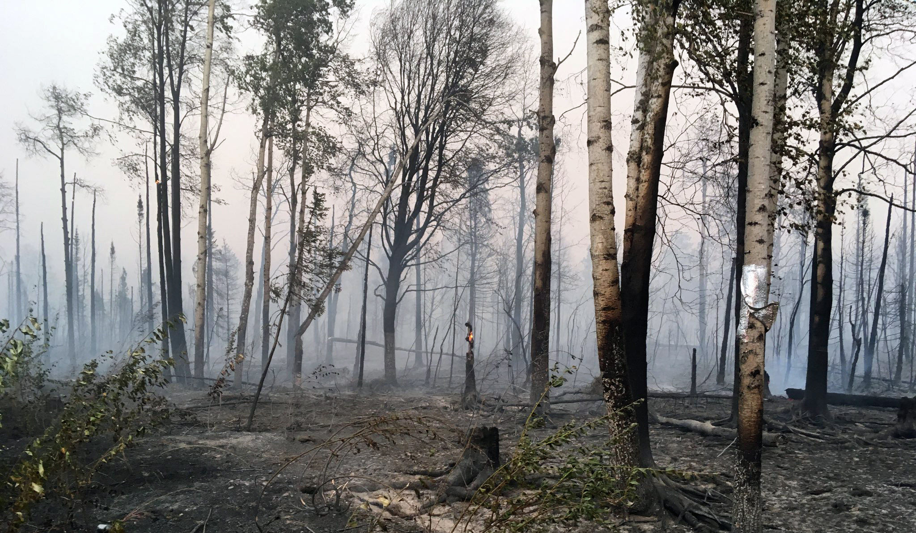
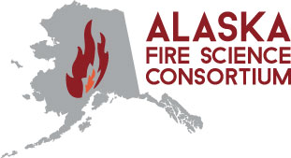
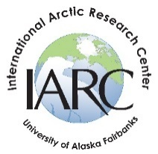
Why is Alaska’s ‘firescape’ so sensitive to warming climate?
Association of Fire
Ecology—Cultivating Pyrodiversity
Nov. 2019
McKinley Fire, 2019
Maureen Clark/Alaska Division of Forestry
Randi Jandt, Fire Ecologist
--with contributions by Peter Bieniek, UAF Research Meteorologist, and Eric Miller, BLM Fire Ecologist
Notes:
Would like to consider WHY, what makes boreal “firescape” sensitive to warming climate? I’ll review some of the recent data and literature, and colleagues are letting me share a couple of brand new findings that shed light on increasing boreal forest flammability.

Slide 2
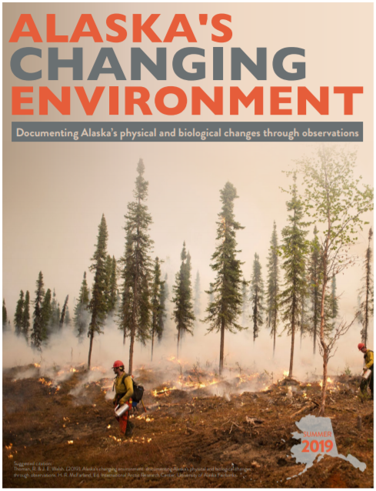
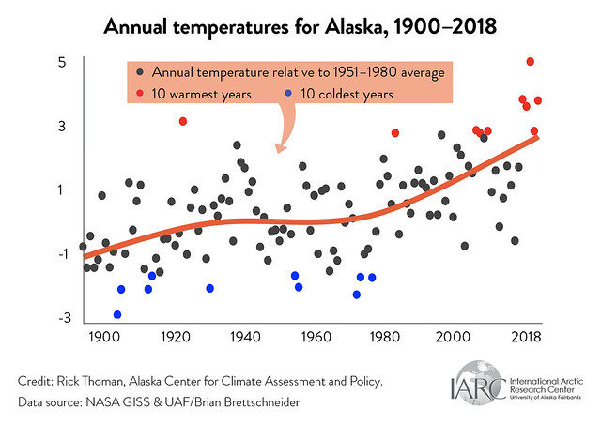
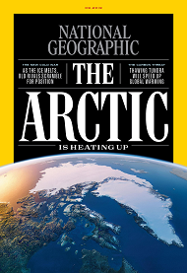
Alaska warming twice as fast as the rest of the country:
5 of 10 warmest years on record >
Growing seasons 30% longer (FAI), 38% (Kenai) longer since 1952.
Temperature Departure, ⁰F
AVG: + 4⁰ F
Winter: + 6.7⁰
in 60 yrs
https://uaf-iarc.org/our-work/alaskas-changing-environment/
Notes:
Average annual statewide temperature since 1900: rate of change not constant—4 of last 5 years record warm in AK and globally last 5 years warmest on record. Arctic amplification phenomenon. Check out Alaska’s Changing Environment. The average temperature across Alaska increased by 4 degrees Fahrenheit in the past 60 years, more than double the increase in the lower 48 states, and winter temperatures have gone up by almost 7 degrees in that same span. That data comes from the National Oceanic and Atmospheric Administration, which projects another 2 to 4 degree Fahrenheit increase by 2050.

Slide 3
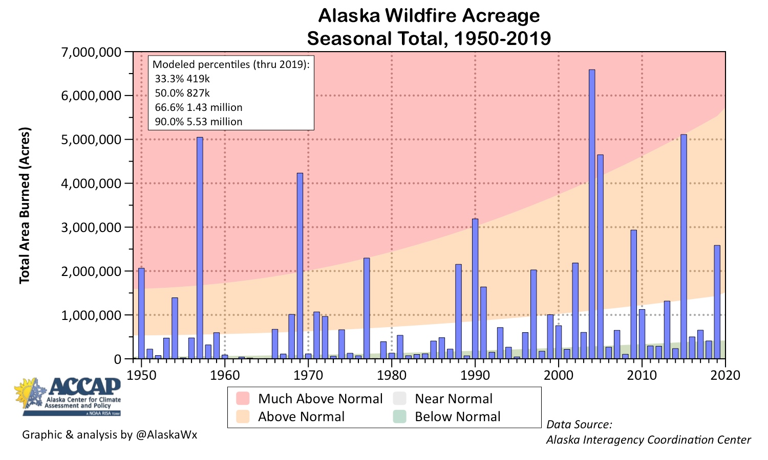
Frequency of large fire seasons up 2X since 1990
Notes:
Frequency of large fire seasons doubled since 1990. Actually have pretty good fire records for AK—recordkeeping has improved since 1980s when they began using more aircraft and computerized the records and again in the satellite era with more accurate maps (remember fires are often smaller when accurately mapped?). But as a 2nd line of evidence consider: where there’s smoke, there’s fire. FAI airport visibility impacts due to smoke tracks a very similar trend—zero impact days have disappeared in modern era.

Slide 4
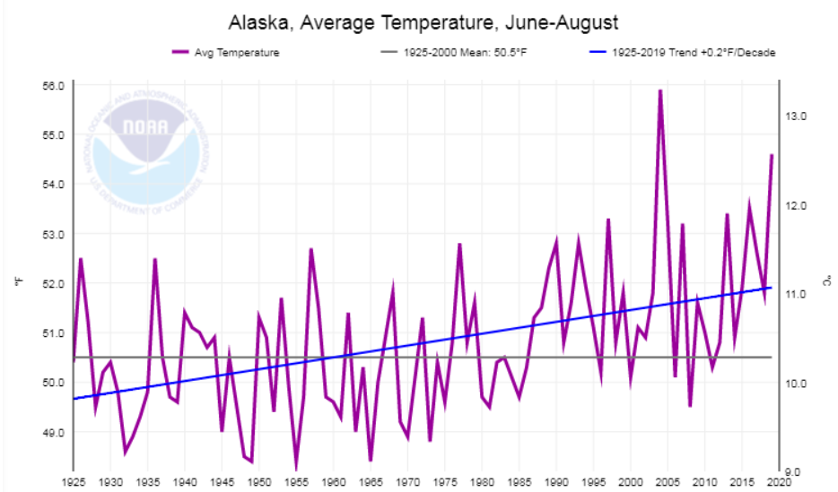
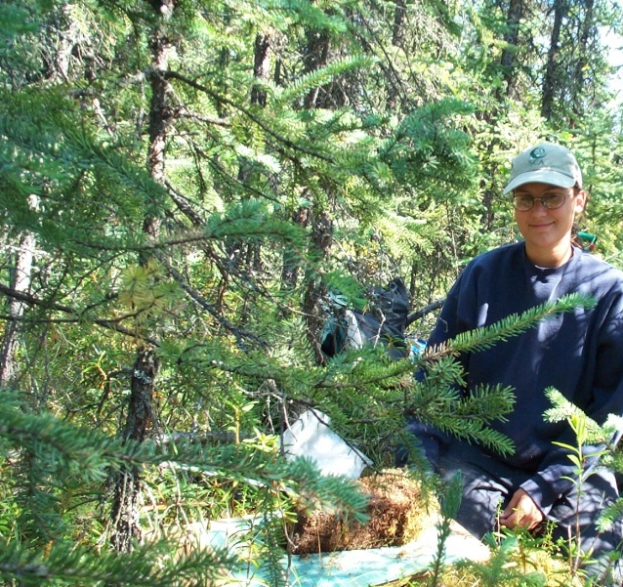
Boreal fire regime sensitive to T°--
1925-2019
https://www.ncdc.noaa.gov/cag/statewide/time-series/
Photo by R Jandt
Especially summer T°
Notes:
Summer T⁰s influence boreal fire regime most directly, and mostly due to forest floor characteristics. Layers of moss and moss duff comprise much of the surface fuel underlying boreal spruce forest.

Slide 5
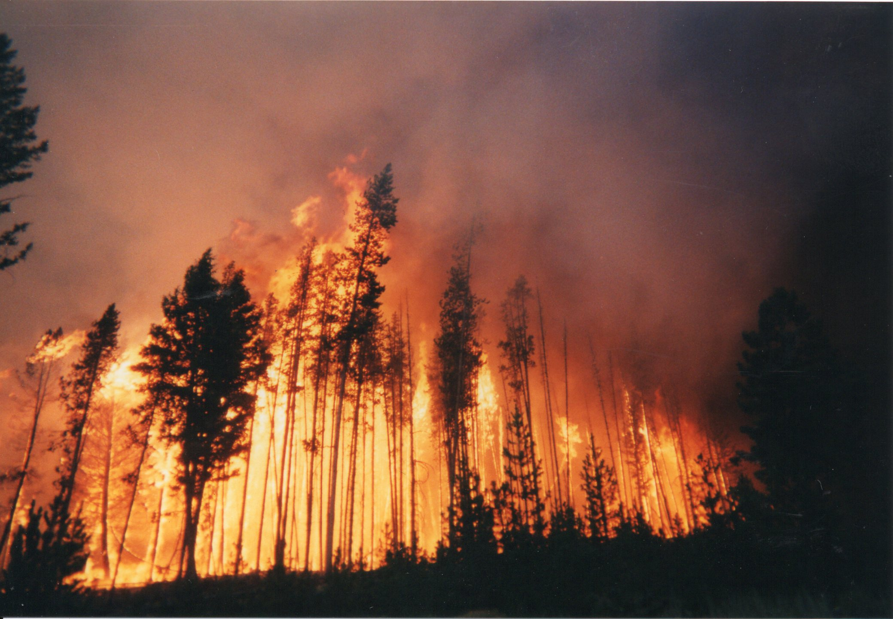
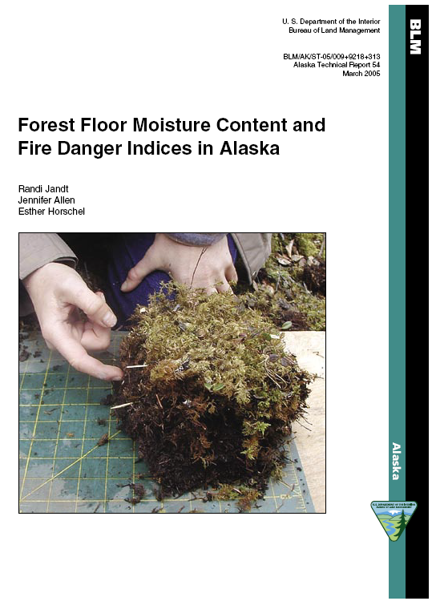
It’s the drying of the moss that determines fire danger
CFFDRS
25-50 T/ac in black spruce
Notes:
This is one reason Alaska uses the CFFDRS, which models fire danger based on the potential drying of these moss/organic soil layers. How many use or are conversant with FWI’s? Surface layers (down t o ~ 10 cm) of Moss duff responds faster to heat and 24 hrs/sunlight a day than the large woody slash of the western US—we do not need extended drought to have big fires. Fuel loading can be 25-50 tons/acre in typical black spruce stand.

Slide 6
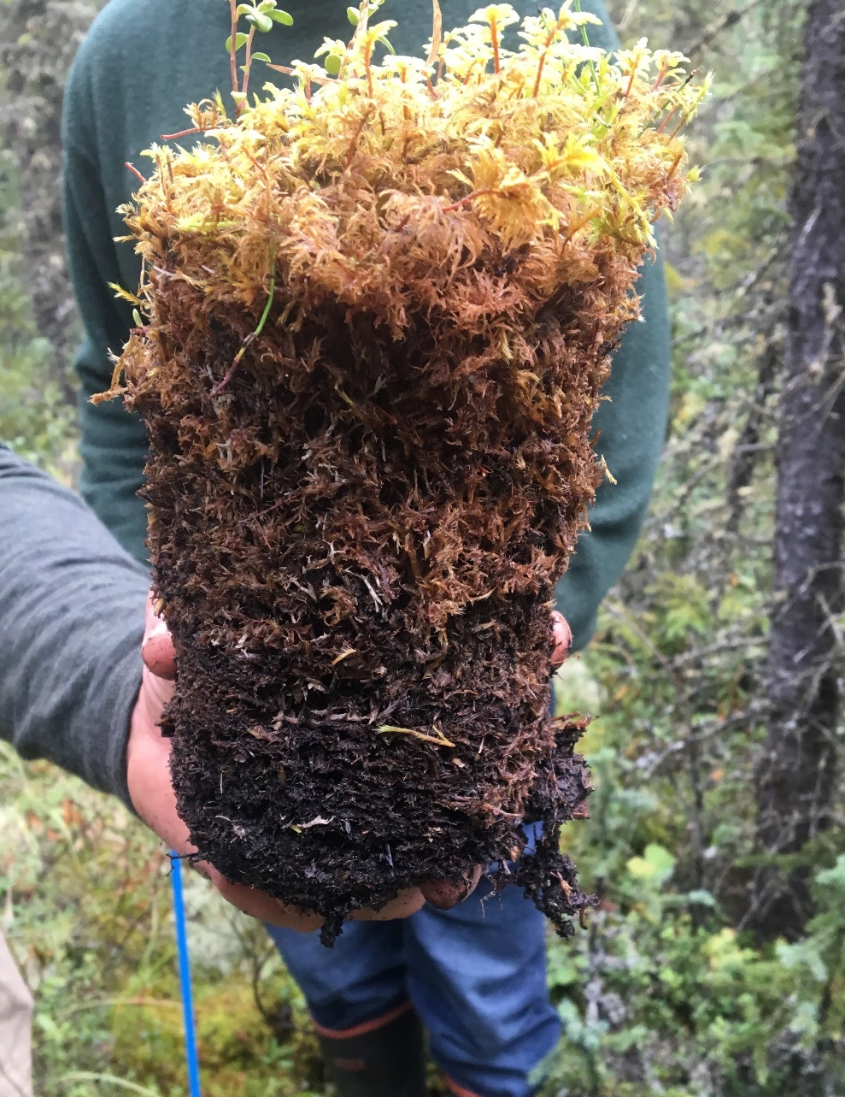
Properties of Feathermoss
Top layers have high Surface-to-Air Volume ratio;
Get moisture exclusively from atmosphere;
Behave more like a dead fuel although green.
DC equation (only) models evaporative drying in upper duff layer; but differs somewhat from drying trends observed in field sampling (Alaska)
Live Moss
--FFMC
Dead Moss
--DMC
Upper Duff
--DC
Lower Duff
Mineral Soil
Notes:
Miller (2010) Fuels with high Surface to Air Volume ratios respond quickly to atmospheric moisture. SAV of feathermosses is higher (possibly double) that of standard one-hour fuels (~1,200 to 2,200 m2/m3). The live moss (LM) layer is composed of green moss ~3 cm deep. It does not have a rhizoidal connection to substrate (like sphagnum, for example) so it is dependent of atmospheric MC and is virtually at equilibrium in drier atmospheric conditions: always behaves as if cured, more like a dead fuel than live. The structure of the dead moss (DM) layer resembles the live moss layer except it is brown and slightly more compact. The upper duff (UD) layer (used at the DC layer in Alaska) is light brown, often with white fungal material, and much more compact and decomposed. The lower duff (LD) layer is most often black, very dense, and sits on the inorganic mineral soil.
The Drought Code was developed in the late 1960s as part of the Canadian Forest Fire Danger Rating System to represent a deep column of soil that dries relatively slowly. Most indices/codes (incl. FFMC/DMC) operate on gravimetric moisture content and use a logarithmic drying equation, but the DC is based on a Potential Evaporation model that balances daily precipitation and evaporation in units of millimeters of water.

Slide 7
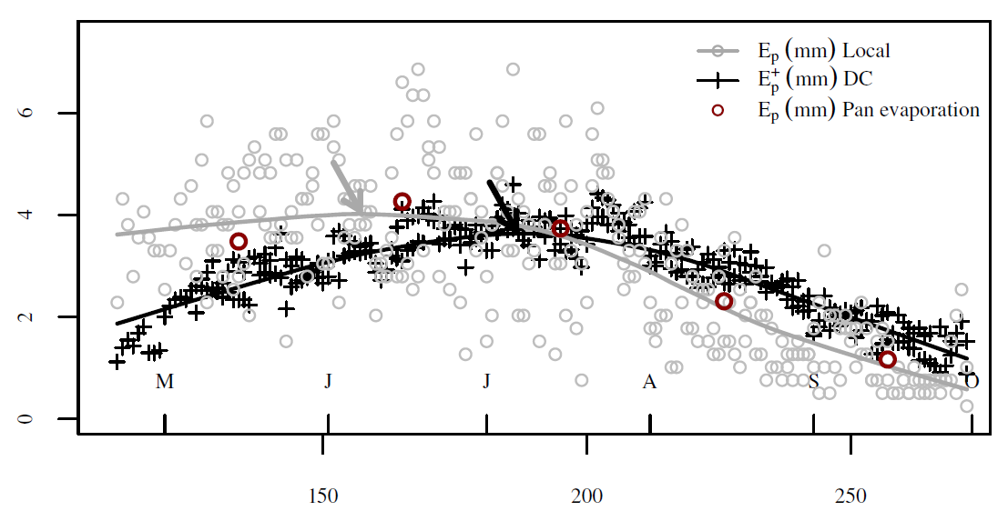
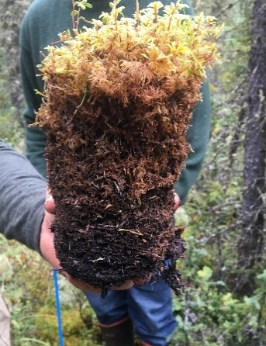
Compare Theoretical and Observed Drying Rates:
E_{p} or E⁺_{p}
(mm)
Calculated Potential Daily Evaporation in Fairbanks (“Local”)
DC index-Potential Daily Evaporation
Pan of water (Fairbanks)-measured Evaporation
Day of the Year (Julian Day)
Courtesy of Eric A. Miller, BLM-Alaska Fire Service
Notes:
Modeling the drying of this duff layer at 10 cm depth is important as and indicator of drought, deep burning (higher fire severity for us) and resistance to control. Miller (in prep.) created this comparison graph that shows Potential Daily Evaporation (using Fairbanks RAWS data)--GREY, and measured Evaporation in Fairbanks (Pan of Water, shown as average for each month)—RED, compared to the Potential Daily Evaporation modeled by the DC equation—BLACK. Evaporative potential is on the y-axis and Day-of-the-Year on the x-axis.

Slide 8
Compare Theoretical and Observed Drying Rates:
A simpler equation for DC has many advantages over the one in current use.
E_{p} or E⁺_{p}
(mm)
Potential evaporation in the DC algorithm compared to local estimates from Fairbanks, Alaska, for the 2015 and 2018 fire seasons with LOESS smoothing curves (span=50%). Mean monthly measurements of pan evaporation (1931-2005) for Fairbanks are also shown for reference.
Day of the Year (Julian Day)
Courtesy of Eric A. Miller, BLM-Alaska Fire Service
Notes:
Miller (in prep): concludes DC poorly represents daily evaporative potential in interior Alaska (is likely biased toward British Columbia, where equations were calibrated). Although Evaporative potential appears to peak in early June (June 7, grey arrow and red circle) the DC’s evaporative potential does not peak until a month later (July 7, black arrow) and remains substantially above realistic evaporative potential for most of the late summer. Field-measured moss MC trends validate this chart – for 20 years we have been finding that before summer solstice, DC underestimates the rate of moss drying in interior Alaska, while late in the summer DC’s tend to be unrealistically dry.

Slide 9
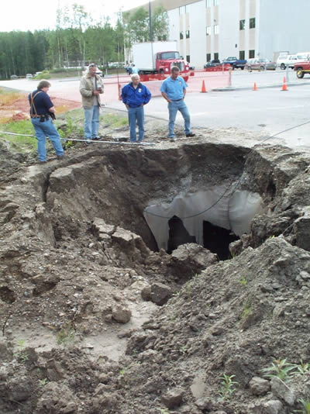
Vulnerability of permafrost: By 2100 Alaska may lose 25% of its permafrost.
Thermokarst near UAF-GI building Photo by V. Romanovsky
Notes:
Another factor to consider is subsurface warming: USGS projects AK may lose up to 25% of its permafrost by 2100. Pastick et al. 2016: From 2010 to 2050, projected NSP extents declined by 7%, 14%, and 12% under low, moderate, and severe emission scenarios, respectively. Why important to fire?
Thermokarst near UAF-GI building.

Slide 10
Absence of ice enhances drainage and drying of forest floor (and trees)
Jim Reardon (ret.) USFS Fire Lab in Missoula, MT gets ready to burn an Alaska duff sample in an experiment.
Notes:
With the ice layer gone, or deeper—moss duff layer can dry out fast. For example, when the seasonal frost boundary layer disappears (mid-June to mid-July depending on the site and spring rainfall) the MC of moss layers as measured in the field plunges rapidly.
Photo: Jim Reardon at Missoula Fire Lab getting ready to burn an Alaska duff plug.

Slide 11
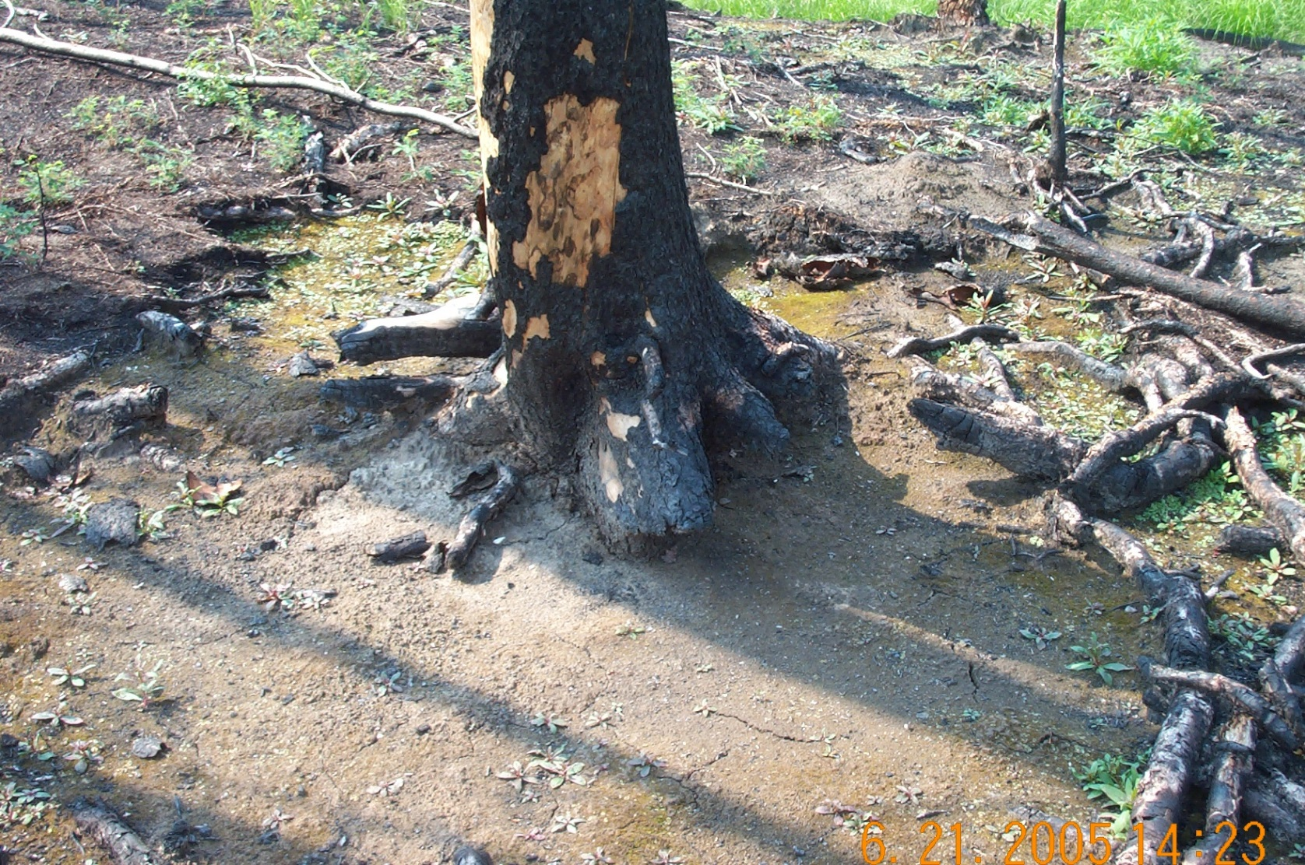
Deep drying of moss can lead to higher (soil) Burn Severity . . . which can in turn lead to more thaw . ..
Notes:
So loss of permafrost can lead to deeper burning (higher burn severity-on left-MM and RL showed good examples of this)—which itself can lead to more thawing (vicious cycle here). Forest floor live and dead compacted moss not only carries the fire, but also contains most of the biomass.
Fire-induced thaw: Recent studies by Michaelides (2019), Minsley (2016), Nossov-Brown have helped quantify these relationships in boreal forest while Iwahana (2016) and Jones (2016) have done so in Alaska tundra.

Slide 12
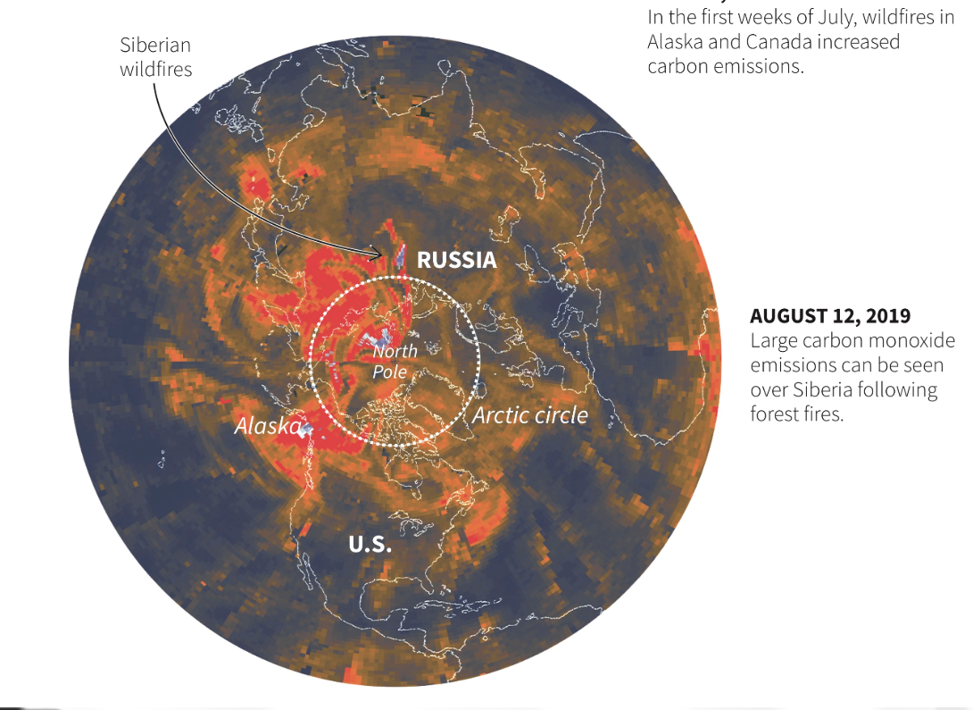
One Consequence of Deeper Drying—more smoke:
Wildfire Emissions (CO) in 2019
Source: Atmospheric Infrared sounder, NASA
Arctic Today., 9/11/2019. Y. Rosen
2010 “peatland” fires near Moscow caused an estimated 56,000 deaths and $15 B losses
Notes:
One consequence of deeper drying of moss fuelbeds is the potential for increased smoke emissions, by as much as 10x, due to biomass consumed. There are good recent studies quantifying emissions of “severe” i.e. deep-burning fires in AK and Canada but the contribution by other Arctic countries is largely undocumented (like Siberian fires this year). But they can be substantial, 56,000 deaths and $15 billion in losses attributed to smoke in Russia in 2010 (Loboda, 2019)

Slide 13
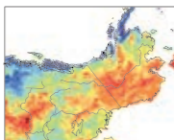
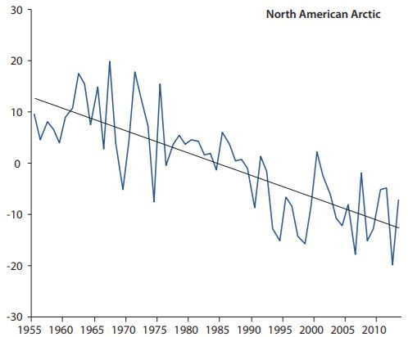
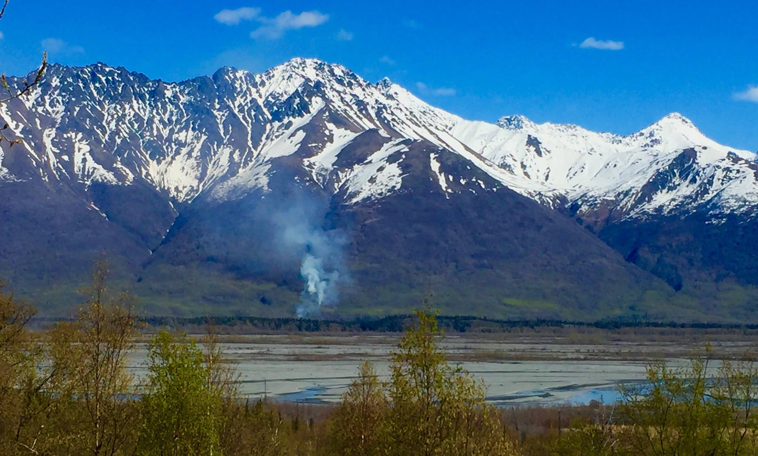
Longer Fire Season: Fewer Snow Cover Days
Brown, et al. 2017. Arctic Terrestrial Snow Cover. Fig 3.6: Trends in snow–free days 1980-2010 using satellite data
Source: Fig. 3.9 Ch. 3, Brown et al., SWIPA 2017.
+4-6
+2-4
-6-8 /decade
April 17th 2016—Fire jumped on Knik R near Palmer.
Photo Amy Breen, Researcher, UAF
Change in snow cover days/yr in N. American Arctic (66° N) 1951-2014
Interior & N Alaska have more snow-free days: average of 4 days decade.
Notes:
Annual snow-cover duration (SCD) is one way to quantify lengthening potential fire season and figures from Snow Water Ice and Permafrost show trends measured 2 different ways. Right: North American Arctic north of 66°N (anomalies with respect to a 1971–2000 reference period) from 20 climate stations. The trend over the period (-4.4 days per decade) is statistically significant at the 0.05 level. On the Left: using satellite data snow reconstructions to show trends in snow-cover duration (SCD) from Liston and Hiemstra (2011). Green/yellow colors are least change, 2 days more or less/decade while most of interior AK is at least orange—4-6 days/decade.

Slide 14
Future projections: more warm days
Number of days per year reaching 77°F (25°C) or higher.
Most burning occurs on just a few really warm days.
Almost no place with >10 days/yr
Many places with >30 days/yr
Fig. 6. Lader et al. 2017, Projections of 21st Century Climate Extremes for Alaska
Notes:
Most burning occurs on “extreme” days. The number of days above 77 deg per summer—the days that are key to drying out fuelbeds—is expected to more than double in the next couple decades and double again by the last decades of the century for FAI and many other places in the fire-prone interior. The statewide average is at the bottom right. This is expected to have a large impact on fire danger indices. (Uses GFDL climate model 3, RCP 8.5) Number of days reaching over 77 deg F (T_{max} > 25°C) per year averaged for successive 30-yr periods.

Slide 15
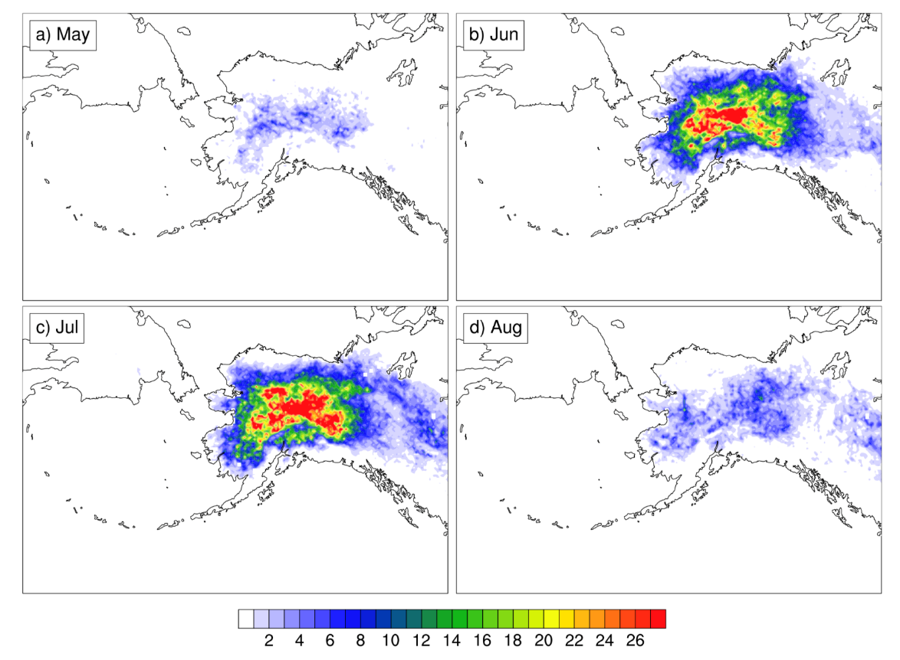
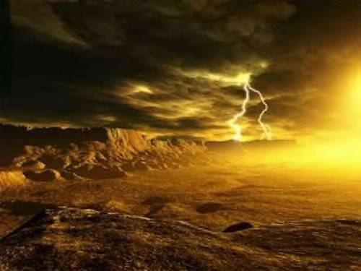
As Alaska warms, lightning season and geographic range could increase
The status quo:
Monthly average number of lightning strikes in each 20km grid box over 1986-2015 for (a) May, June, July and August.
Bieniek et al. 2019. (in review) Lightning variability in dynamically downscaled simulations of Alaska's present and future summer climate. Journal of Applied Meteorology & Climatology
Notes:
Currently, most lightning occurs in June and July, but as the summers warm we are seeing more convective lightning storms across a wider swath of the state, and extending more into spring and fall.

Slide 16
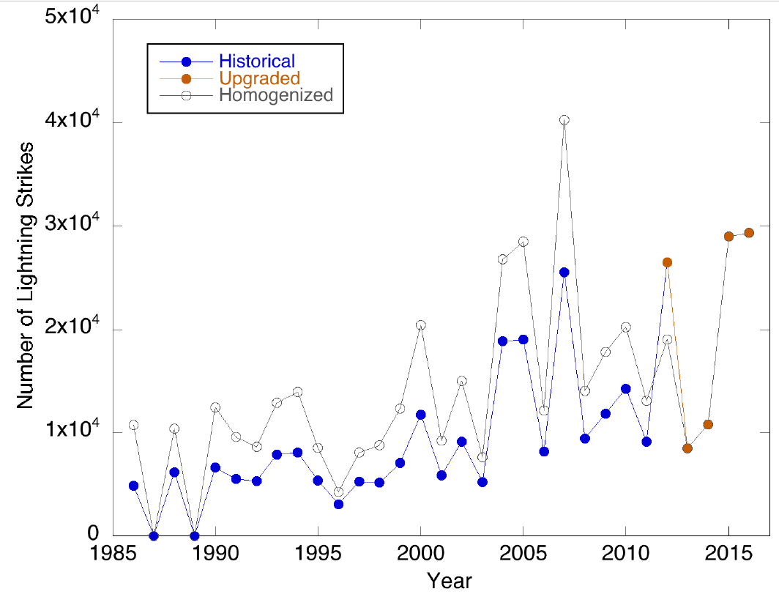
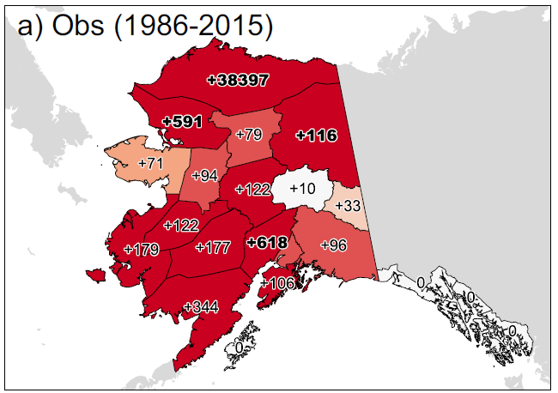
Is there evidence for increased lightning in AK with the observed warming?
May-August lightning strikes across Interior Alaska for the historical ALDS network (1986-2012, blue), the new upgraded sensor network (2012-2015, orange) and backcast of “corrected” historical strike counts (grey).
% change June/July lightning 1986-2015 w/ Theil-Sen trend estimators
(bold = p < 0.05)
Bieniek et al. 2019. (In Review) Lightning variability in dynamically downscaled simulations of Alaska's present and future summer climate. Journal of Applied Meteorology and Climatology
Notes:
Left: May-August counts of lightning strikes across the Interior for the historical network (1986-2012, blue), the new upgraded sensor network (2012-2015, red) and backcast of “corrected” historical homogenized strike counts (grey). Right: % change of June-July observed lightning 1986-2015 (using Theil-Sen trend estimator and Mann-Kendall--nonparametric). NE Alaska 2x, Noatak and Matanuska/Susitna 6x, N. Slope—ridiculous!
Bieniek et al. 2019. (In Press) Lightning variability in dynamically downscaled simulations of Alaska's present and future summer climate. Journal of Applied Meteorology and Climatology

Slide 17
Estimated change in burn area
Veraverbeke et al., 2017 Nature Climate Change
The present:
Then add 5° F
& 19 mm rain
By mid-century.
Notes:
Sander Veraverbeke--whose expertise is remote sensing and modeling—assembled a huge dataset of all satellite-detected hotspots in Alaska, all lightning strikes, etc. to predict the effect on annual area burned (shown here in percent) by mid-century. ( Veraverbeke et al. 2017)

Slide 18
Annual burn area would increase ~50% by 2050-2074
Lightning up 59%
Veraverbeke et al., 2017 Nature Climate Change
Burn Area up by 55% (or 46% with Fuels feedback)
Notes:
Projections on increased summer temperature from now to mid-century, under a business-as-usual climate scenario (RCP8.5), indicate an increase of 5 ⁰ F (2.85 ⁰ C), with 19mm more rainfall/yr, ¾ inch. Study predicted that would lead to 59% more lightning with a 78% jump in lighting-started wildfires, and increase burned area by half (55% or 46%) (Veraverbeke 2017). Just using regressions of ac burned in the past with temperature can give you much higher increases: 2-4X increases, but we feel there will be some feedback from conversion of the forest to younger stand types.

Slide 19
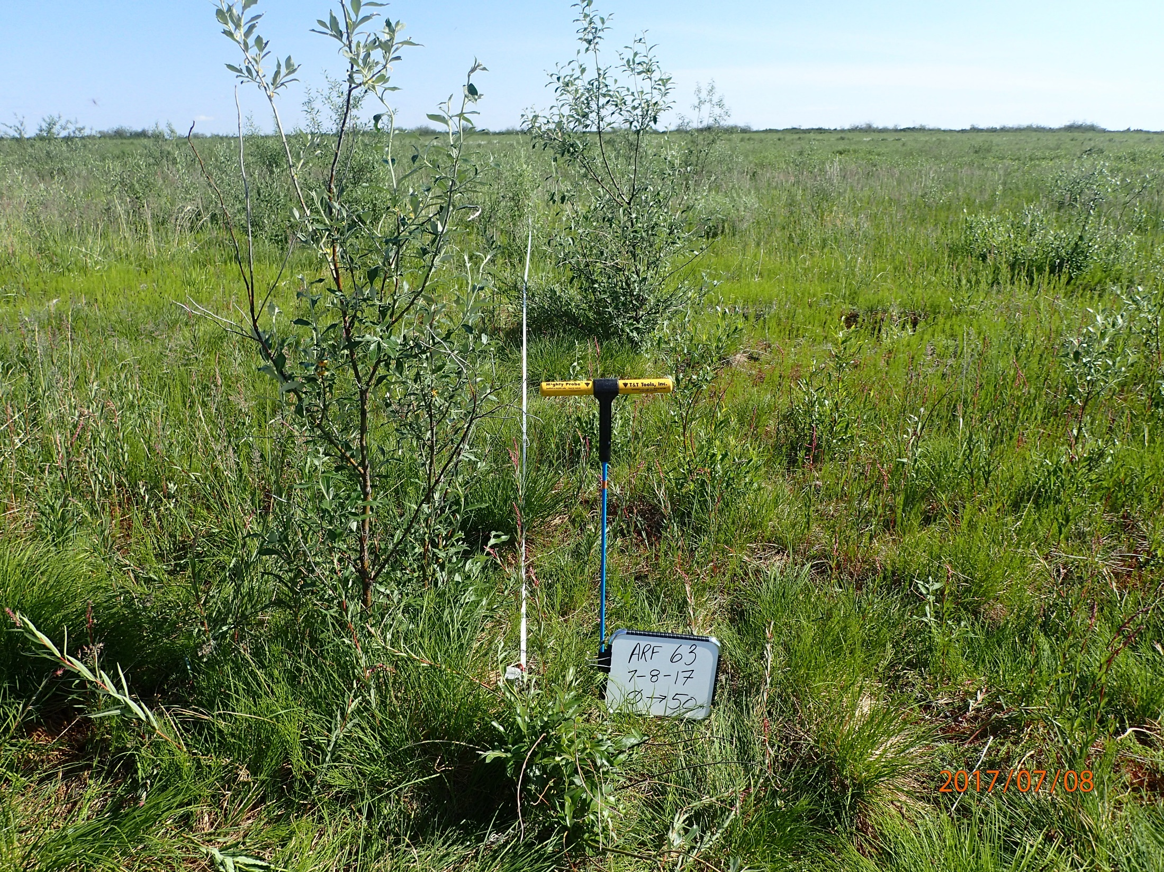
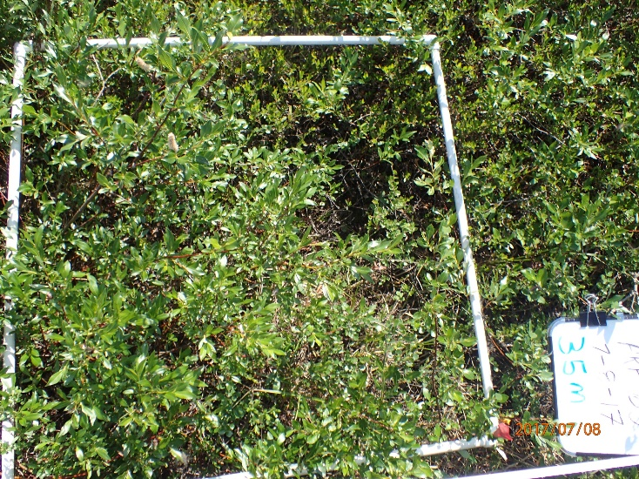
Fire/Fuel feedbacks: tundra fires could induce development of shrub fuels. Boreal fires could transform landscapes to less flammable hardwood stands.
Notes:
For example, at 10-year-old North Slope tundra burn; Fire/Fuel feedbacks: tundra fires could induce development of shrub fuels. Boreal fires could transform landscapes to less flammable hardwood stands.

Slide 20
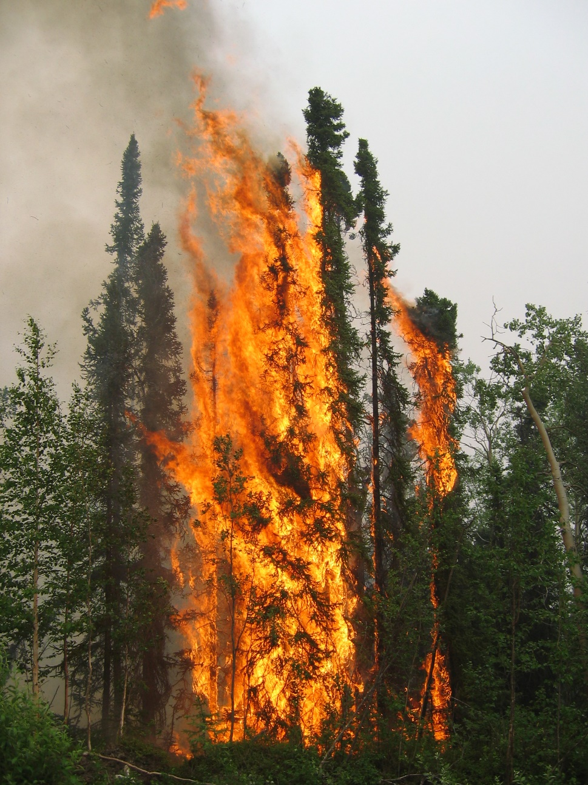
Questions?
Acknowledgements: Joint Fire Science Program, UAF International Arctic Research Center, BLM Alaska Fire Service
CONCLUSIONS:
Layers of moss that comprise much of the surface fuel underlying boreal spruce forest have unique characteristics that amplify flammability rapidly in a warming climate.
Weather patterns that favor convective storm development, trend increasing very warm summer days, longer growing seasons, and subsurface changes due to warming permafrost all contribute to fire season severity in Alaska.
rjandt@alaska.edu
Thank you!

Slide 22
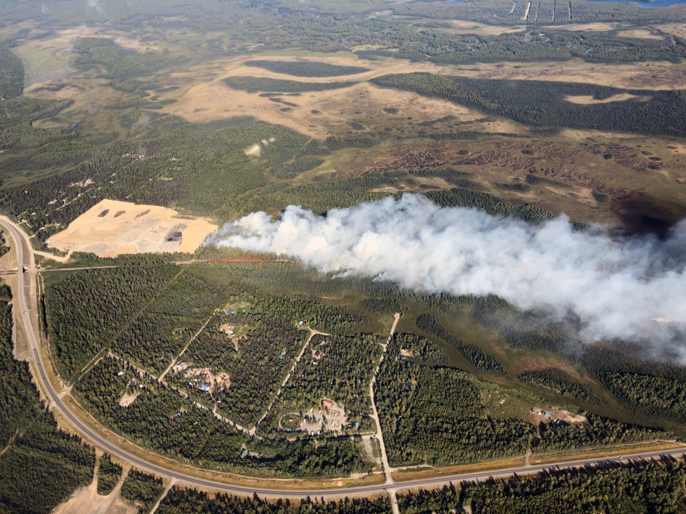
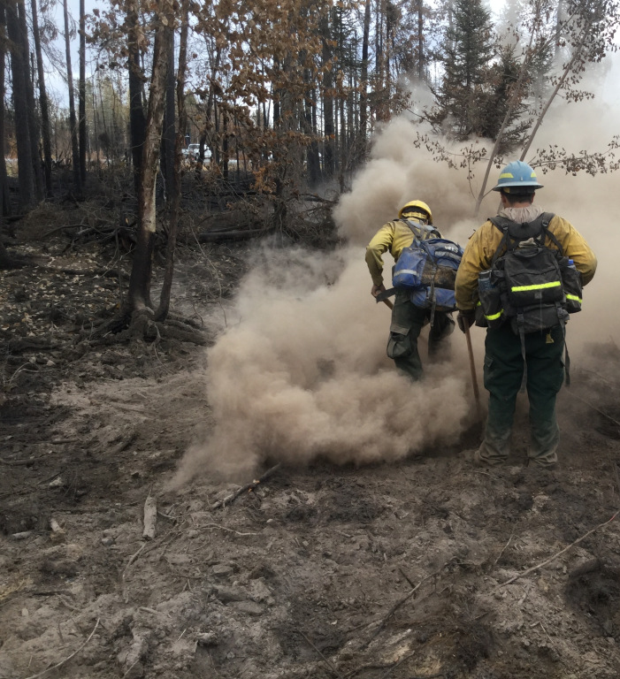
Adaptation Strategies: Tactical suppression strategy—more point protection
McKinley Fire, Aug 17, 2019
Photo: Alaska Division of Forestry
McKinley Fire ash pits, 2019
Photo: Bruce Giersdorf
Notes:
Firefighters mopping up in the deep ash pits on McKinley Fire. Photo credit: Bruce Giersdorf

Slide 23
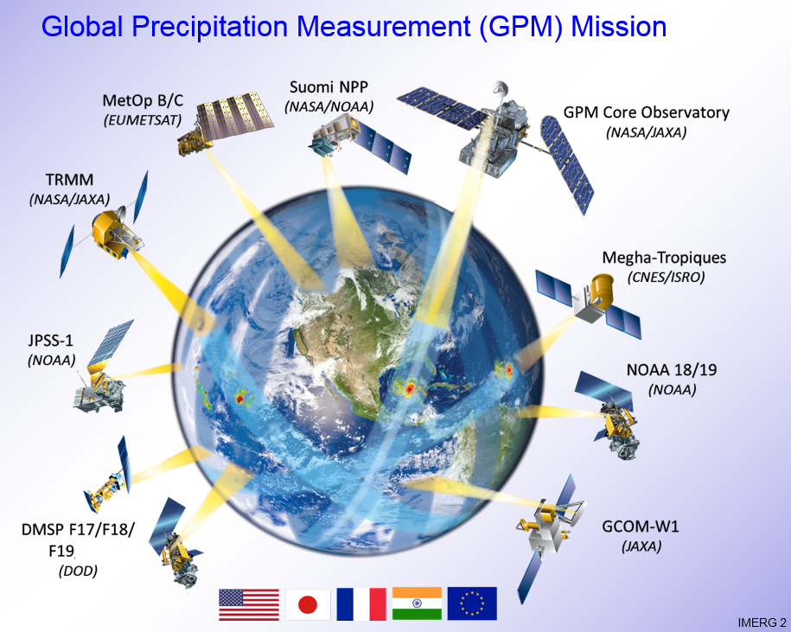
Fire suppression efficiencies— adoption of new technologies
Notes:
Drones receiving a lot of press, working with NASA, NOAA, NSF, MesoWest, many angles to improve forecasting, prediction capability, detection and monitoring, and operations.

Slide 24
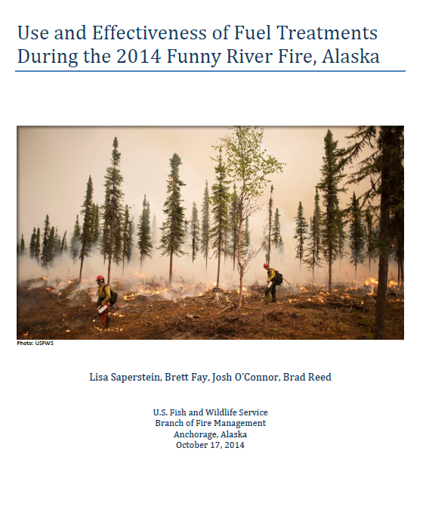
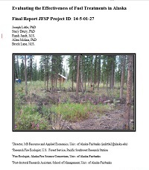
Fuel treatments
Pile burning Sterling Fuel Break
Photo: USFWS Kenai NWR
Notes:
Primarily stand scale treatments at cabin-neighborhood-village scale. Few landscape treatments.

Slide 25
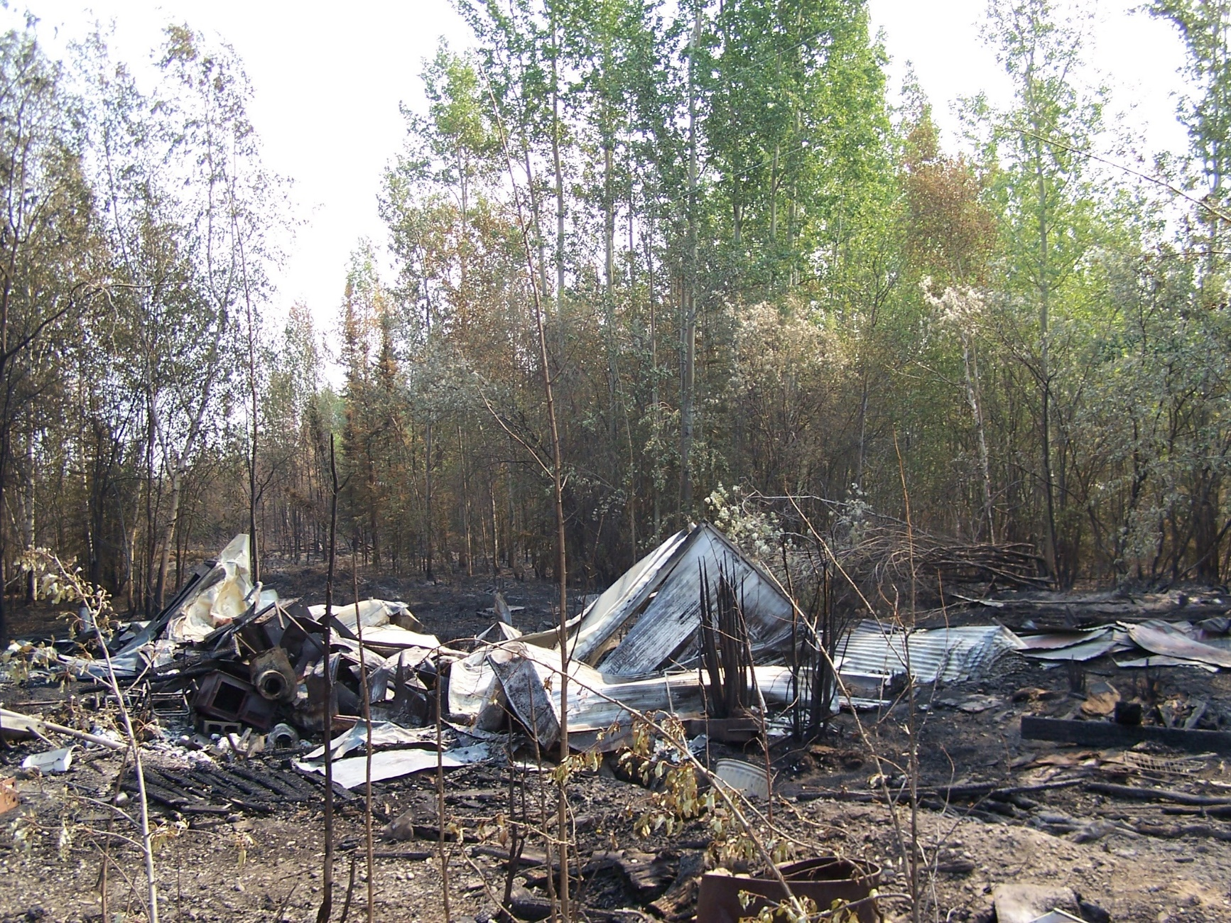
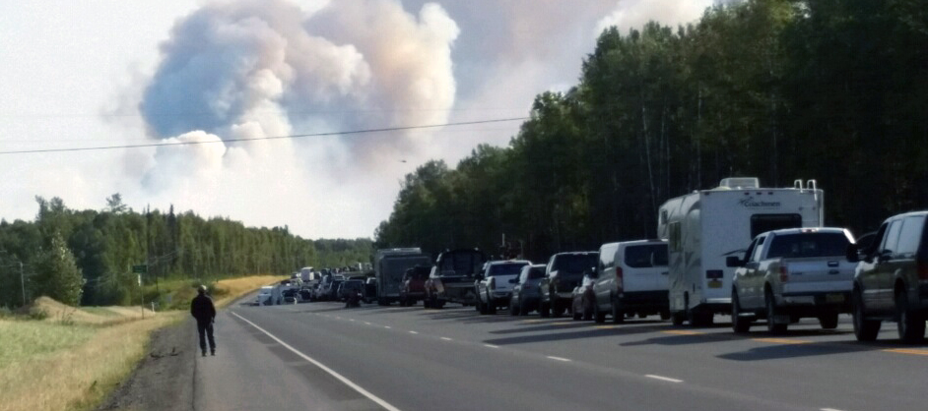
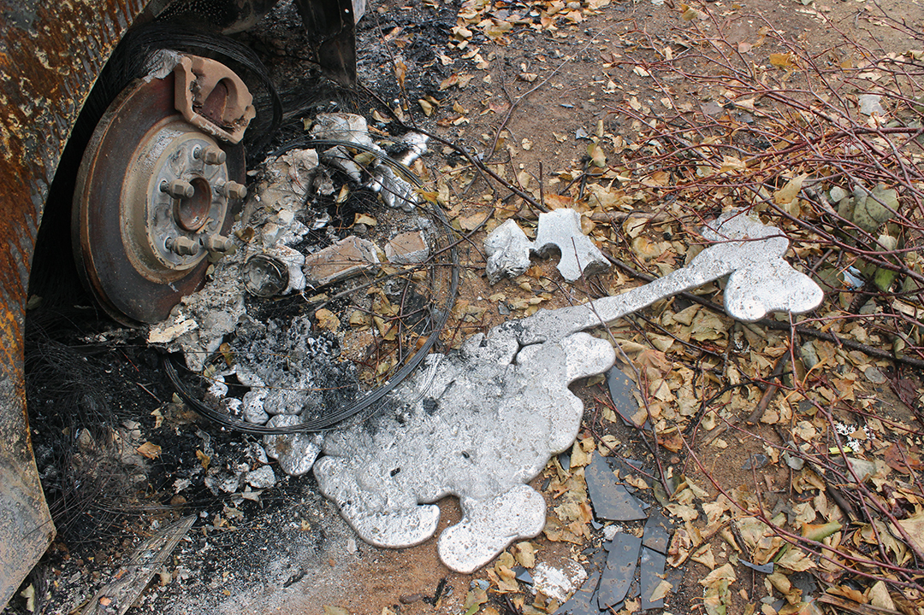
Pre-fire planning and preparation of communities
McKinley Fire 8/18, 2019
Photos: Alaska Div. Forestry
Remains of trailer home after wildfire
Photo: A. Kohley

