Slide 1
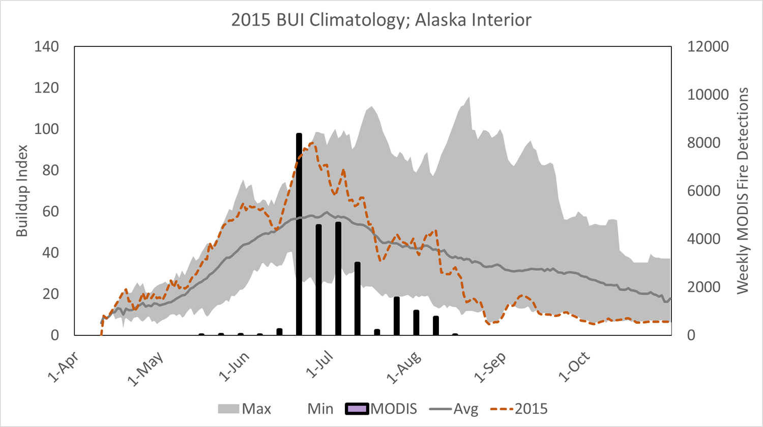
Representing our
Current and Future Situation
Using Climatological Reference with our fire history
Surface Observations vs Gridded (modeled) weather
Improving Reanalysis Climatology

Slide 2
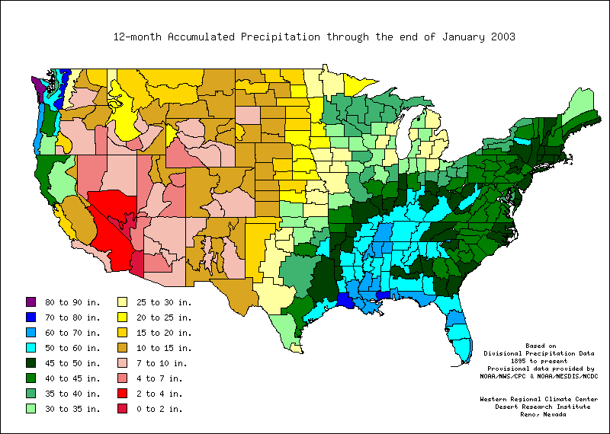
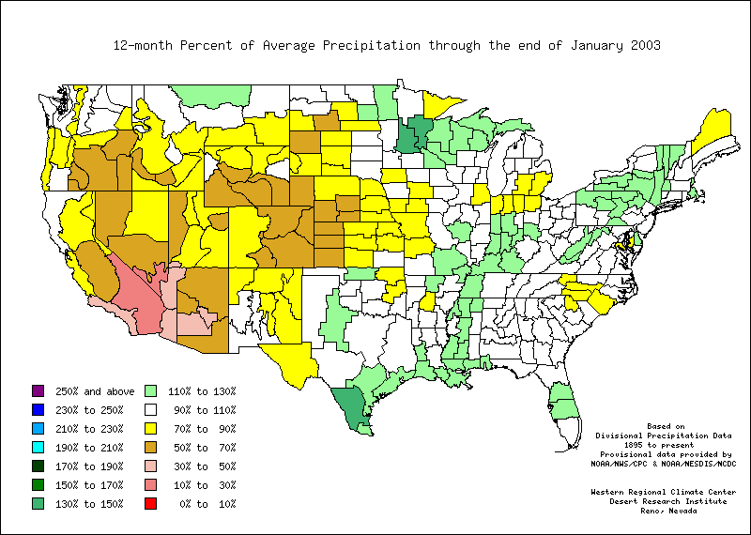
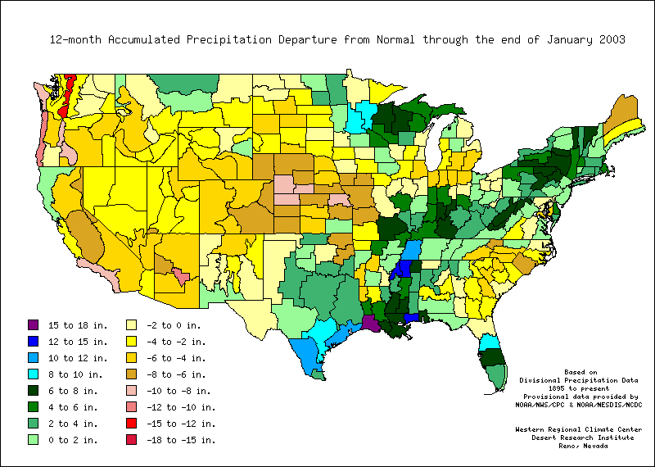
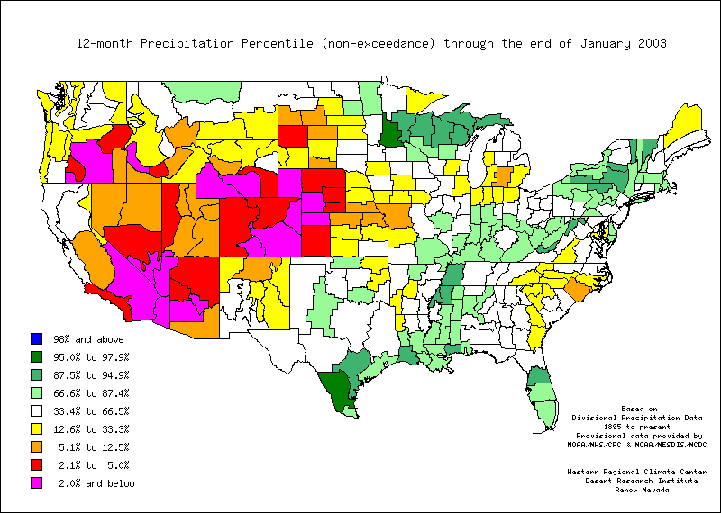
Climatological Reference
(12 Month Precipitation as example)
Current
Value
Percent
Of Normal
(Average)
Anomaly
or
Departure
From
Normal
Ranking
or
Percentile
All except “Current Value” require Climatology (Weather History)

Slide 3
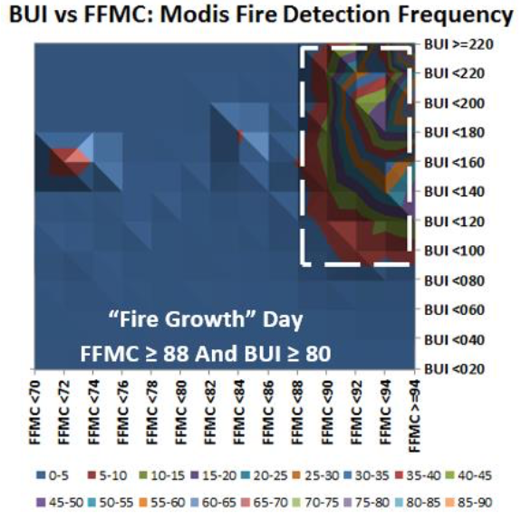
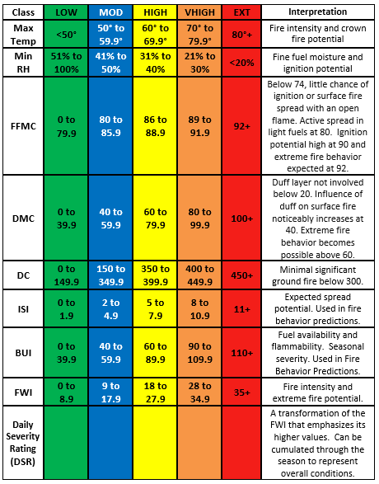
Current Value and Thresholds
A successful strategy for Alaska for many years

Slide 4
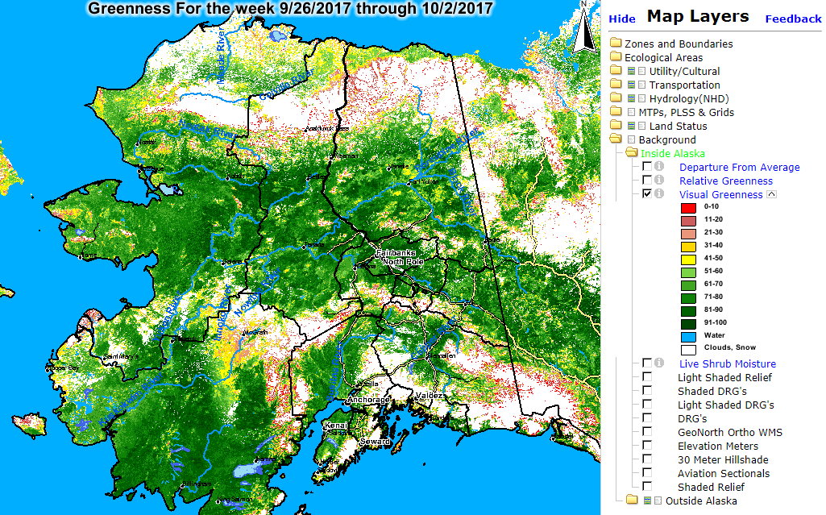
Visual Greenness
Percent of Maximum (emphasizes current value)

Slide 5
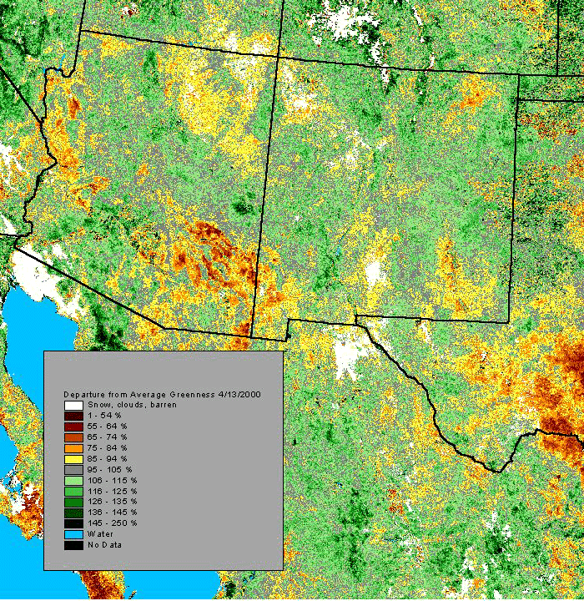
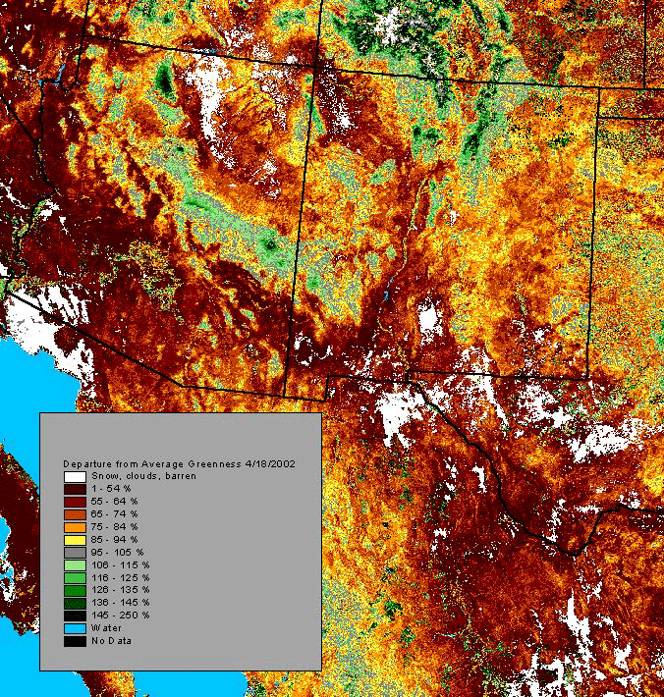
Departure from Average Greenness
2000 vs. 2002

Slide 6
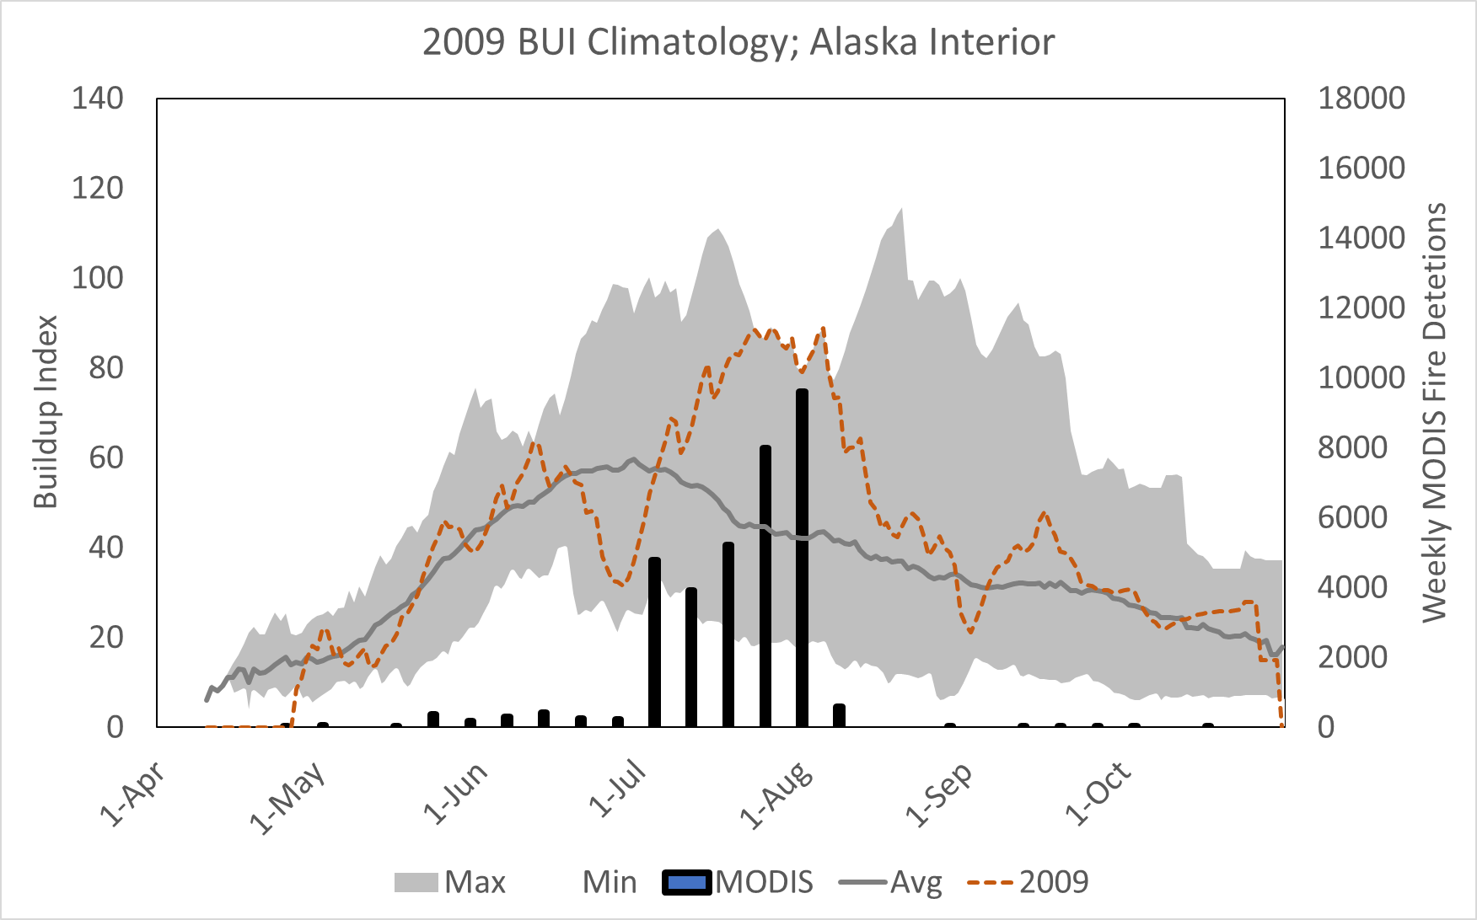
2009 Season Storyteller Graph
(Departure from Normal/Average)
Notes:
And finally, in 2015, the MODIS detects tell the story we still remember vividly…one of being completely overwhelmed over a 3-4 week period in late June and early July before the season began to moderate. BUI was setting new daily records during that period.
I hope I’ve explained why we feel the way we do about both the Fire Weather Index, or FWI, system and the NFDRS system, regardless of version. There is widespread trust in and support for continued use of the FWI system in Alaska and in the Lake States.

Slide 7
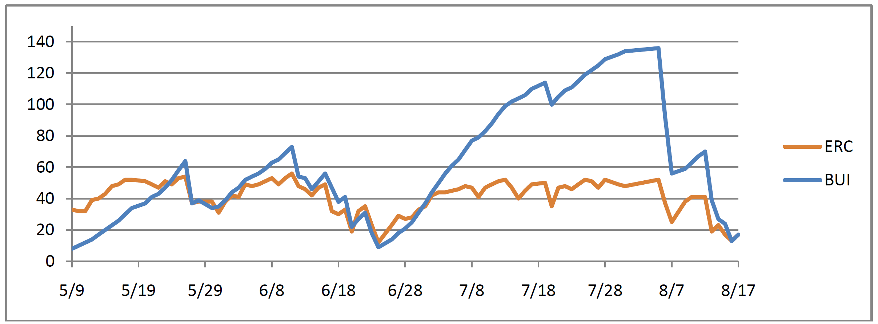
Eric Miller’s 2009 Analysis of ERCg & BUI for the Lake Minchumina RAWS & Titna River Fire
BUI shows the departure much better than ERCg
Titna River Fire started July 11th and burned 162,000 acres
Nearly all of 2009’s nearly 3 million acres burned in July
Notes:
In this example from 2009, fire managers and analysts were frustrated with the quality and utility of FSPro analyses, leading Eric Miller to write a paper comparing and contrasting ERC and BUI as possible cause for the frustration.
This graph from his paper shows that BUI for the local station, as expected, peaked during the period of active fire growth. At the same time, ERCg (1978 version) was flat through much of the active period, and actually somewhat lower than levels in the spring.

Slide 8
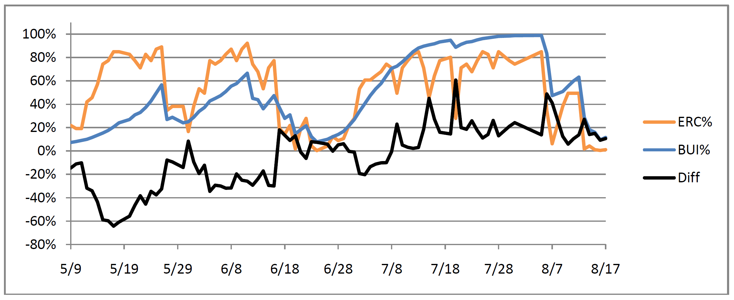
Eric Miller’s 2009 Analysis of ERCg & BUI
Using percentiles instead of values
Lake Minchumina RAWS, Climatology 1989-2008, 2009 Percentiles
During the Titna fire analysis period of July 19 to August 6, BUI averaged 95th percentile, ERCg averaged 71st percentile
Notes:
Knowing that many approaches are applying percentile climatologies to normalize indices and make them more comparable, Eric converted the 2009 trendlines for BUI and ERCg. Certainly it flattens and compresses the BUI trend.
The resulting percentiles showed that BUI still averaged values at the 95th percentile during the active fire period, while ERC values hovered at the 71st percentile. Not just a few false negatives, but a string of them when this fire was most active.
ERC levels that low were creating a drag on FSPro spread analyses.

Slide 9
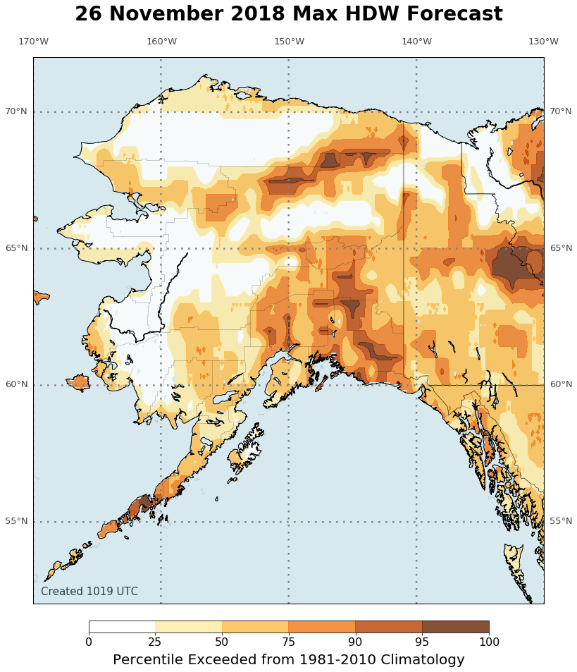
Percentiles, or Ranking
How does current value rank when compared to all values in the collected history of observations.
95th percentile means current value is greater than 95% of all observations in collected history

Slide 10
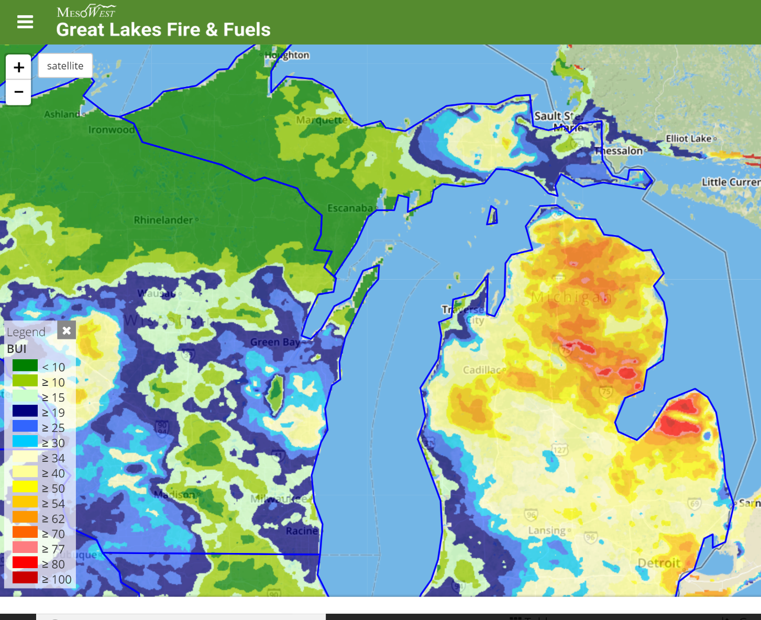
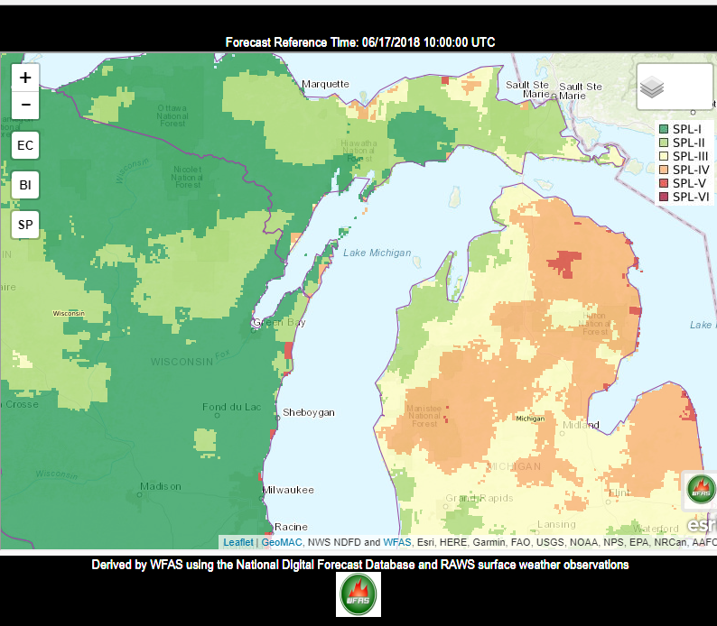
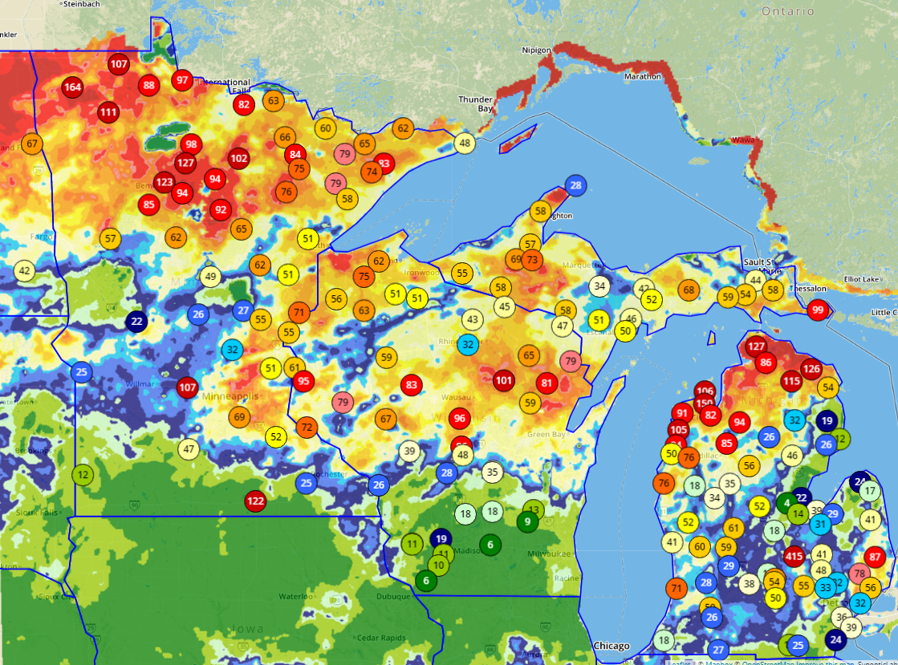
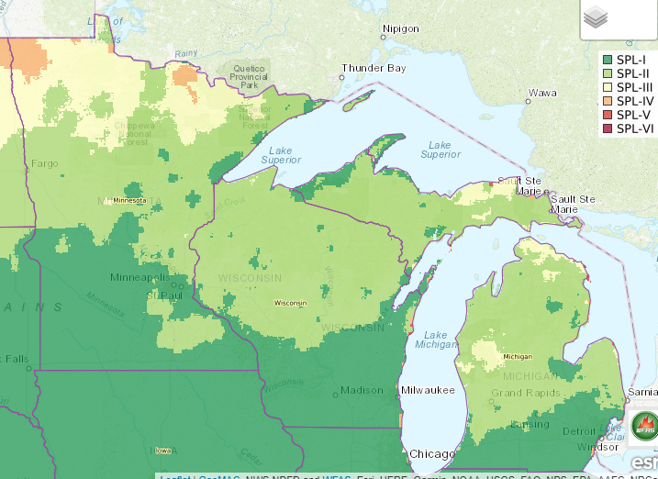
June 17, 2018
Great Lakes Fire & Fuels BUI current values versus
Wildland Fire Assessment System (WFAS) ERCg Ranking or Percentile
Aug 21, 2018
Notes:
This comparison of ERCg “Percentiles” (on the right) and BUI “current values” on the left, show the difference between thresholding fire business activity (BUI thresholded with historic fire activity) and basic climatology (ERCg percentile weather based on historic pattern of weather without fire business correlation)
Also embedded here is the effectiveness of the indices themselves.

Slide 11
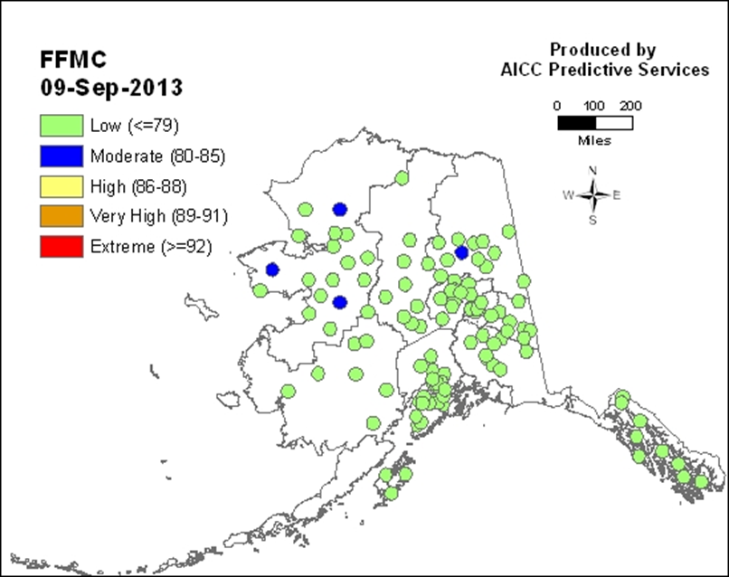
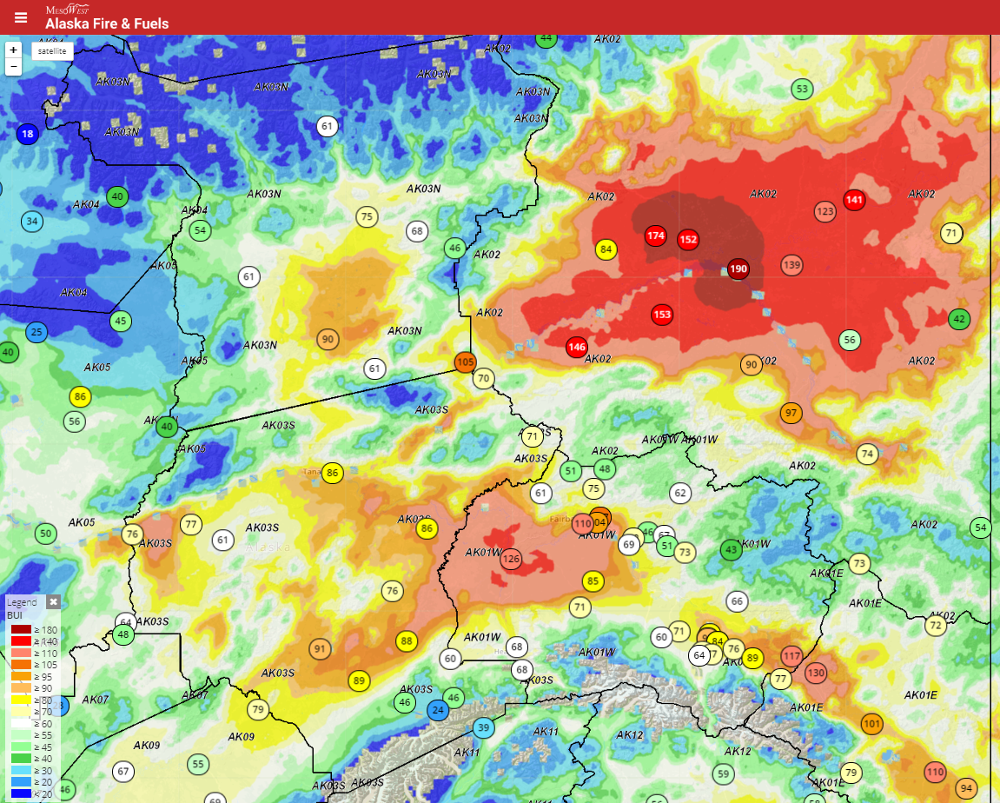
Surface Observations and Gridded (modeled) Weather
How can we take best advantage of the gridded data that we are provided

Slide 12
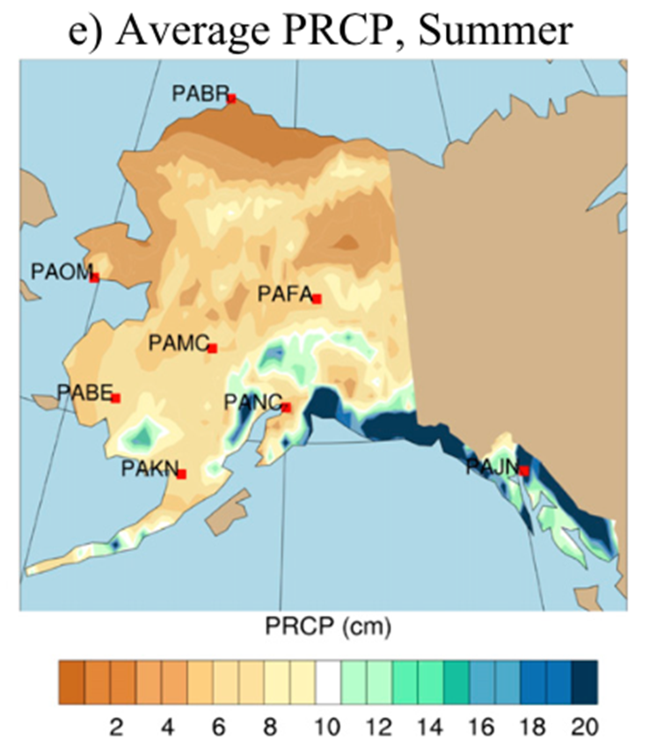
Reanalysis Climatology gridded weather history
Reanalysis Climatology uses forecast models and data assimilation systems to 'reanalyse' archived observations and create global data sets of history of the atmosphere, land surface, and oceans.
Reanalysis data are used for monitoring climate change, for research and education, and for commercial applications.
Often very little data assimilated from Alaska observations
Prism Data

Slide 13
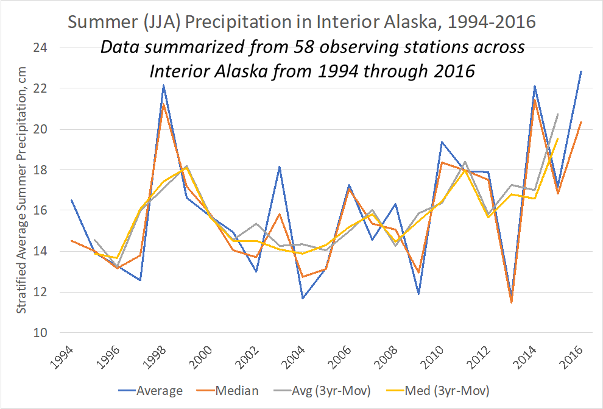
What happens when little data assimilated?
Prism data vs Surface Observation History

Slide 14
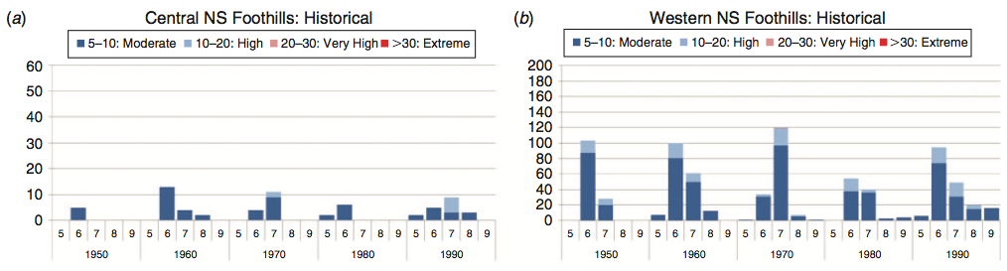
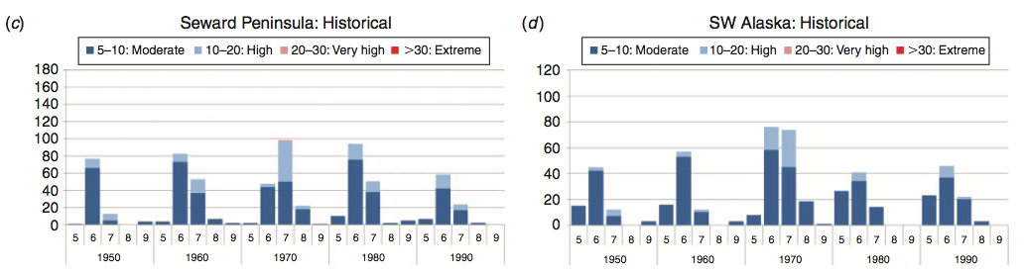
Fire in arctic tundra of Alaska: past fire activity, future fire potential, and significance for land management and ecology
Derived from CanESM2

Slide 15
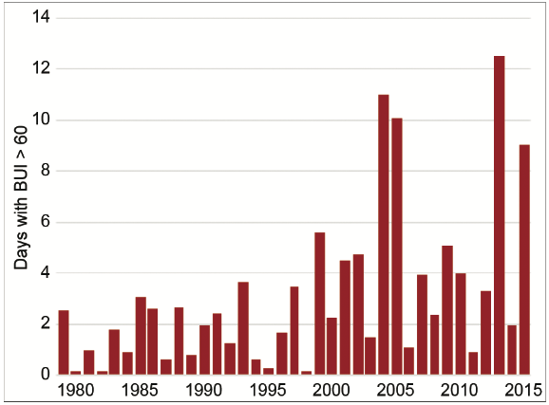
AN ASSESSMENT OF THE ROLE OF ANTHROPOGENIC CLIMATE CHANGE IN THE ALASKA FIRE SEASON OF 2015
Surface observations, below, show that 2004 was most significant season by far and shows less of an increasing trend.
Modeled from ERA downscaled Reanalysis
Modeled trend, above, exaggerates importance of later years, especially 2013 and 2015.
Notes:
Zeke and Heidi were part of a group that authored an article attempting to use reanalysis data to derive BUI as the indicator for climate change and its role in the large fire season in 2015.
The work used the BUI threshold of 60 to identify and compare the number of days producing significant fire potential each season. Its trend is shown in the graph in the upper right
Again, they knew from fire history and surface wx observations that the number of growth days was much higher than being estimated with this reanalysis climatology.
In fact, the overall trend seems to be significantly mismatched with climatological frequency from surface observations.

Slide 16
Average BUI for Interior Alaska
ERA-Interim Averages for BUI are based on 20km downscaled grid cells within boreal region
Observation Averages for BUI are based on surface estimates at weather station locations within boreal region
Almost a 50% difference
Notes:
With our stated confidence in BUI as a good indicator of seasonal fire potential, we began an effort to learn the issues with considering forecasting it over longer periods of weeks and months.
Initial attempts were to evaluate the capacity for downscaled ERA-Interim to represent seasonal trends over a historic period…with disappointing results when compared to our surface observation database. Even the seasonal averages showed significant differences in relative trends. With earlier peaks and faster seasonal declines.

Slide 17
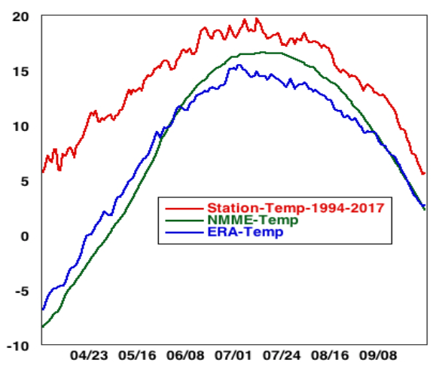
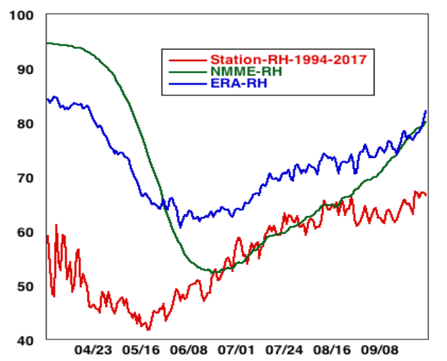
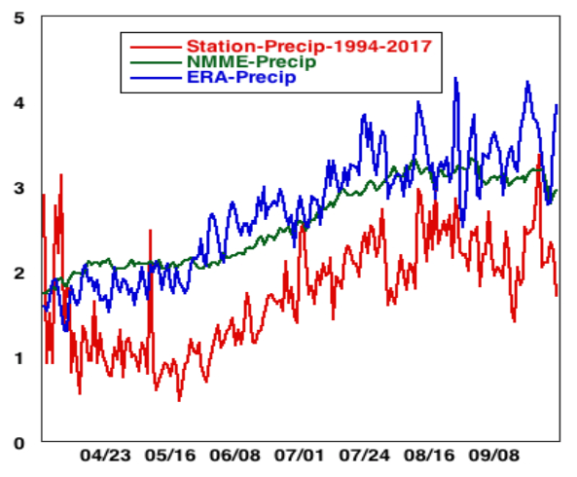
Unlike CONUS, very little observation data in AK models. No surface obs in precip model
Sources of error are in the underlying weather elements…
Temp, rh, precip
Notes:
This is because the models do a poor job of representing the underlying weather elements. Temp, RH, and Precip trends all underrepresent the drying effects of temp (too low), RH (too high) and overstate the wetting effect of Precip (too high) in these graphs.
We are working to correct this bias in local projects? Are national efforts doing that?

Slide 18
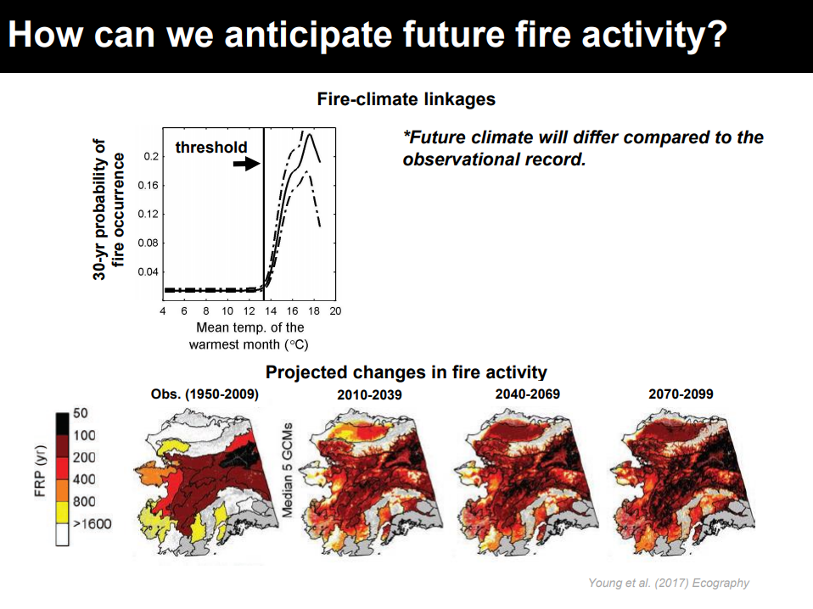
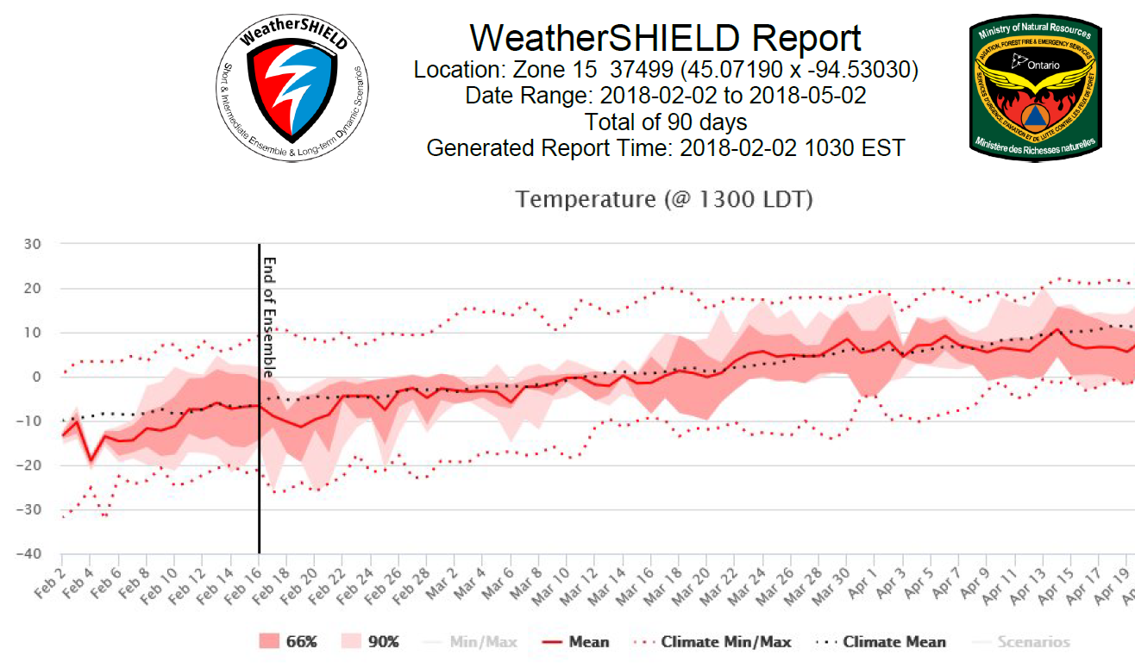
Why do we need Gridded Climatology?
Young, A.M., Higuera, P.E., Duffy, P.A. & Hu, F.S. (2016) Climatic thresholds shape northern high-latitude fire regimes and imply vulnerability to future climate change. Ecography, 39, 1-12.

Slide 19

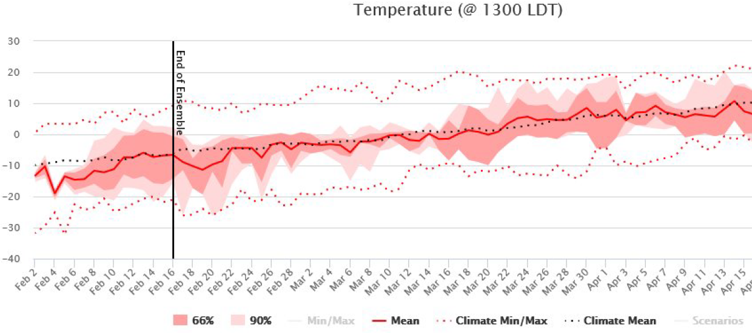
End of Deterministic

Slide 20
What is needed for Better Gridded (Reanalysis) Climatology?
Select the best reanalysis dataset for Alaska
Downscaling to better capture role of elevation and terrain in critical inputs
Bias reduction of critical inputs to insure better match between current and forecast outputs and the historical reference
Maintain system that keeps the downscaled and bias-reduced reanalysis up to date and accessible.

Slide 22
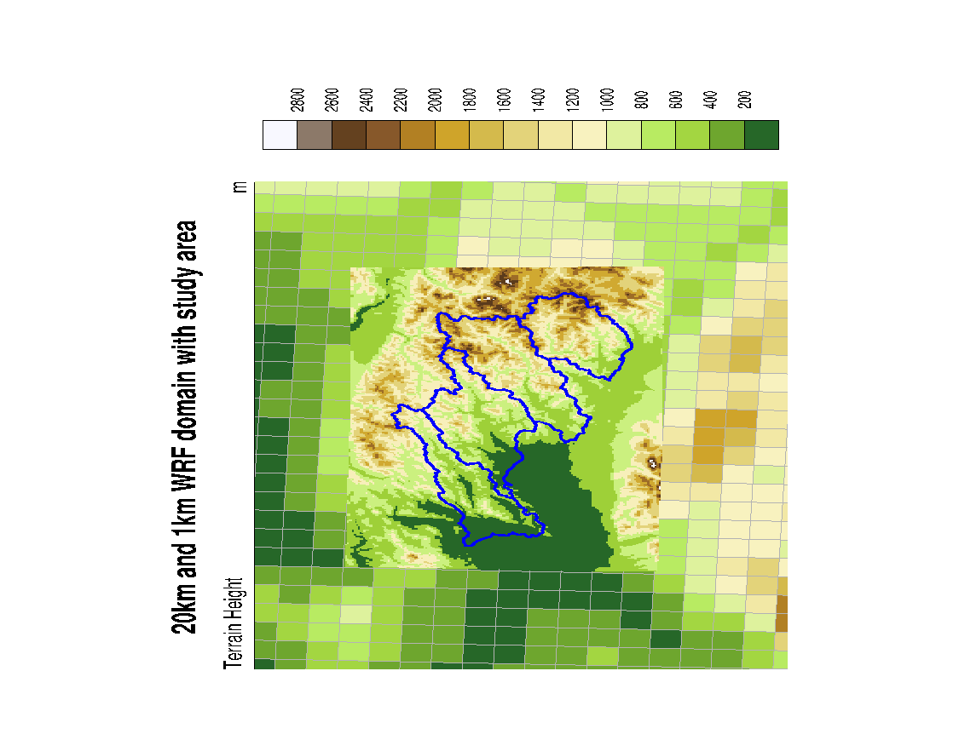
Downscaling

Slide 23
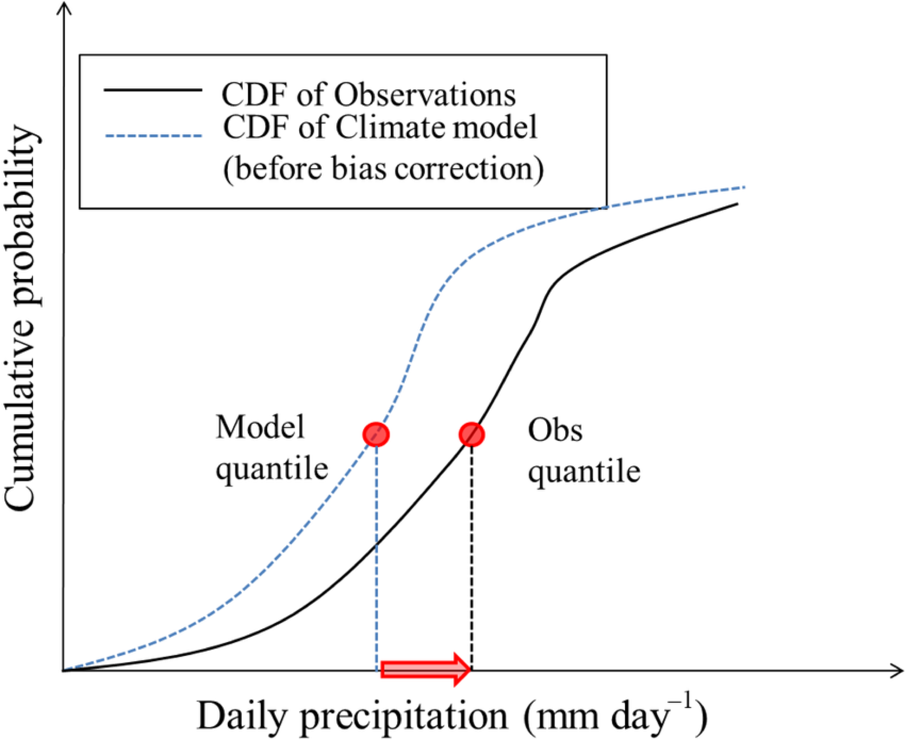
Bias Reduction is a key part of the task
Cumulative Distribution Function (CDF)
Tell you the likelihood of having a value less than a certain number.
—100%
Quantile mapping corrections
in progress using 1994-2010 period.
—50%
—25%
[Kwon et al. 2016]

Slide 24
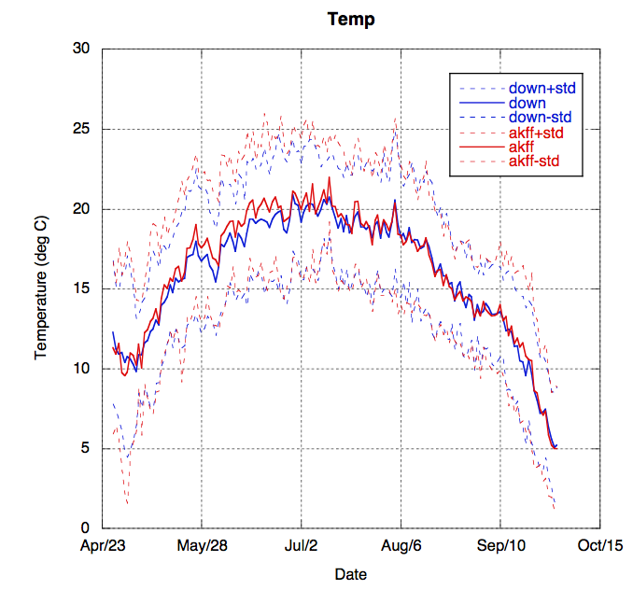
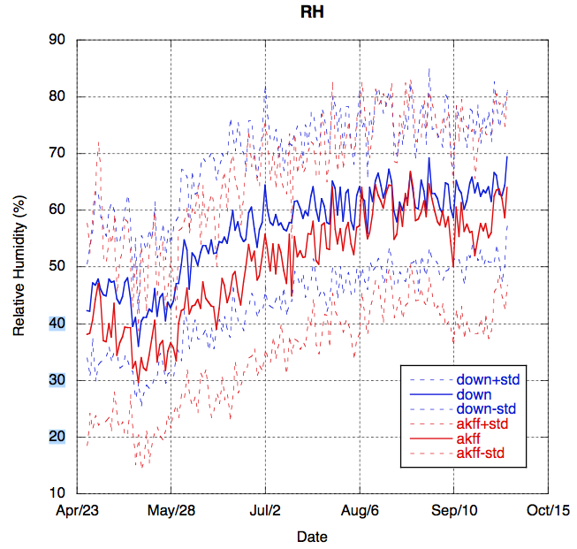
Fairbanks ASOS & Downscaled Reanalysis
RH Bias is more significant than Temp
Bias is most significant during
pre-green and peak seasons, May-July
Notes:
When we examined a specific location, the surface observations from the Fairbanks Airport and the corresponding reanalysis grid cell history, we found the explanation for the poor match between them.
There was significant bias in all for required elements.
Temperature and relative humidity are shown here, with the largest bias circled here. Notice that this is the period of peak potential for fire activity and growth.

Slide 25
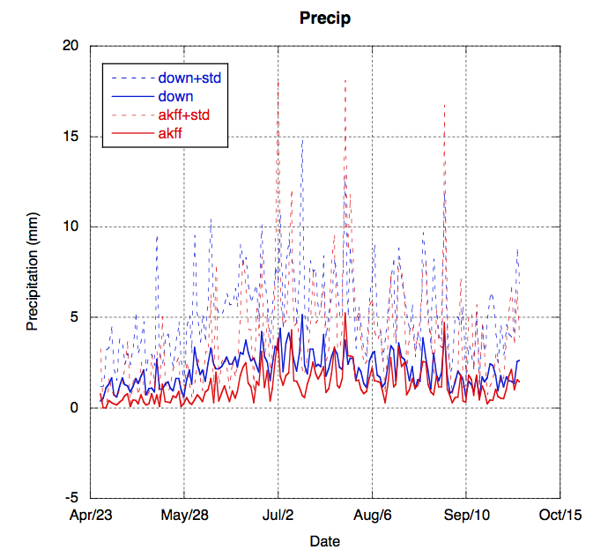
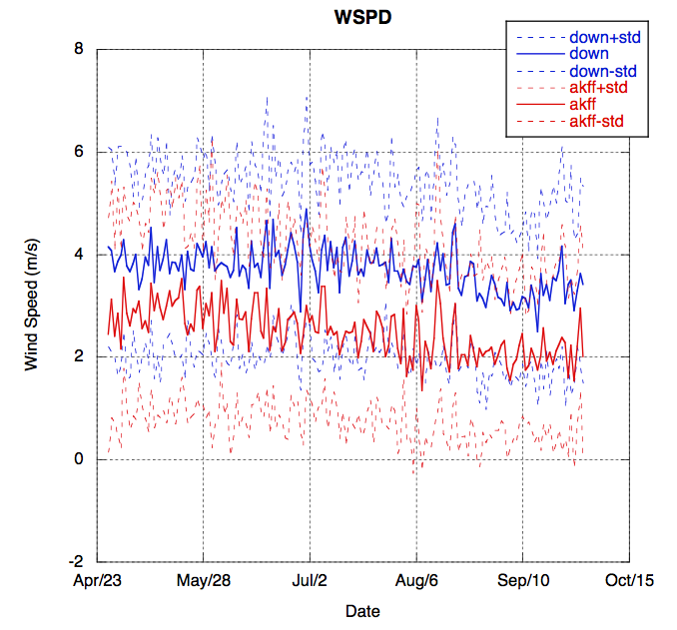
Fairbanks ASOS & Downscaled Reanalysis
Precipitation obs not assimilated in AK Reanalysis Climatologies
Precipitation bias is, again, most significant during peak season
Wind Bias throughout season for a variety of reasons
Notes:
Similarly, precipitation and windspeed bias were also significant. Precipitation again focused much of its bias during the peak season.

Slide 26
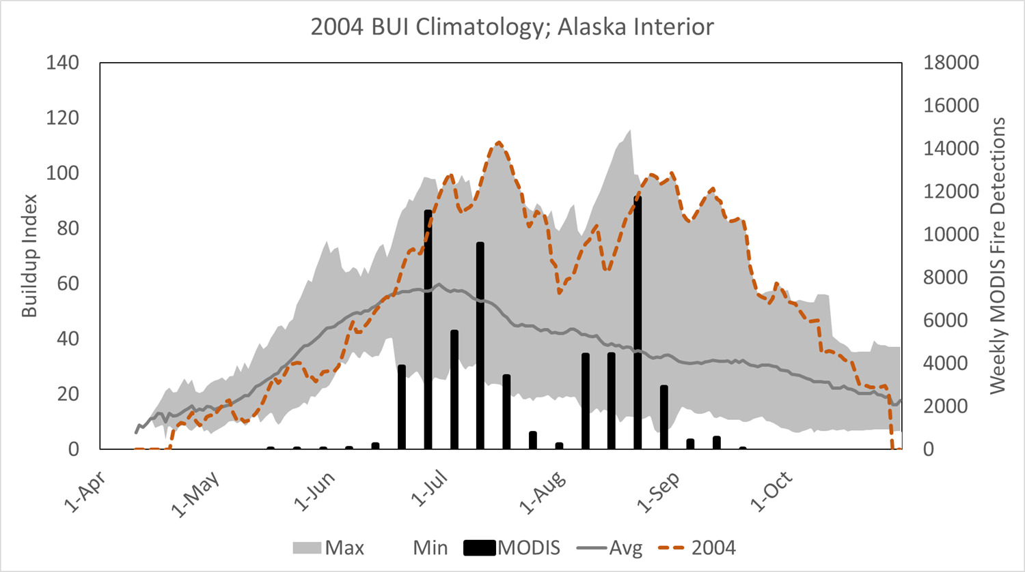
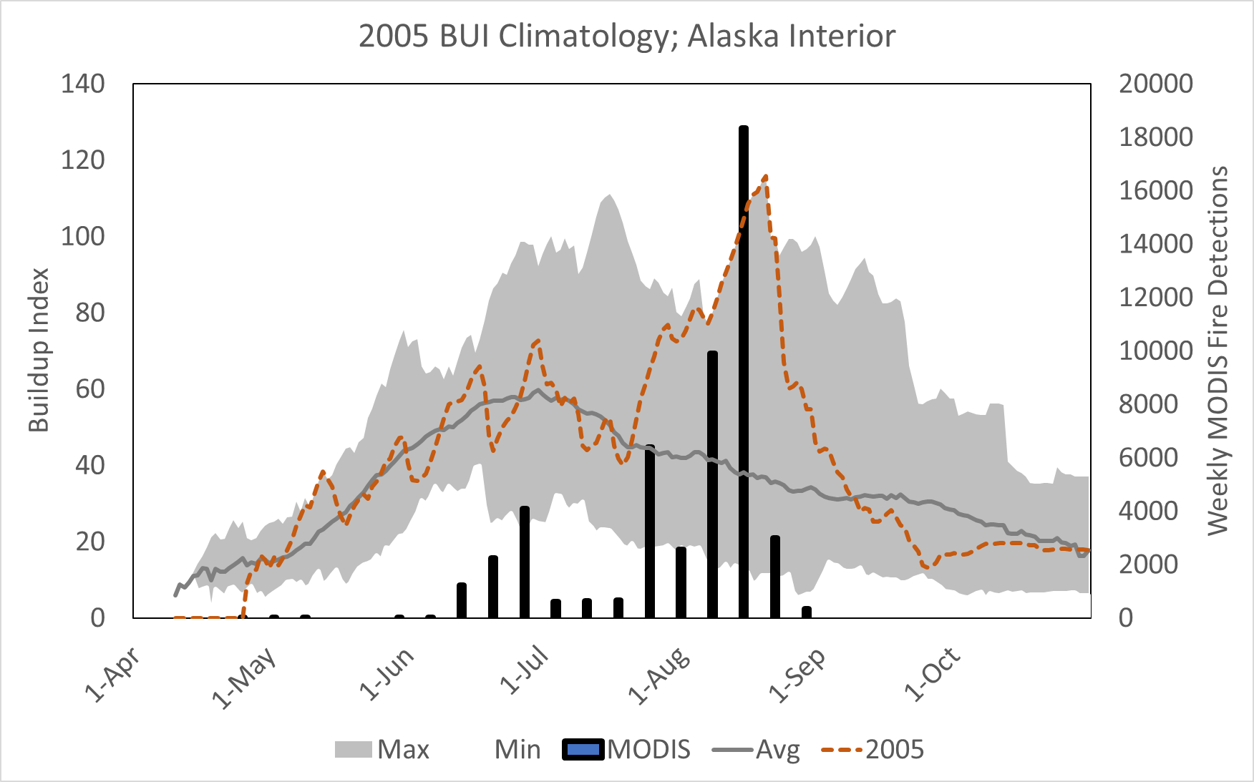
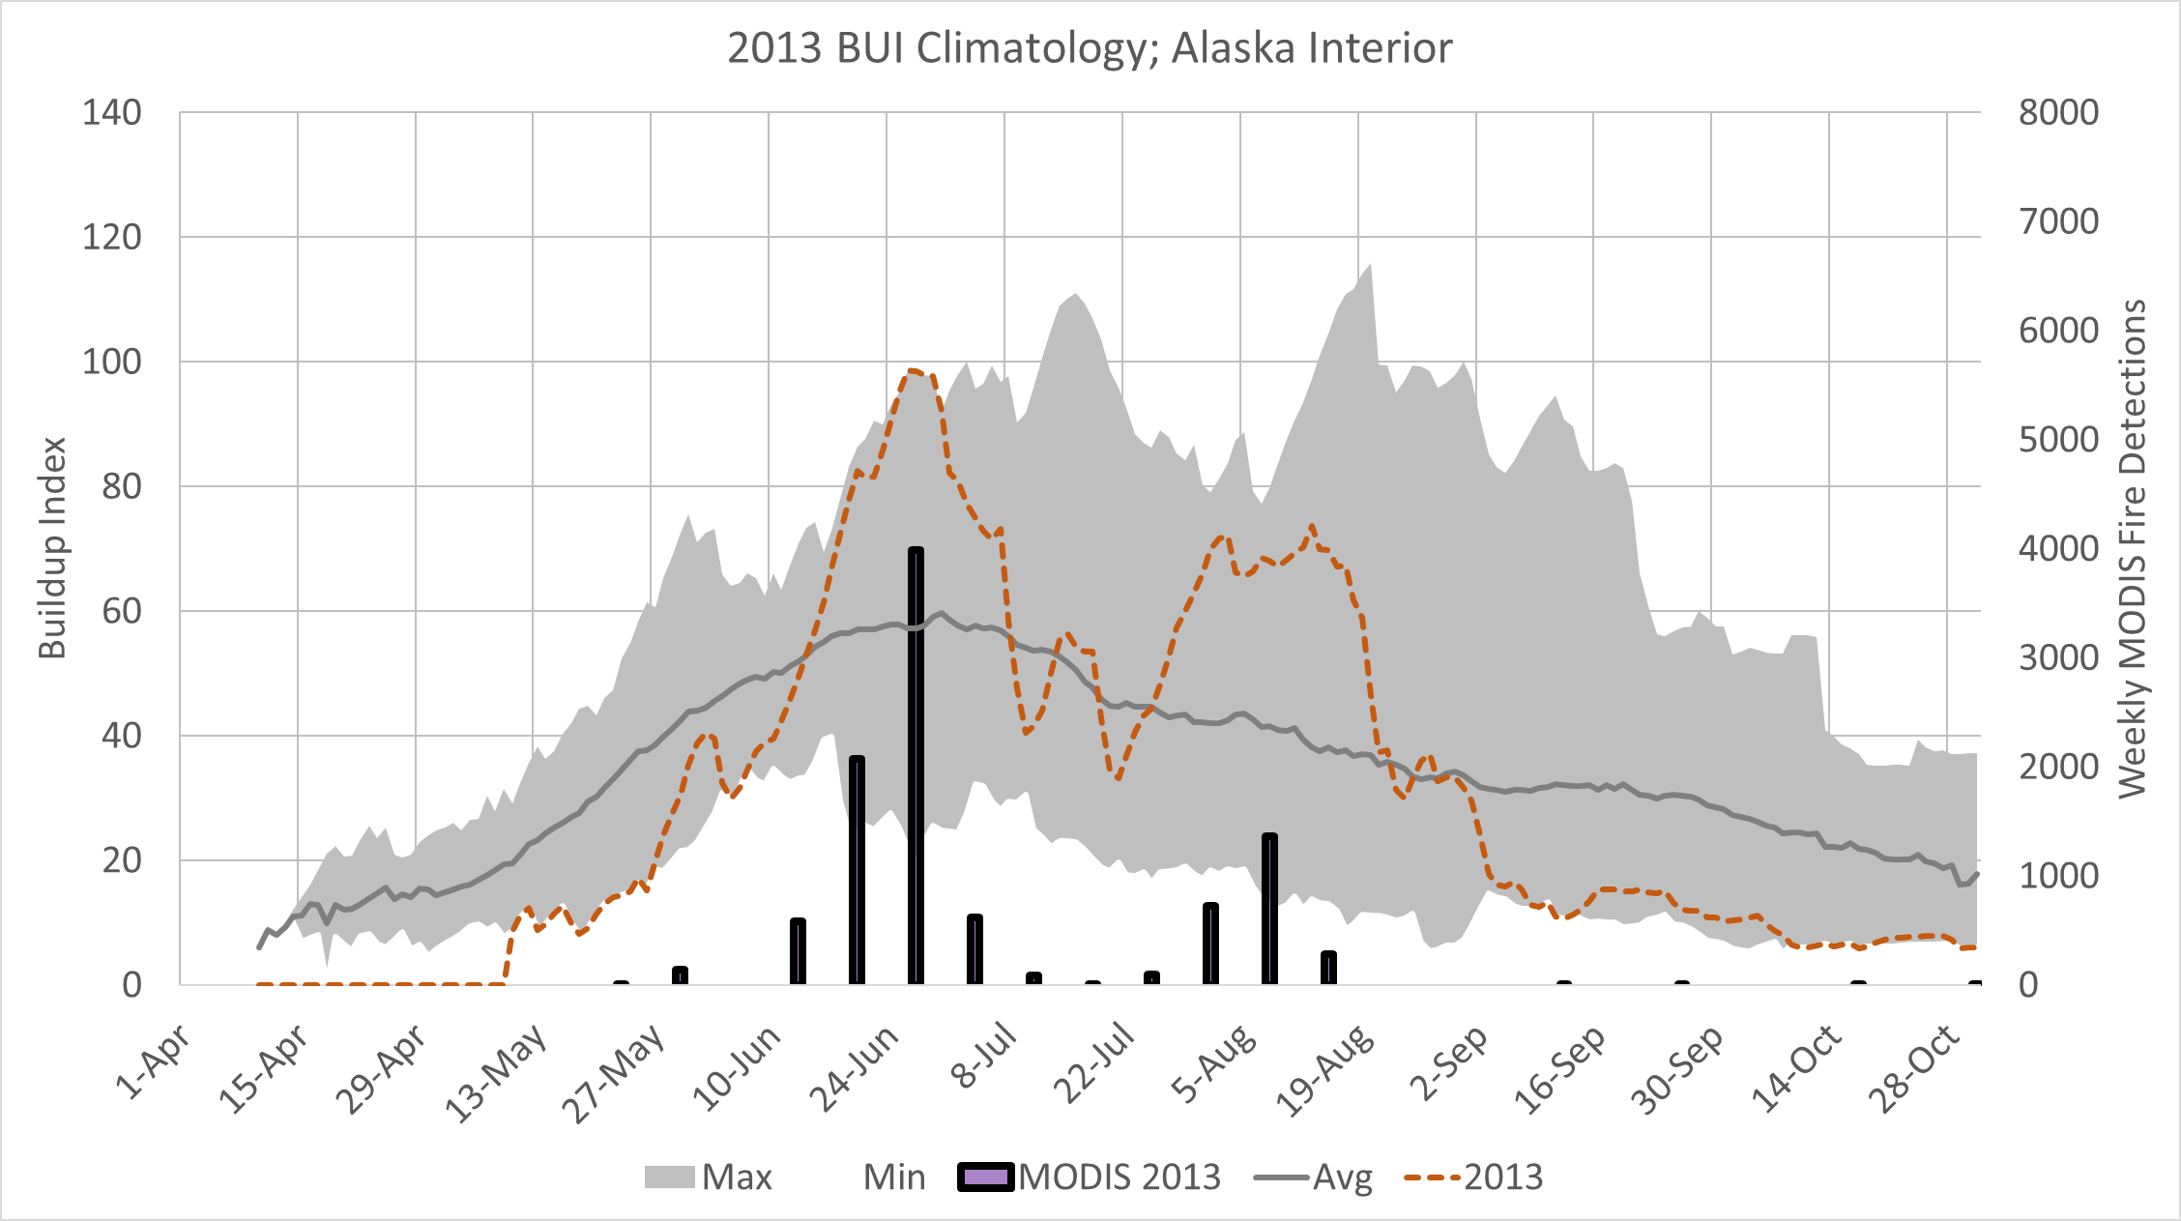
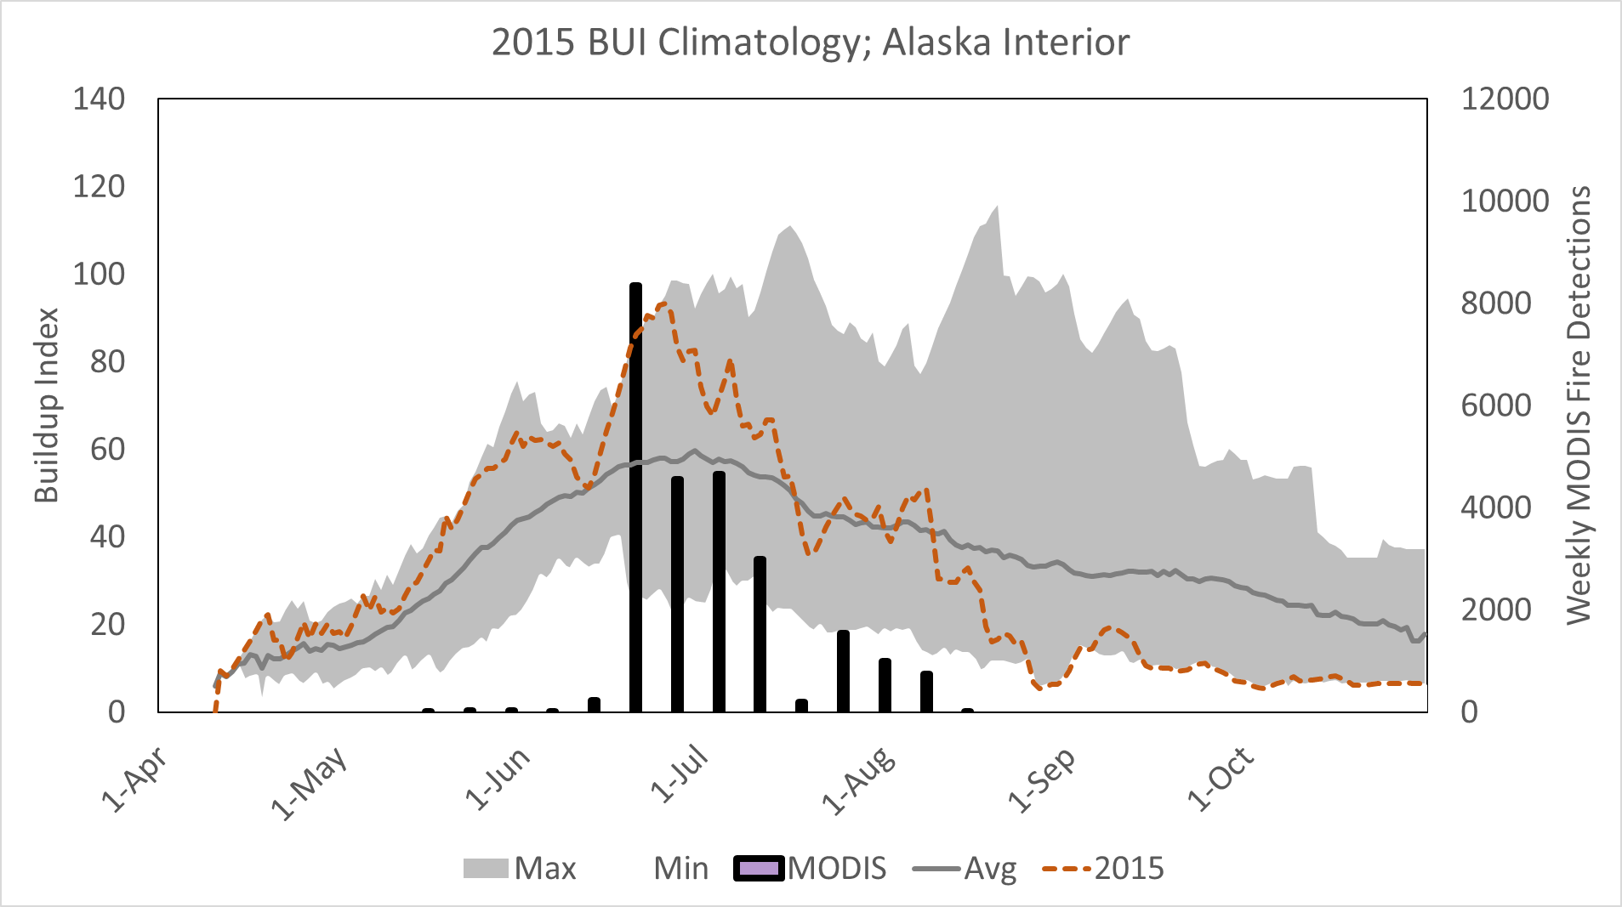
2004 versus 2005/2013/2015
BUI Trends Compared
Notes:
And finally, in 2015, the MODIS detects tell the story we still remember vividly…one of being completely overwhelmed over a 3-4 week period in late June and early July before the season began to moderate. BUI was setting new daily records during that period.
I hope I’ve explained why we feel the way we do about both the Fire Weather Index, or FWI, system and the NFDRS system, regardless of version. There is widespread trust in and support for continued use of the FWI system in Alaska and in the Lake States.

Slide 27
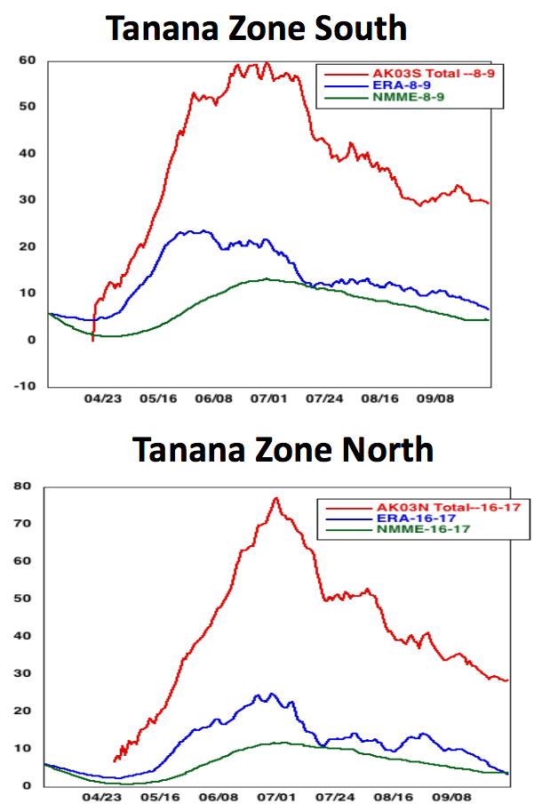
Comparison of AKFF Surface Observations, Reanalysis Data (ERA), & Forecast Model (CFSv2 from NMME)
Note that BUI estimates from the reanalysis (ERA) and Forecast (NMME) models fall well short of the observed BUI levels from the AKFF database. Even the trends have significant differences, peaking at different times
Notes:
We also explored the possibility that aggregating results to Predictive Service areas, including several surface observing locations and several grid cells for each.
In this graph of average BUI for two adjacent PSAs, not that both the ERA reanalysis and backcasted results from the CFSv2 produced disappointing results.

Slide 28
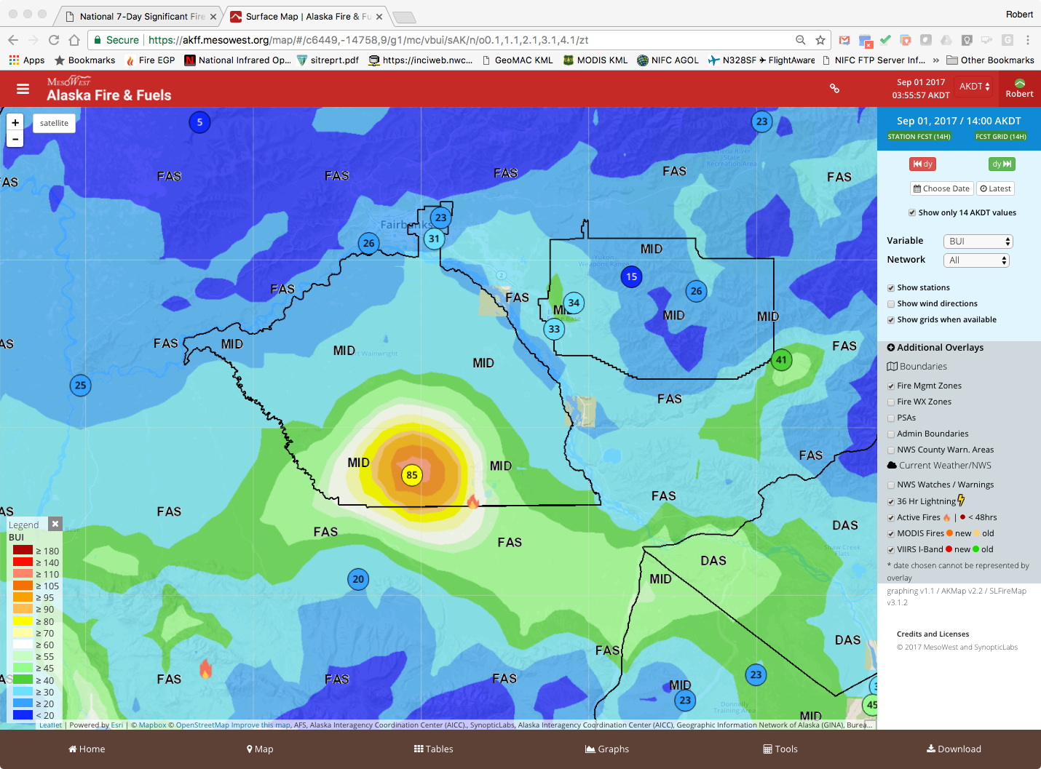
Understanding Impact of Bad Data
RTMA (used in AKFF) depends heavily on surface obs
Notes:
History isn’t very long

Slide 29
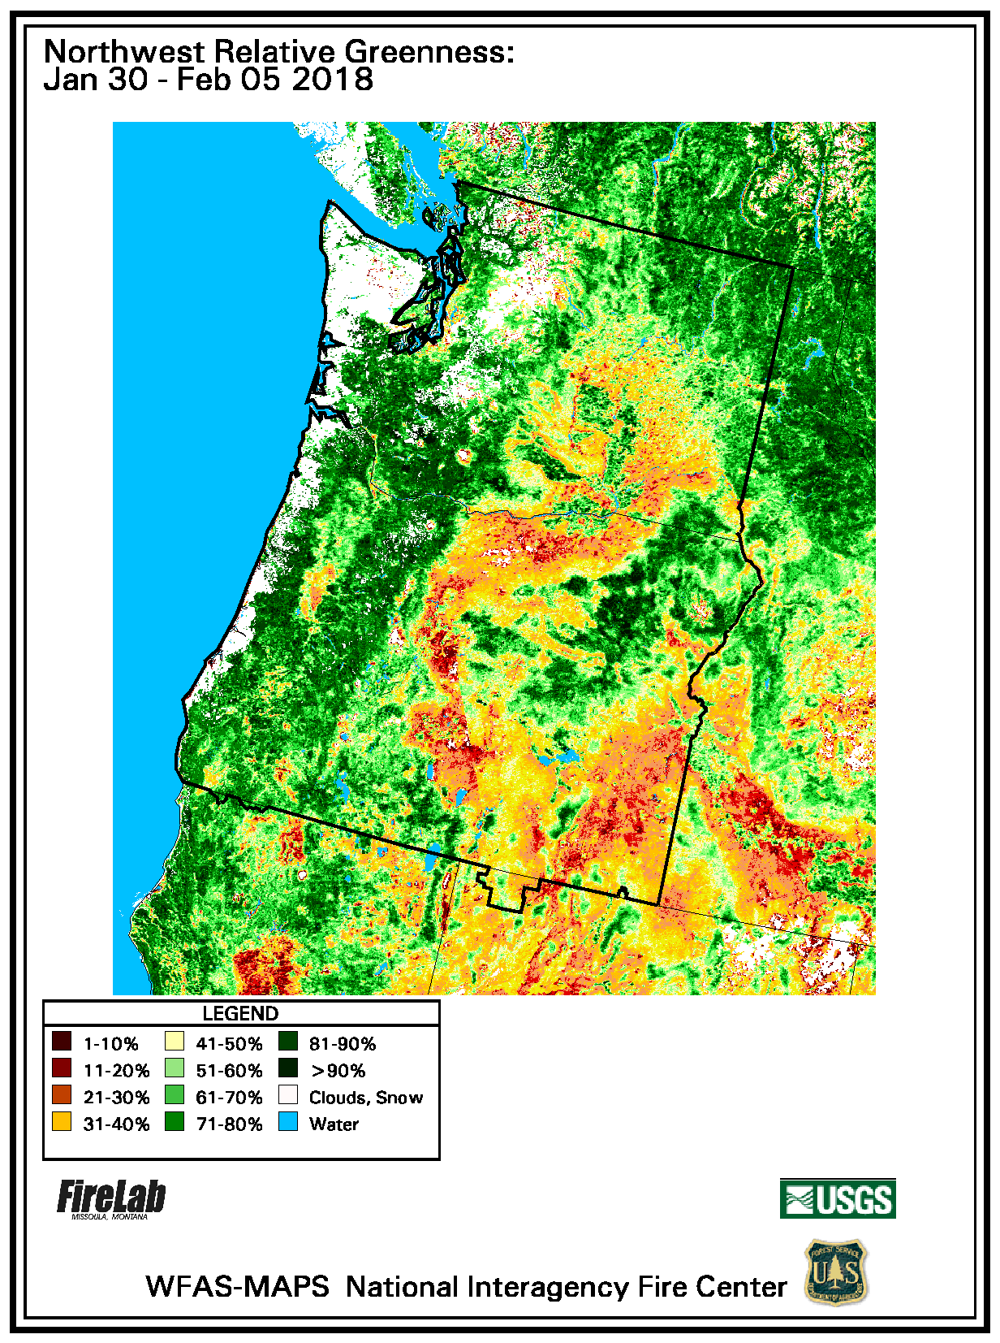
Remote Sensing Climatology
Example: Normalized Differential Vegetation Index (NDVI)
Products
NDVI (Current value): Observed vegetative condition (weekly)
Visual Greenness (Ranking): Related to overall maximum value (alfalfa field or golf course) – can see from the air
Relative Greenness (% of normal): Related to max value for that specific location
Departure from Average (Anomoly): Absolute difference current & historic normal greenness

